Slide 1

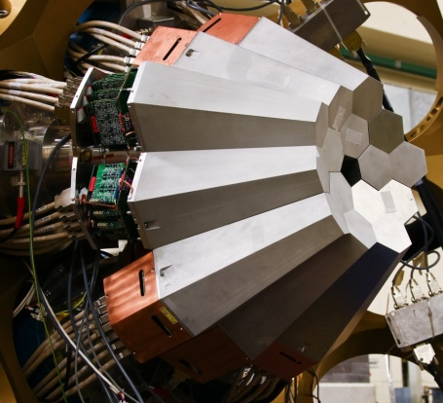
AGATA Collaboration Council Meeting

Slide 2
AGATA ACC Agenda
27th June 2013, Liverpool
Minutes of the last meeting from Orsay 2012
Outstanding actions
Membership, ACC updates
Data policy
Publication procedure
Publications
Report from AMB
Report from ASC
Web page
The open meeting and EGAN workshop
Next annual meeting
Any Other Business
Notes:
Huge collaboration
Over 40 laboratories in 10 countries
Others joining, Turkey, Hungary

Slide 3
AGATA ACC Agenda
27th June 2013, Liverpool
Minutes of the last meeting from Orsay 2012
Outstanding actions
Ongoing action on ALL: Keep the information on the ACC web page up to date. Supply information on such things as technical publications, student PhD thesis and AGATA presentations to JS.
Ongoing action on ALL: Content in the form of overview presentations has been made available, please add your talks where appropriate. The aim is to provide generic talks with slides for those who need slides for AGATA presentations. JS Bormio presentation has been added to the ACC webpage.
Ongoing action on NIM paper authors: reminder to reference the AGATA technical NIM paper.
Akkoyun et al., Nuclear Instruments and Methods in Physics Research A 668 (2012) 26–58
Action John Simpson: Hungary needs a representative B. Nyako be contacted. Done
There will be a call for letters of intent to host AGATA post the current agreement with GANIL. Exact dates at GANIL have not been formally agreed by the ASC. Likely early 2016 call for future locations in Europe. ACTION John Simpson to discuss with Bo Cederwall Status
John Simpson to inform ASC chair Bo Cederwall of the outcome of the vote. ASC will make the appointment then it will be announced. ACTION John Simpson Done Silvia Lanzi
The procedure of implementing this policy is to be defined.
Core author list now needs circulation; John will circulate for the ACC.
ACTION John Simpson done
Ongoing on all to keep web pages up to date
Notes:
Huge collaboration
Over 40 laboratories in 10 countries
Others joining, Turkey, Hungary

Slide 4
AGATA ACC
Terms of Reference:
The ACC is the advisory body of the ASC on scientific matters concerning the AGATA project.
The tasks of the ACC are as follows:
elects the AGATA spokesperson who will serve for a period of two years.
advises the ASC on scientific matters concerning the AGATA project and the research programme through the AGATA Spokesperson.
nominates the Campaign Spokesperson for each experiment campaign to the ASC.
hold meetings, at least annually, to receive reports from the ASC and AMB on the progress of the project and from the Campaign Spokespersons on the progress of the research programme.
hold an annual open meeting of the AGATA Collaboration to present the status of the Project and to discuss future experiment campaigns.
Administer the data policy
Administer the scientific publications policy
Maintain web pages
Notes:
Huge collaboration
Over 40 laboratories in 10 countries
Others joining, Turkey, Hungary

Slide 5
AGATA ACC
Membership
Bulgaria:
Univ. Sofia Georgi Rainovski rig@phys.uni-sofia.bg
INRNE Sofia Pavel Petkov petkov@inrne.bas.bg
Finland:
Univ. Jyväskylä Rauno Julin rauno.julin@phys.jyu.fi
France:
GANIL Caen Emmanuel Clement clement@ganil.fr
LPSC –IN2P3 Grenoble Gary Simpson gary.simpson@lpsc.in2p3.fr
IPN–IN2P3 Lyon Olivier Stezowski stezow@IPNL.IN2P3.FR
CSNSM–IN2P3 Orsay Joa Ljungvall ljungvall@csnsm.in2p3.fr
IPN–IN2P3 Orsay Francois Le Blanc leblanc@ipno.in2p3.fr
CEA/DSM/IRFU Saclay Wolfram Korten wolfram.korten@cea.fr
IPHC –IN2P3 Strasbourg Dominique Curien curien@ires.in2p3.fr
Germany:
GSI Darmstadt Juergen Gerl j.gerl@gsi.de
TU Darmstadt Norbert Pietralla pietralla@ikp.tu-darmstadt.de,
Univ. zu Köln Peter Reiter preiter@ikp.Uni-Koeln.DE
TU München Roman Gernhaeuser roman.gernhaeuser@ph.tum.de
Hungary:
ATOMKI Barna Nyako nyako@atomki.hu
Italy:
INFN Firenze Adriana Nannini Adriana.Nannini@fi.infn.it
INFN Legnaro Daniel Napoli Daniel.R.Napoli@lnl.infn.it
INFN Milano Benedicte Million Benedicte.Million@mi.infn.it
INFN Padova Silvia Lenzi silvia.lenzi@pd.infn.it
Poland:
IFJ PAN Krakow Adam Maj Adam.Maj@ifj.edu.pl
University of Warsaw (HIL) Krzysztof Rusek Krzysztof.Rusek@fuw.edu.pl
Notes:
Huge collaboration
Over 40 laboratories in 10 countries
Others joining, Turkey, Hungary

Slide 6
AGATA ACC
Membership
Romania:
IFIN/HH Bucharest Victor Zamfir zamfir@tandem.nipne.ro
Spain:
IFIC, CSIC-University of Valencia Andres Gadea gadea@ific.uv.es
Electronic Engineering Department University of Valencia (UVEG) Vicente González vicente.gonzalez@uv.es
IEM, CSIC, Madrid Andrea Jungclaus andrea.jungclaus@csic.es
Department of Fundamental Physics, University of Salamanca Begoña Quintana quintana@usal.es
Sweden:
Chalmers Univ. of Technology Göteborg Andreas Heinz andreas.heinz@chalmers.se
Lund Univ. Dirk Rudolph Dirk.Rudolph@nuclear.lu.se
Royal Institute of Technology Stockholm Bo Cederwall cederwall@nuclear.kth.se
Uppsala Univ. Johan Nyberg johan.nyberg@physics.uu.se
Turkey:
Univ. Ankara Ayse Kaskas aysekaskas@yahoo.com
Univ. Istanbul Ela Ganioglu ganioglu@istanbul.edu.tr
Technical Univ. Istanbul Cenap Ozben ozben@itu.edu.tr
UK:
Univ. Brighton Alison Bruce Alison.Bruce@brighton.ac.uk
Daresbury Laboratory John Simpson john.simpson@stfc.ac.uk
Univ. Edinburgh Phil Woods pjw@ph.ed.ac.uk
Univ. Liverpool Andrew Boston A.J.Boston@liverpool.ac.uk
Univ. Manchester Dave Cullen Dave.cullen@manchester.ac.uk
Univ. Surrey Phil Walker P.Walker@surrey.ac.uk
Univ. West of Scotland John Smith John.F.Smith@uws.ac.uk
Univ. York Mike Bentley mab503@york.ac.uk
Notes:
Huge collaboration
Over 40 laboratories in 10 countries
Others joining, Turkey, Hungary

Slide 7
AGATA ACC Data Policy
Definition – Output of the AGATA system
Primary contact for each experiment has to be defined
Ownership AGATA
Spokesperson of AGATA delegates ownership and access to primary contact
Done for Legnaro so far period of two years, needs updating
GSI to do
http://npg.dl.ac.uk/agata_acc/AGATA_Data_Policy.html
Exploitation
Annual report to ACC of status of experiment (report at annual meeting)
Publication information to the ACC
Brief report on experiments, send in or keep up to date.
http://npg.dl.ac.uk/agata_acc/AGATA_Data_Policy.html
Notes:
Huge collaboration
Over 40 laboratories in 10 countries
Others joining, Turkey, Hungary

Slide 8
AGATA ACC
AGATA Publication and Publications Policy
Policy defined for Physics and technical publications
Maintain list on AGAA ACC web pages
What else, thesis, reports, talks …..
Technical publications, AMB approval
Publications Policy:
ASC
Core authors for physics papers from Legnaro (156)
List defined
Sign up required
Administration ASC asked ACC
Web based system.
Notes:
Huge collaboration
Over 40 laboratories in 10 countries
Others joining, Turkey, Hungary

Slide 9
AGATA ACC
AGATA Publication and Publications Policy Web based system
Created and maintained by Johan Nyberg
https://www.agata.org/physics_publications/
Instructions
Submit paper to Johan Nyberg (copy John Simpson)
Set a deadline for core authors to reply (2 weeks)
List of core authors available after deadline
System works, not totally automatic yet
Notes:
Huge collaboration
Over 40 laboratories in 10 countries
Others joining, Turkey, Hungary

Slide 10
AGATA ACC
AGATA Publications status
Technical Publications (63)
Scientific publications
High-Spin Structure in 40K P.-A. Soderstrom et al., Physical Review C 86, 054320 (2012)
Collective nature of low-lying excitations in ^{70,72,74}Zn from lifetime measurements using the AGATA Demonstrator C. Louchart et al., Physical Review C 87, 054302 (2013)
Global properties of K-hindrance probed by the gamma-decay of the warm rotating 174W nucleus V.Vandone et al., Physics Letters B in press
Towards the determination of superdeformation in 42Ca
K. Hadyńska-Klęk et al., Acta Physica Polonica B44(2013)617-625,
Refinement of the 42Ca level scheme. Preliminary results from the first AGATA Demonstrator experiment
K. Hadyńska-Klęk, Acta Physica Polonica B42(2011)817,
Study of High-lying States in 208Pb with the AGATA Demonstrator
R. Nicolini, Acta Physica Polonica B Vol. 42, No. 3–4, 2011, p653
Cross-coincidences in the 136Xe+208Pb Deep-inelastic Reaction
R.S. Kempley, Acta Physica Polonica B
Vol. 42, No. 3–4, 2011, page 717
Study of the Order-to-Chaos transition in W-174 with the AGATA-Demonstrator
V Vandone, XIX INTERNATIONAL SCHOOL ON NUCLEAR PHYSICS, NEUTRON PHYSICS
AND APPLICATIONS (VARNA 2011) IOP Journal of Physics Conference Series
Volume: 366 Article Number: 012045
Notes:
Huge collaboration
Over 40 laboratories in 10 countries
Others joining, Turkey, Hungary

Slide 11
AGATA ACC
Report from the AMB
Andy Boston
Notes:
Huge collaboration
Over 40 laboratories in 10 countries
Others joining, Turkey, Hungary

Slide 12
AGATA ACC
Report from ASC
Last meeting March 2013 Milan
Discussed:
Project status, detectors, elec…..27 max at GSI
34-35 at GANIL (8 trip, 5 doubles)
Common fund, ENSAR, Country funding status
Funding shortfall, operation costs
AGATA/NUSTAR/DEGAS
ACC
GSI status, actions, letters
GANIL extension 2016 accepted
Next location of AGATA 2017.... Worldball
Bo Cederwall to stay as chair for extra 6 months
(Italy, France….)
ENSAR2 (JRA’s, TNR)..
1-2 October 2013
Notes:
Huge collaboration
Over 40 laboratories in 10 countries
Others joining, Turkey, Hungary

Slide 13
Where we are now: AGATA-PreSPEC @ GSI
Successful completion of LNL “Demonstrator” campaign
Transfer and installation at GSI spring 2012
Commissioning at GSI
First part of AGATA-PreSPEC campaign successfully completed in
autumn – winter 2012.
- 8 (out of 11) proposals approved by GSI PAC
- 5 (7) weeks of beam time used
accepted 46 days 23 days to run
AGATA-PreSPEC workshop, Darmstadt Dec 10-11, 2012
- 18 LOIs submitted for Autumn 2013 campaign
GSI Campaign ends (according to current agreement) Dec 2013,
followed by transfer to GANIL
Discussion!

Slide 14
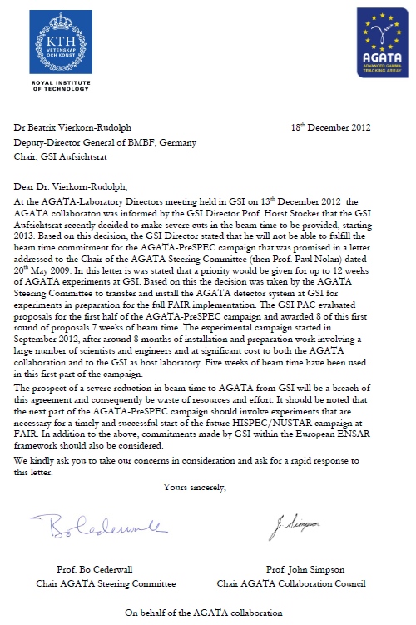

Slide 15
GANIL campaign
GANIL Local AGATA Project Manager: Emmanuel Clément
GANIL Physics campaign Spokesperson elected by ACC: Silvia Lenzi
LOIs submitted and prepared towards proposals
Campaign starts early 2014 according to current agreement
Final dates for transfer to GANIL and start installation tbd
GANIL has requested AGATA throughout 2016 Approved
Given the unprecedented developments of Large Scale Nuclear Physics accelerator facilities in Europe a very exciting future with AGATA lies ahead
The next step is AGATA@GANIL starting in 2014!

Slide 16
Where we are now: AGATA-PreSPEC @ GSI
Status
Unclear
1st PAC backlog of ~3 weeks
GSI offered 3 week plus 21 nights, ASC noted
When? Early 2014?
Which experiments to run? Backlog or new proposal?
New PAC? (ah-hoc)
When to move to GANIL, status
AMB invested other sites, no sensible location

Slide 17
Status and perspectives
1.-12. 2013 GSI shutdown
3.-5. 2014 Physics runs II (3 weeks + 21 nights)??
Latest news:
Three months beam time for experiments in 2014 accepted by BMBF!!!
Modalities for distribution are again under discussion. Probably a committee of representatives of the former G-PAC, FAIR reseach collaborations, FAIR accelerator division and GSI management will propose a schedule to be endorsed by GSI upper management.
GSI In-House group + ASC + PSC + NUSTAR-BR fight to get the second part of our campain scheduled!!!

Slide 18
Beyond the GANIL campaign
Where and When?
Open Call for Laboratory Expressions of Interest for the next campaigns
Expect bids from main European laboratories
Physics Community (ACC and other collaborations) will be involved

Slide 19
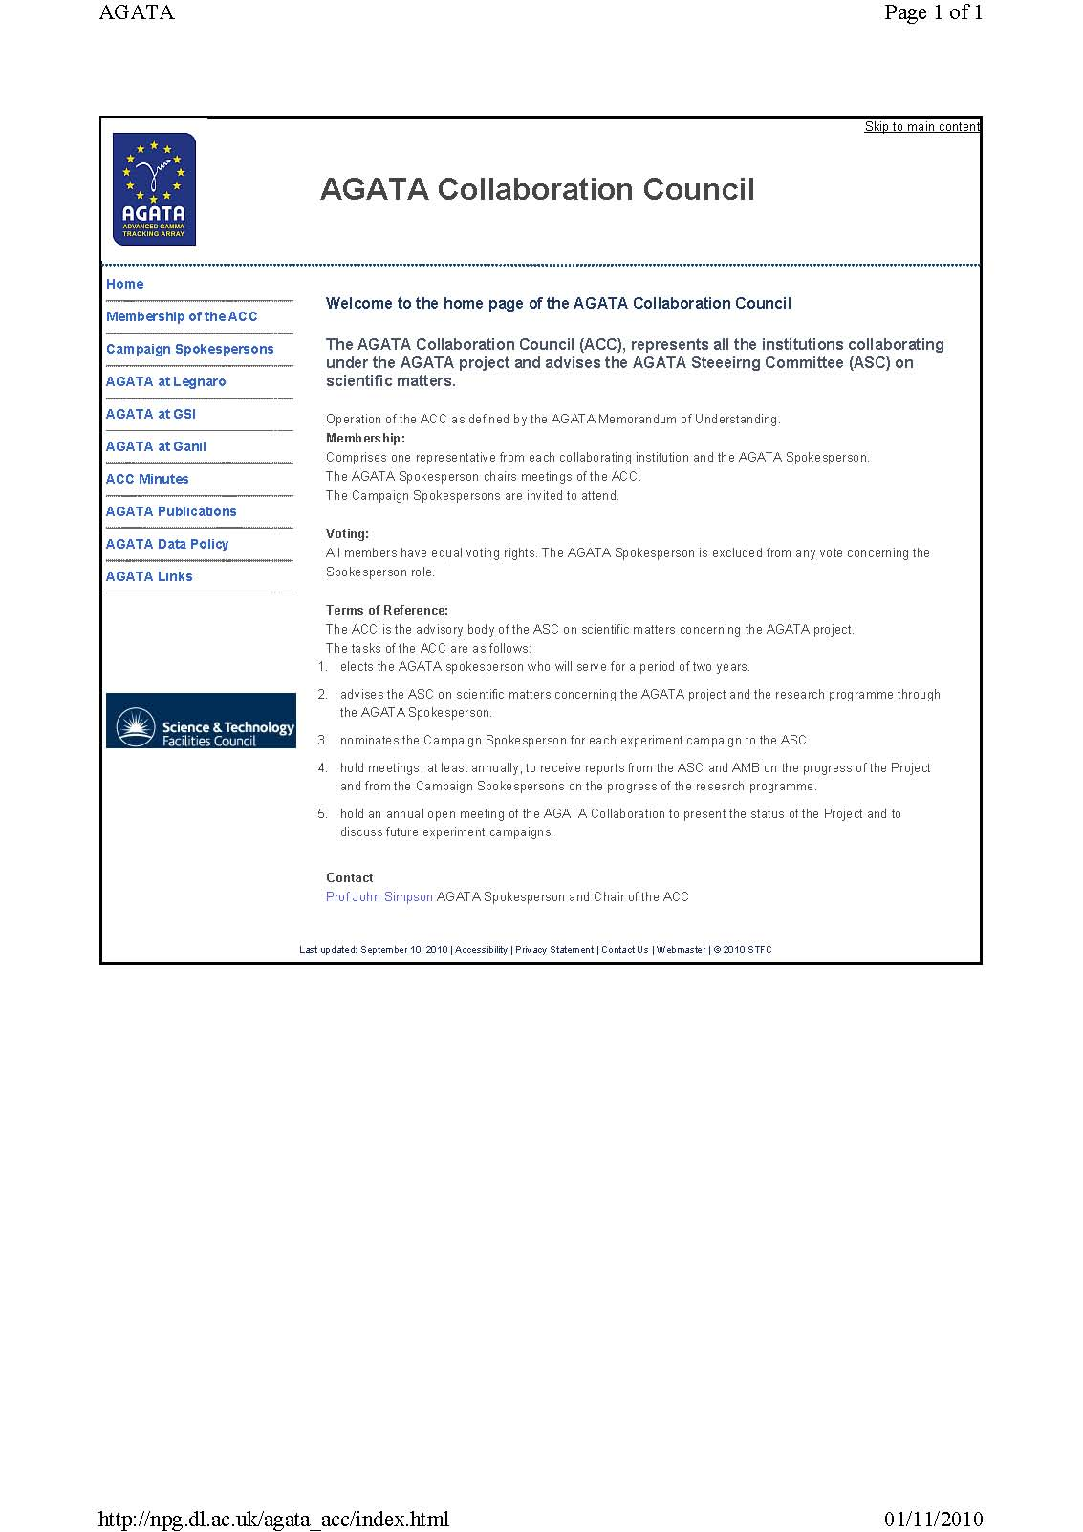
AGATA ACC
Web pages
http://npg.dl.ac.uk/agata_acc/index.html
Comments
Additions
Input
Notes:
Huge collaboration
Over 40 laboratories in 10 countries
Others joining, Turkey, Hungary

Slide 20
AGATA ACC
Annual collaboration meetings
EGAN workshop
Format
Comments
Notes:
Huge collaboration
Over 40 laboratories in 10 countries
Others joining, Turkey, Hungary

Slide 21
AGATA ACC
Annual collaboration meeting
2010 Legnaro Discussion at the inauguration
2010 Istanbul LNL Status LoI
GSI LoI
2010 Lyon LNL LoI
SPIRAL LoI
GSI Status
2011 Padova with EGAN
Results
Status and Plans
2012 Orsay with EGAN
Results
Status and plans
2013 Liverpool with EGAN, 24-27 June
Science results LNL
Experiment status GSI
GANIL future
Data Analysis
GRETINA
Next time GSI? When?
Notes:
Huge collaboration
Over 40 laboratories in 10 countries
Others joining, Turkey, Hungary

Slide 22
AGATA ACC
Any other business
Notes:
Huge collaboration
Over 40 laboratories in 10 countries
Others joining, Turkey, Hungary

