Slide 1
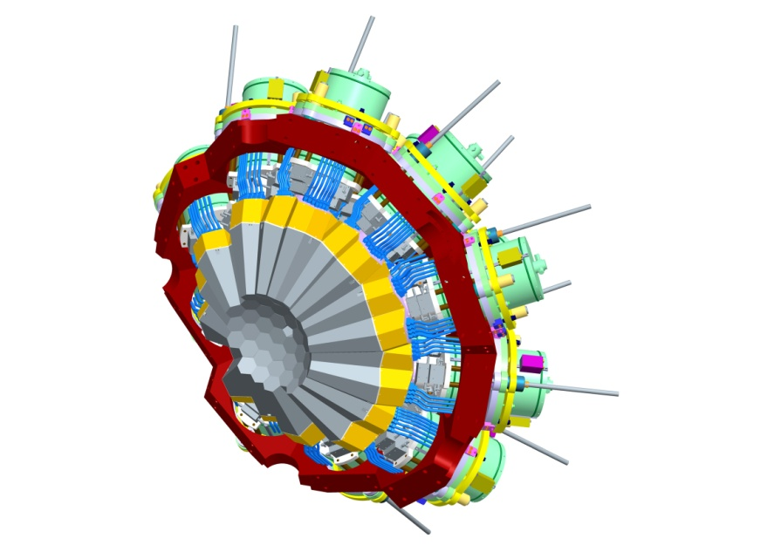
AGATA Collaboration Council
Lyon November 2010
Notes:
Introduction
Overview of the system
Physics outcomes from this meeting important
define physics case
experimental constraints
range of experiments
key experiments demonstrator/full array
meeting
Key design parameters Before too late
120/180 decision

Slide 2
AGATA ACC Agenda
25th November 2010, Lyon
Terms of Reference
Membership
Web pages
Annual collaboration meeting
Campaign Spokespersons
AGATA data policy
AGATA Publications ad publications Policy
Any Other Business
Notes:
Huge collaboration
Over 40 laboratories in 10 countries
Others joining, Turkey, Hungary

Slide 3
AGATA ACC
Terms of Reference:
The ACC is the advisory body of the ASC on scientific matters concerning the AGATA project.
The tasks of the ACC are as follows:
elects the AGATA spokesperson who will serve for a period of two years.
advises the ASC on scientific matters concerning the AGATA project and the research programme through the AGATA Spokesperson.
nominates the Campaign Spokesperson for each experiment campaign to the ASC.
hold meetings, at least annually, to receive reports from the ASC and AMB on the progress of the project and from the Campaign Spokespersons on the progress of the research programme.
hold an annual open meeting of the AGATA Collaboration to present the status of the Project and to discuss future experiment campaigns.
Notes:
Huge collaboration
Over 40 laboratories in 10 countries
Others joining, Turkey, Hungary

Slide 4
AGATA ACC
Membership
Comprises one representative from each collaborating institution and the AGATA Spokesperson.
The AGATA Spokesperson chairs meetings of the ACC.
The Campaign Spokespersons are invited to attend.
Notes:
Huge collaboration
Over 40 laboratories in 10 countries
Others joining, Turkey, Hungary

Slide 5












The AGATA Collaboration
Bulgaria: Univ. Sofia
Denmark: NBI Copenhagen
Finland: Univ. Jyväskylä
France: GANIL Caen, IPN Lyon, CSNSM Orsay, IPN Orsay,
CEA-DSM-DAPNIA Saclay, IreS Strasbourg
Germany: GSI Darmstadt, TU Darmstadt, Univ. zu Köln, LMU München, TU München
Hungary: Debrecen
Italy: INFN and Univ. Firenze, INFN and Univ. Genova, INFN Legnaro, INFN and Univ. Napoli, INFN and Univ. Padova, INFN and Univ. Milano, INFN Perugia and Univ. Camerino
Poland: IFJ PAN Krakow, SINS Swierk, HIL & IEP Warsaw
Romania: NIPNE & PU Bucharest
Sweden: Chalmers Univ. of Technology Göteborg, Lund Univ.,
Royal Institute of Technology Stockholm, Uppsala Univ.
UK: Univ. Brighton, STFC Daresbury, Univ. Edinburgh, Univ. Liverpool,
Univ. Manchester, Univ. Paisley, Univ. Surrey, Univ. York
Turkey: Univ. of Ankara, Istanbul University
Spain
Notes:
Huge collaboration
Over 40 laboratories in 10 countries
Others joining, Turkey, Hungary

Slide 6
AGATA ACC
Membership
Bulgaria:
Univ. Sofia Georgi Rainovski rig@phys.uni-sofia.bg
INRNE Sofia Pavel Petkov petkov@inrne.bas.bg
Finland:
Univ. Jyväskylä Rauno Julin rauno.julin@phys.jyu.fi
France:
GANIL Caen Gille de France defrance@ganil.fr
LPSC –IN2P3 Grenoble Gary Simpson gary.simpson@lpsc.in2p3.fr
IPN–IN2P3 Lyon Olivier Stezowski stezow@IPNL.IN2P3.FR
CSNSM–IN2P3 Orsay Amel Korichi korichi@csnsm.in2p3.fr
IPN–IN2P3 Orsay Francois Le Blanc leblanc@ipno.in2p3.fr
CEA/DSM/IRFU Saclay Wolfram Korten wolfram.korten@cea.fr
IPHC –IN2P3 Strasbourg Dominique Curien curien@ires.in2p3.fr
Germany:
GSI Darmstadt Juergen Gerl j.gerl@gsi.de
TU Darmstadt Norbert Pietralla pietralla@ikp.tu-darmstadt.de,
Univ. zu Köln Peter Reiter preiter@ikp.Uni-Koeln.DE
TU München Reiner Kruecken reiner.kruecken@ph.tum.de
Italy:
INFN Firenze Adriana Nannini Adriana.Nannini@fi.infn.it
INFN Legnaro Daniel Napoli Daniel.R.Napoli@lnl.infn.it
INFN Milano Benedicte Million Benedicte.Million@mi.infn.it
INFN Padova Silvia Lenzi silvia.lenzi@pd.infn.it
Poland:
IFJ PAN Krakow Adam Maj Adam.Maj@ifj.edu.pl
University of Warsaw (HIL) Krzysztof Rusek Krzysztof.Rusek@fuw.edu.pl
Notes:
Huge collaboration
Over 40 laboratories in 10 countries
Others joining, Turkey, Hungary

Slide 7
AGATA ACC
Membership
Romania:
IFIN/HH Bucharest Victor Zamfir zamfir@tandem.nipne.ro
Sweden:
Chalmers Univ. of Technology Göteborg Thomas Nilsson Thomas.Nilsson@chalmers.se
Lund Univ. Dirk Rudolph Dirk.Rudolph@nuclear.lu.se
Royal Institute of Technology Stockholm Bo Cederwall cederwall@nuclear.kth.se
Uppsala Univ. Johan Nyberg johan.nyberg@physics.uu.se
Turkey:
Univ. Ankara Ayse Kaskas kaskas@science.ankara.edu.tr
Univ. Istanbul Nizam Erduran erduran@istanbul.edu.tr
Technical Univ. Istanbul Cenap Ozben ozben@itu.edu.tr
UK:
Univ. Brighton Alison Bruce Alison.Bruce@brighton.ac.uk
Daresbury Laboratory John Simpson john.simpson@stfc.ac.uk
Univ. Edinburgh Phil Woods pjw@ph.ed.ac.uk
Univ. Liverpool Andrew Boston A.J.Boston@liverpool.ac.uk
Univ. Manchester Dave Cullen Dave.cullen@manchester.ac.uk
Univ. Surrey Phil Walker P.Walker@surrey.ac.uk
Univ. West of Scotland John Smith John.F.Smith@uws.ac.uk
Univ. York Mike Bentley mab503@york.ac.uk
Notes:
Huge collaboration
Over 40 laboratories in 10 countries
Others joining, Turkey, Hungary

Slide 8
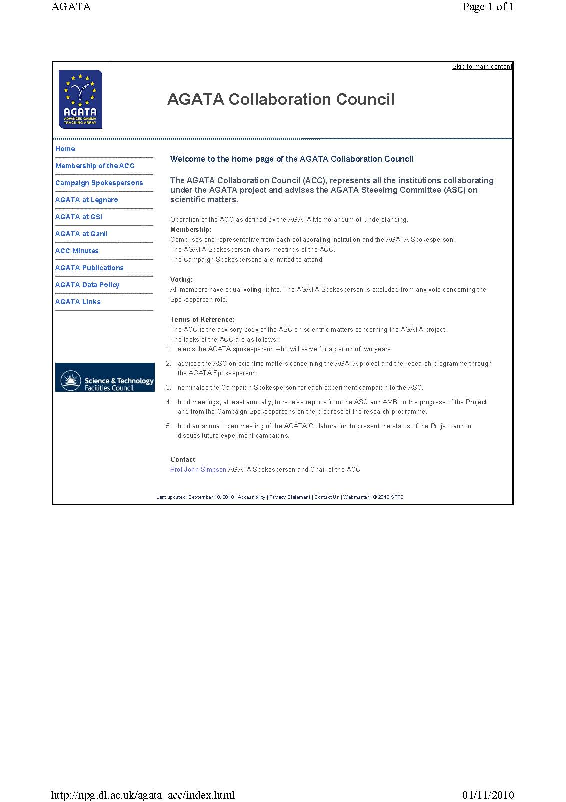
AGATA ACC
Web pages
http://npg.dl.ac.uk/agata_acc/index.html
Comments
Additions
Input
Notes:
Huge collaboration
Over 40 laboratories in 10 countries
Others joining, Turkey, Hungary

Slide 9
AGATA ACC
Annual collaboration meeting
2010 Legnaro Discussion at the inauguration
2010 Istanbul LNL Status LoI
GSI LoI
2010 Lyon LNL LoI
SPIRAL LoI
GSI Status
2011 ?
Results
Status and Plans
Proposal for ACC meeting in 2011
Joint AGATA ACC and EGAN Workshop
Padova
27-30th June 2011
European Gamma & Ancillary detectors Network
Notes:
Huge collaboration
Over 40 laboratories in 10 countries
Others joining, Turkey, Hungary

Slide 10
AGATA ACC
AGATA campaign Spokespersons
Legnaro Sean Freeman
Andres Gadea
GSI Wolfram Korten
Mike Bentley (Prespec)
Ganil ?
Notes:
Huge collaboration
Over 40 laboratories in 10 countries
Others joining, Turkey, Hungary

Slide 11
Previous planning
ASC Decisions:
AGATA remain in LNL until end June 2011
Transfer to GSI, earliest start October 2011
At least 15 month operation period
Transfer to GANIL, earliest start spring 2013
Current planning
ASC Decision:
AGATA remains in LNL until end December 2011
Formal request to LNL management sent by ASC
Follows that:
Transfer to GSI, earliest start April 2012
At least 15 month operation period
Transfer to GANIL, earliest start autumn 2013

Slide 12
AGATA ACC
AGATA Data Policy
Precise:
Definition – Output of the AGATA system
Primary contact for each experiment has to be defined
Ownership AGATA
Spokesperson of AGATA delegates ownership and access to primary contact
Done for Legnaro so far
period of two years
Storage
Limited space locally therefore archival to GRID (AMB)
Exploitation
Annual report to ACC of status of experiment
Publication information to the ACC
http://npg.dl.ac.uk/agata_acc/AGATA_Data_Policy.html
Notes:
Huge collaboration
Over 40 laboratories in 10 countries
Others joining, Turkey, Hungary

Slide 13
AGATA ACC
AGATA Primary contacts
Verney – Duchene – de Angelis | Structure beyond the N=50 shell closure in neutron-rich nuclei in the vicinity of 78Ni: The case of N=51 nuclei | 10
Chapman – Haas | Lifetimes of intruder states in N ~ 20 sd-pf-shell neutron-rich nuclei | 8
Gadea | RDDS lifetime measurement in the region of the neutron-rich doubly magic 132Sn: Lifetime of the 6+ state in 136Te. | 8
Merchan – Ur – Marginean |  | 10
Wheldon | Confirmation of the molecular structure of excited bands in 21Ne | 5
Valeria Vandone Primary contact Silvia Leoni | Order‐to‐chaos transition in warm rotating 174W nuclei | 7 | √
Valiente Dobon Jose Javier | lifetime measurements of the neutro-rich Cr isotopes | 5 | √
Zsolt Podolyak | Neutron-rich nuclei in the vicinity of 208Pb | 5 | √
Eda Sahin – Maria Doncel – Andreas Goergen | Lifetime measurement in neutron‐rich Ni, Cu, and Zn isotopes | 10 | √
Roberto Menegazzo – Calin Ur | Lifetime measurement of the 6.792 MeV state in 15O | 7 | √
Adam Maj, Pawel Napiorkowski, Faisal Azaiez | Coulomb excitation of the presumably superdeformed band in 42Ca | 6 | √
Leske Joerg | Precision lifetime study in the neutron‐rich N=84 isotone 140Ba from DSAM measurements following Coulomb‐barrier alpha‐transfer reactions on a 136Xe | 3
Roberto Nicolini Primary Contact Angela Bracco | Inelastic scattering as a tool to search for highly excited states up to the region of the Giant Quadrupole Resonance | 8 | √
PAC July 2009 February 2010 July 2010
Notes:
Huge collaboration
Over 40 laboratories in 10 countries
Others joining, Turkey, Hungary

Slide 14
AGATA ACC
AGATA Publication and Publications Policy
Maintain list on AGAA ACC web pages
Physics and technical publications
What else, thesis, reports, talks …..
Technical publications, AMB approval
Publications Policy:
Who are the authors
Acknowledgements
Types of papers (Science, technical, …)
The AGATA collaboration
Thoughts?
Notes:
Huge collaboration
Over 40 laboratories in 10 countries
Others joining, Turkey, Hungary

Slide 15
AGATA ACC
Any Other Business
AGATA in FAIR
Notes:
Huge collaboration
Over 40 laboratories in 10 countries
Others joining, Turkey, Hungary

