Slide 1
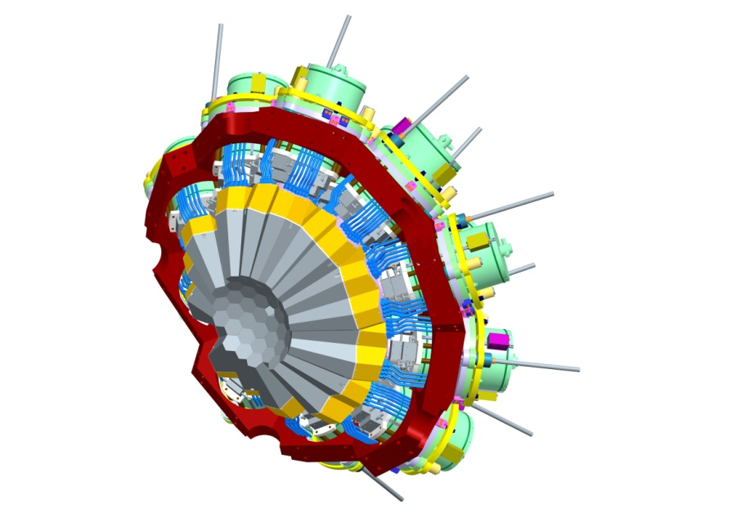
AGATA Collaboration Council
Orsay June 2012
Notes:
Introduction
Overview of the system
Physics outcomes from this meeting important
define physics case
experimental constraints
range of experiments
key experiments demonstrator/full array
meeting
Key design parameters Before too late
120/180 decision

Slide 2
AGATA ACC Agenda 27th June 2012, Orsay
Minutes of the last meeting from Padova 2011
Outstanding actions
Membership, ACC updates
Experiment status
Report from ASC
Report from AMB
Campaign Spokesperson at Ganil
Publications policy
Web page
The open meeting and EGAN workshop
Next annual meeting
Any Other Business
Notes:
Huge collaboration
Over 40 laboratories in 10 countries
Others joining, Turkey, Hungary

Slide 3
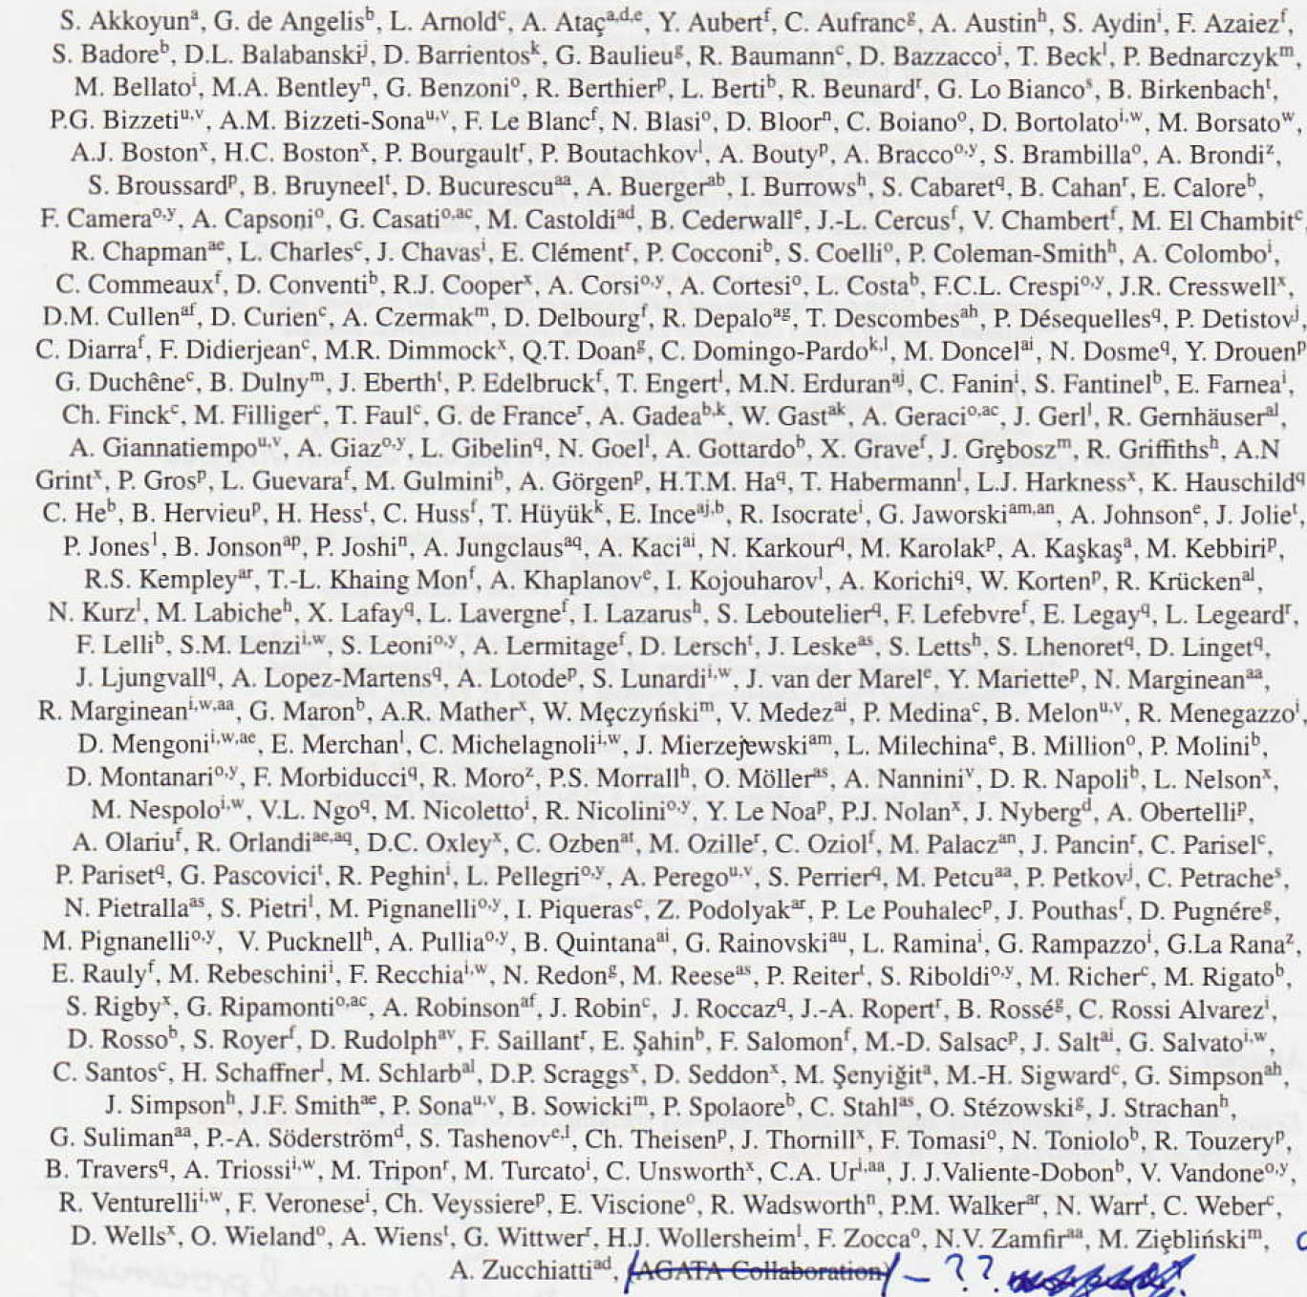
The AGATA reference
AGATA – Advanced Gamma Tracking Array
Nuclear Instruments and Methods in Physics Research A 668 (2012) 26–58

Slide 4
AGATA ACC
Terms of Reference:
The ACC is the advisory body of the ASC on scientific matters concerning the AGATA project.
The tasks of the ACC are as follows:
elects the AGATA spokesperson who will serve for a period of two years.
advises the ASC on scientific matters concerning the AGATA project and the research programme through the AGATA Spokesperson.
nominates the Campaign Spokesperson for each experiment campaign to the ASC.
hold meetings, at least annually, to receive reports from the ASC and AMB on the progress of the project and from the Campaign Spokespersons on the progress of the research programme.
hold an annual open meeting of the AGATA Collaboration to present the status of the Project and to discuss future experiment campaigns.
Notes:
Huge collaboration
Over 40 laboratories in 10 countries
Others joining, Turkey, Hungary

Slide 5
AGATA ACC
Terms of Reference:
The ACC is the advisory body of the ASC on scientific matters concerning the AGATA project.
The tasks of the ACC are as follows:
elects the AGATA spokesperson who will serve for a period of two years.
advises the ASC on scientific matters concerning the AGATA project and the research programme through the AGATA Spokesperson.
nominates the Campaign Spokesperson for each experiment campaign to the ASC.
hold meetings, at least annually, to receive reports from the ASC and AMB on the progress of the project and from the Campaign Spokespersons on the progress of the research programme.
hold an annual open meeting of the AGATA Collaboration to present the status of the Project and to discuss future experiment campaigns.
Administer the data policy
Administer the scientific publications policy
Maintain web pages
Notes:
Huge collaboration
Over 40 laboratories in 10 countries
Others joining, Turkey, Hungary

Slide 6
AGATA ACC
Membership
Bulgaria:
Univ. Sofia Georgi Rainovski rig@phys.uni-sofia.bg
INRNE Sofia Pavel Petkov petkov@inrne.bas.bg
Finland:
Univ. Jyväskylä Rauno Julin rauno.julin@phys.jyu.fi
France:
GANIL Caen Emmanuel Clement clement@ganil.fr
LPSC –IN2P3 Grenoble Gary Simpson gary.simpson@lpsc.in2p3.fr
IPN–IN2P3 Lyon Olivier Stezowski stezow@IPNL.IN2P3.FR
CSNSM–IN2P3 Orsay Joa Ljungvall ljungvall@csnsm.in2p3.fr
IPN–IN2P3 Orsay Francois Le Blanc leblanc@ipno.in2p3.fr
CEA/DSM/IRFU Saclay Wolfram Korten wolfram.korten@cea.fr
IPHC –IN2P3 Strasbourg Dominique Curien curien@ires.in2p3.fr
Germany:
GSI Darmstadt Juergen Gerl j.gerl@gsi.de
TU Darmstadt Norbert Pietralla pietralla@ikp.tu-darmstadt.de,
Univ. zu Köln Peter Reiter preiter@ikp.Uni-Koeln.DE
TU München Roman Gernhaeuser roman.gernhaeuser@ph.tum.de
Italy:
INFN Firenze Adriana Nannini Adriana.Nannini@fi.infn.it
INFN Legnaro Daniel Napoli Daniel.R.Napoli@lnl.infn.it
INFN Milano Benedicte Million Benedicte.Million@mi.infn.it
INFN Padova Silvia Lenzi silvia.lenzi@pd.infn.it
Poland:
IFJ PAN Krakow Adam Maj Adam.Maj@ifj.edu.pl
University of Warsaw (HIL) Krzysztof Rusek Krzysztof.Rusek@fuw.edu.pl
Notes:
Huge collaboration
Over 40 laboratories in 10 countries
Others joining, Turkey, Hungary

Slide 7
AGATA ACC
Membership
Romania:
IFIN/HH Bucharest Victor Zamfir zamfir@tandem.nipne.ro
Spain:
IFIC, CSIC-University of Valencia Andres Gadea gadea@ific.uv.es
Electronic Engineering Department University of Valencia (UVEG) Vicente González vicente.gonzalez@uv.es
IEM, CSIC, Madrid Andrea Jungclaus andrea.jungclaus@csic.es
Department of Fundamental Physics, University of Salamanca Begoña Quintana quintana@usal.es
Sweden:
Chalmers Univ. of Technology Göteborg Andreas Heinz andreas.heinz@chalmers.se
Lund Univ. Dirk Rudolph Dirk.Rudolph@nuclear.lu.se
Royal Institute of Technology Stockholm Bo Cederwall cederwall@nuclear.kth.se
Uppsala Univ. Johan Nyberg johan.nyberg@physics.uu.se
Turkey:
Univ. Ankara Ayse Kaskas aysekaskas@yahoo.com
Univ. Istanbul Ela Ganioglu ganioglu@istanbul.edu.tr
Technical Univ. Istanbul Cenap Ozben ozben@itu.edu.tr
UK:
Univ. Brighton Alison Bruce Alison.Bruce@brighton.ac.uk
Daresbury Laboratory John Simpson john.simpson@stfc.ac.uk
Univ. Edinburgh Phil Woods pjw@ph.ed.ac.uk
Univ. Liverpool Andrew Boston A.J.Boston@liverpool.ac.uk
Univ. Manchester Dave Cullen Dave.cullen@manchester.ac.uk
Univ. Surrey Phil Walker P.Walker@surrey.ac.uk
Univ. West of Scotland John Smith John.F.Smith@uws.ac.uk
Univ. York Mike Bentley mab503@york.ac.uk
Hungary signed MoU
Notes:
Huge collaboration
Over 40 laboratories in 10 countries
Others joining, Turkey, Hungary

Slide 8
AGATA ACC Experiment status
AGATA Data Policy
Precise:
Definition – Output of the AGATA system
Primary contact for each experiment has to be defined
Ownership AGATA
Spokesperson of AGATA delegates ownership and access to primary contact
Done for Legnaro so far
period of two years
Storage
Limited space locally therefore archival to GRID (AMB)
Exploitation
Annual report to ACC of status of experiment (report at annual meeting)
Publication information to the ACC
Brief report on experiments, send in or keep up to date.
http://npg.dl.ac.uk/agata_acc/AGATA_Data_Policy.html
Notes:
Huge collaboration
Over 40 laboratories in 10 countries
Others joining, Turkey, Hungary

Slide 9
AGATA ACC
Report from ASC
Last meeting March 2012 Ganil
Issues:
GSI Host agreement
Detector status
Laboratory Directors meeting (December 2011, Paris)
ACC report, procedure for Ganil Campaign Spokesperson(s)
ASC accepted nomination from Ganil for Emmanueal Clement, local project manager
Ganil Status
Spain, Hungary members, Hungary since signed MoU
Publications policy defined
Operation costs
Next location of AGATA 2015, 2016, 2017....
LoI’s by next ASC (12th Sept)
Report from AMB (Andres Gadea)
Notes:
Huge collaboration
Over 40 laboratories in 10 countries
Others joining, Turkey, Hungary

Slide 10
AGATA ACC
AGATA campaign Spokespersons
Legnaro Sean Freeman
Andres Gadea
GSI Wolfram Korten
Mike Bentley (Prespec)
Ganil ACC vote, status,
1 or 2?
Notes:
Huge collaboration
Over 40 laboratories in 10 countries
Others joining, Turkey, Hungary

Slide 11
AGATA ACC
AGATA Publication and Publications Policy
Maintain list on AGAA ACC web pages
Physics and technical publications
What else, thesis, reports, talks …..
Technical publications, AMB approval
Publications Policy:
ASC
Core authors for physics papers from Legnaro (156)
List defined
Sign up required
Administration ASC asked ACC
Web based system. How?
Thoughts and comments?
Notes:
Huge collaboration
Over 40 laboratories in 10 countries
Others joining, Turkey, Hungary

Slide 12
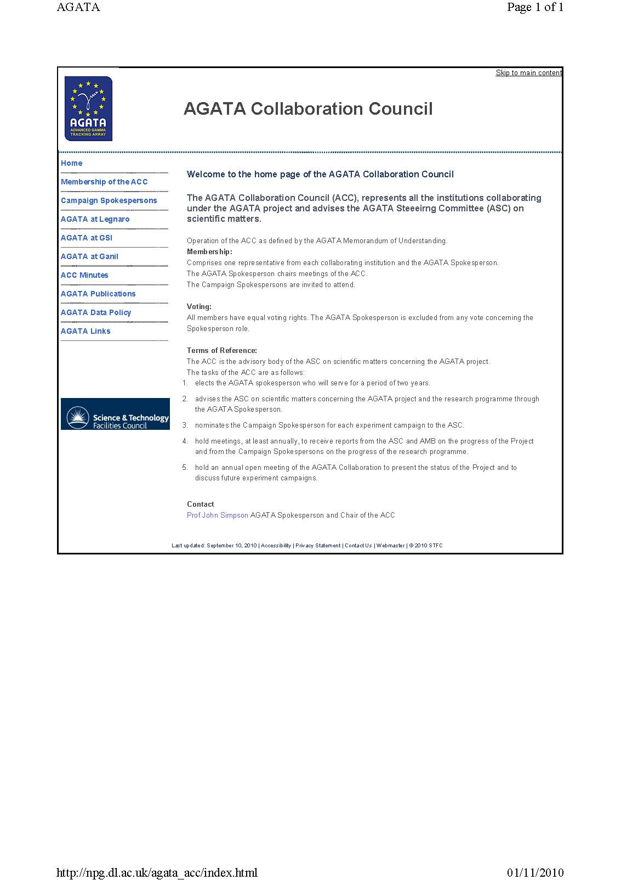
AGATA ACC
Web pages
http://npg.dl.ac.uk/agata_acc/index.html
Comments
Additions
Input
Notes:
Huge collaboration
Over 40 laboratories in 10 countries
Others joining, Turkey, Hungary

Slide 13
AGATA ACC
Annual collaboration meetings
EGAN workshop
Format
Comments
Notes:
Huge collaboration
Over 40 laboratories in 10 countries
Others joining, Turkey, Hungary

Slide 14
AGATA ACC
Annual collaboration meeting
2010 Legnaro Discussion at the inauguration
2010 Istanbul LNL Status LoI
GSI LoI
2010 Lyon LNL LoI
SPIRAL LoI
GSI Status
2011 Padova with EGAN
Results
Status and Plans
2012 Orsay with EGAN
Results
Status and plans
2013 Liverpool with EGAN, 24-28 June
Science programme at GANIL
Proposal for GSI-PAC
Notes:
Huge collaboration
Over 40 laboratories in 10 countries
Others joining, Turkey, Hungary

Slide 15
AGATA ACC
Any other business
Notes:
Huge collaboration
Over 40 laboratories in 10 countries
Others joining, Turkey, Hungary

