Slide 1
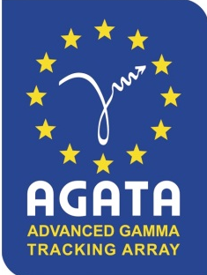
AGATA@GANIL
Status report
AGATA week 2018

Slide 2
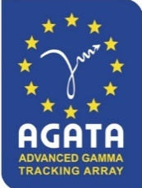
The GANIL Campaign organization
The AGATA campaign at GANIL has been extend to the end of 2020
Each GANIL PAC has a “PrePac” workshop with a specific call : AGATA Collaboration Meeting
1st PAC in 2014 : VAMOS (10 experiments approved)
2nd PAC in 2015 : VAMOS || NEDA (10 experiments approved)
3rd PAC in 2016 : NEDA (6 experiments approved)
4th PAC in 2017: Fully opened by the new GANIL management : 2(1) VAMOS (MUGAST) approved
Pré-PAC in February 2018 :
    12 MUGAST/Coulex with SPIRAL1 beams
    6 Gas-Filled
    5 NEDA-DIAMANT
    3 VAMOS Std
853 UT have been already approved
628 UT have been performed over 22 experiments
5th PAC in Autumn 2018: call for MUGAST-AGATA-VAMOS experiments only
    5 MUGAST-AGATA-VAMOS experiments proposed
Thanks to Silvia for her work in the scientific coordination of the campaign since 2012
Backlog is
1 PARIS-DIAMANT 28 UT
3 NEDA (+ DIAMANT, PARIS, FATIMA) 66 UT
4 VAMOS 92 UT
1 MUGAST 39 UT + Re-schedule of a failed 2018 LISE exp.
2019 beam time should be ~4 months

Slide 3

2018 Technical achievements
Data Acquisition NARVAL → DCOD: process full real-time w/o PSA from 6 to 12kHz per core
Improved PCIe readout libraries for both GGP and LINCO2
Successful integration of NUMEXO2 and its TP in AGATA via the GTS and the DCOD/TM/RCC systems
Learning curve in the CEPH technology
Data analysis and access to the data
* Improved access to the GRID data
* Successful integration of NEDA and DIAMANT in the AGATA data processing
* 2nd Data Analysis Workshops in January 2018
* 3rd focused on the NEDA-DIAMANT-AGATA campaign in early 2019
Efficiencies
*Lot of efforts on source and in-beam efficiencies studies devoted in 2017
* In 2018, we focused our attention on the high rate-capabilities approaching the hardware/software limits
Operation
*We ran 22 experiments in ~11 months of beam time (~2 experiments/month)
    *35 Detectors take data since 2017 in stable conditions
    *There are 1330 electronics channels to manage (Detectors, FEBEE, DAQ, calibrations)
    *~60 000 parameters are prepared to reach the final spectrum
    * 430 To of data produced including the 2018 run
    *In-beam data since 2014, the campaign is approved until 2020 (7 years operation )
    *Detectors maintained cold for more than 1200 days without accidental warming up

Slide 4
Cumulative [TB]
Without Traces…
2017 r3
2017
2016
The NEDA campaign with ~30To of adf files per experiment has been a real challenge for the near line analysis, disks space and backup
2015
2014

Slide 5
Long term Visitors
Visitors 2014-2015
Korichi (CSNSM)- GANIL Support – (18 months)
Perez (IFIC) – Spain and GANIL support ( 3 months)
C. Andreoiu (Simon Fraser University) – Canada and GANIL support (6 months)
Visitors 2016
M. Zielinska (SphN) – GANIL/SPhN Support (6 months)
Perez (IFIC) – Spain and GANIL support (3 months)
Visitors 2017
M. Zielinska (DphN) – GANIL/DPhN Support (4 months)
G. Simpson (LPSC) – GANIL/LPSC Support (4 months)
Visitors 2018
M. L. Jurado (IFIC) – Spain support (4 months)

Slide 6
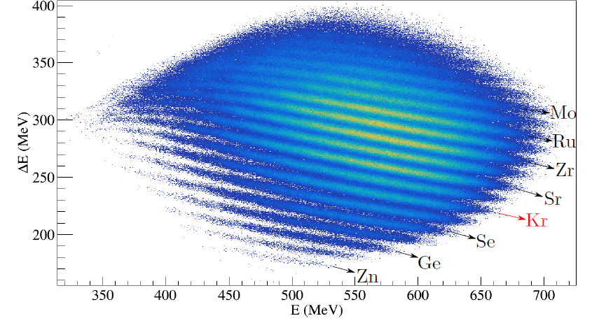
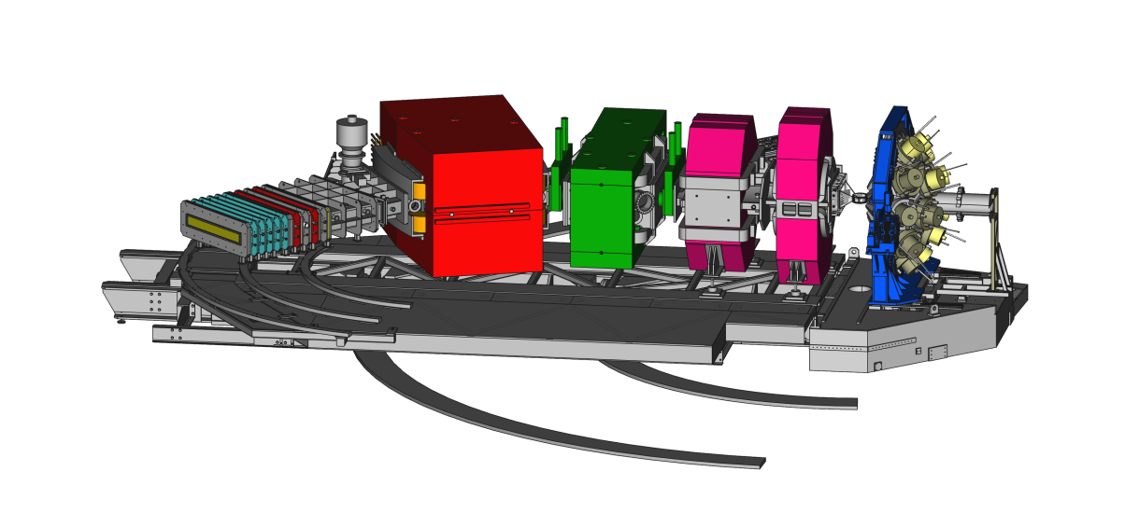
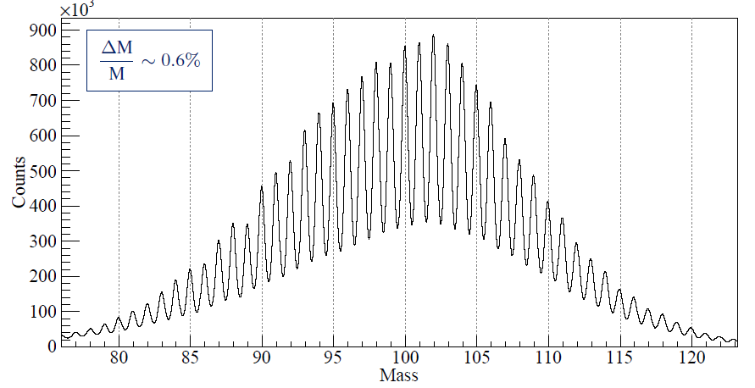
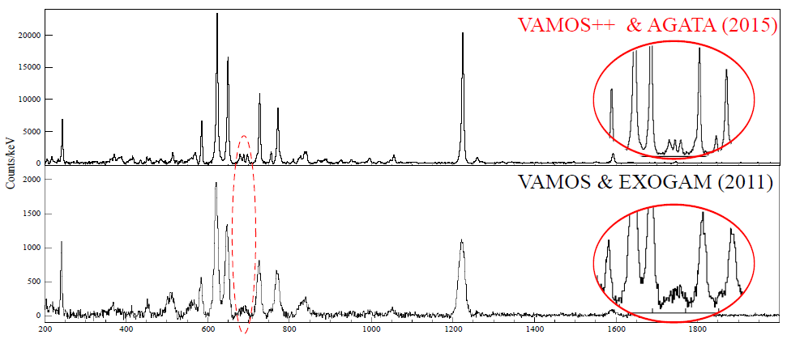
The GANIL Campaign [2015-2020]
Courtesy J. Dudouet
2017-2018 : 35 detectors on-line : Efficiencies measured in nominal position at 1.408 MeV
Core 3.4(1)% (GEANT4 = 3.6%)
AddBack 4.8(1)% (5.1%)
Tracked 4.4(1)% (5.5%)
Nucleons transfer
Fusion-fission
Transfer-fission
E. Clément et al., NIMA 855, 1-12 (2017)
Y. H. Kim et al., Eur.Phys.J. A 53, 162 (2017)

Slide 7
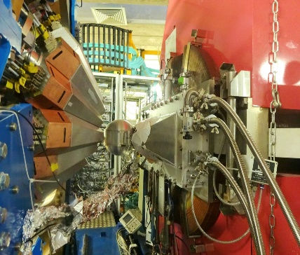
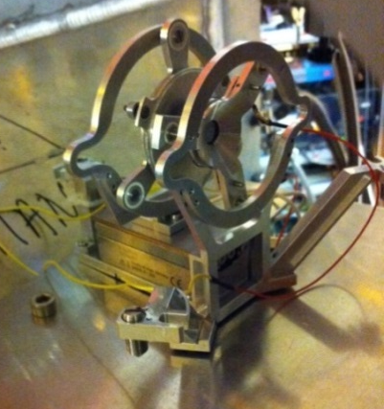
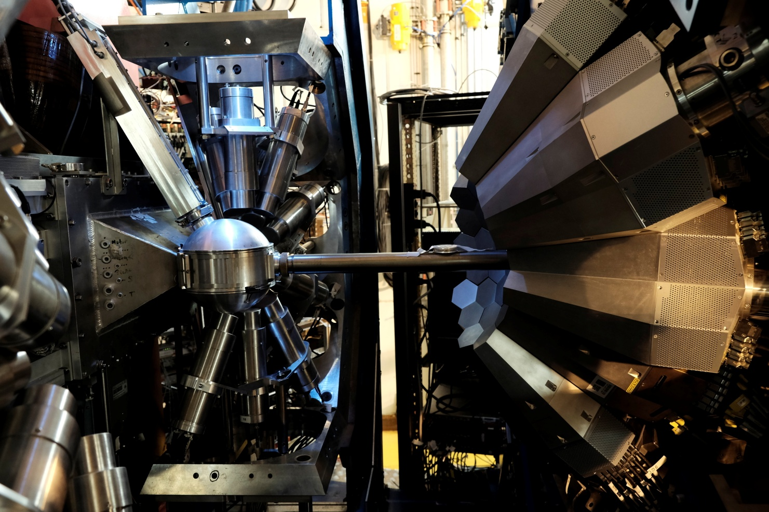
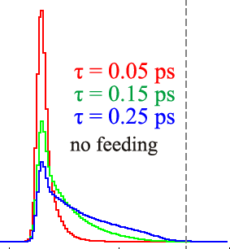
The GANIL Campaign [2015-2020]
Lifetime measurements
2015-2017: 93% of performed experiments are lifetime measurements from fs to μs
E. Clément et al., NIMA 855, 1-12 (2017)
Y. H. Kim et al., Eur.Phys.J. A 53, 162 (2017)
FATIMA-PARIS detectors coupled to AGATA

Slide 8
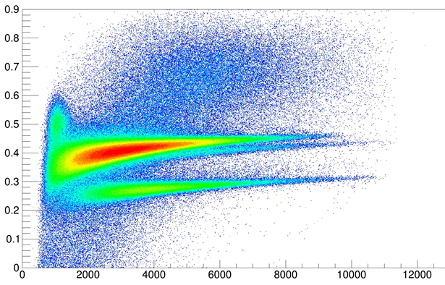
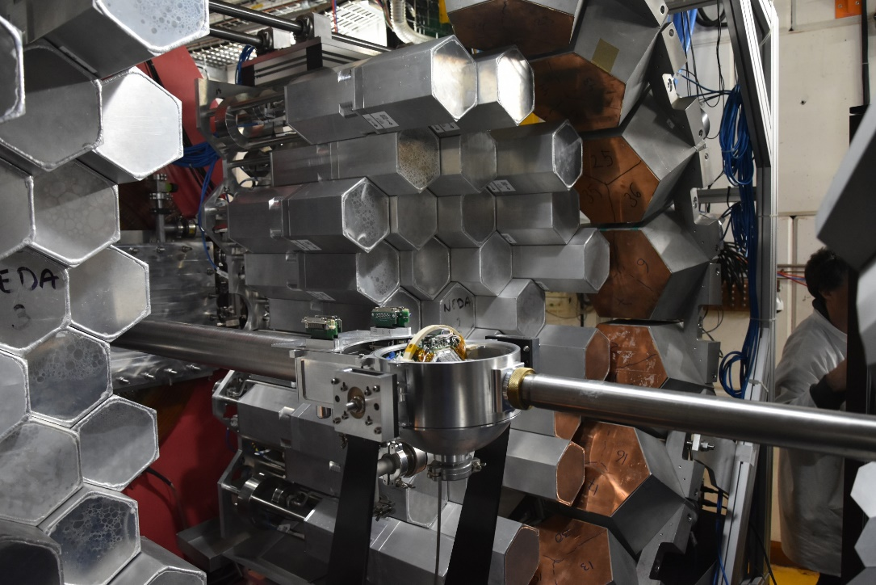
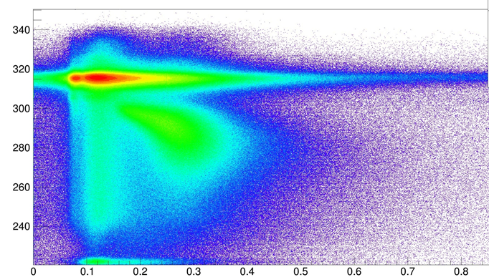
The GANIL Campaign [2015-2020]
2018 run NEDA campaign
DIAMANT and NEDA in full digital system making use of the NUMEXO2 boards and coupled to AGATA with the AGATA GTS system
×20 increase in (nγ²) event rate readout compared to the NWALL-DIAMANT-EXOGAM system in VME-VXI.
T. Huyuk et al, Eur. Phys. J. A (2016) 52: 55 Page 5
PSA
E. Clément et al., NIMA 855, 1-12 (2017)
J. J. Valiente-Dobon et al, to be submitted
p
α
Energy
Time of flight
γ
n
54 self produced NEDA detectors at forward angles and 14 NWALL detectors + plunger
~9% γ-efficiency at 1.4 MeV after tracking
>20% efficiency for 1 neutron
>35% efficiency for 1 proton
PSA – Neural network

Slide 9
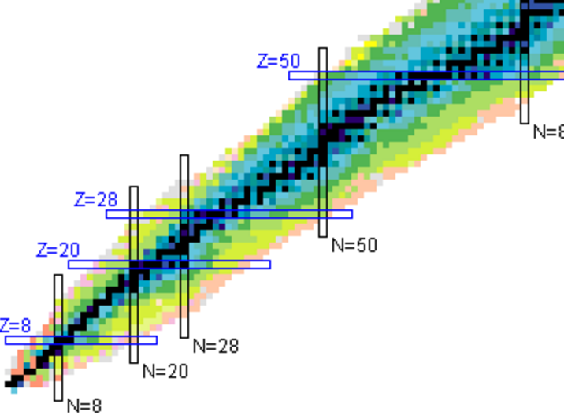
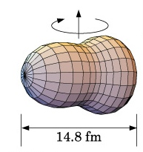
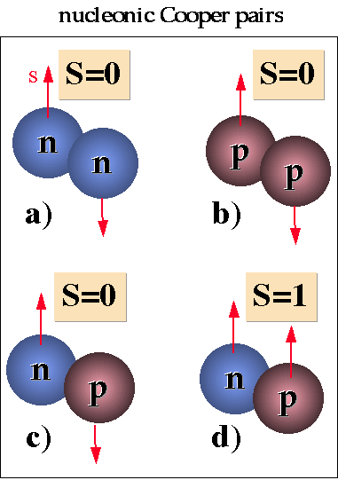
Physics of N~Z nuclei
N=Z
E. Clément/J.J. Valiente-Dobon
Octupoles in ¹¹²Xe
J.. Nyberg
^{102,103}Sn excited levels
B. Cederwall, R Wadsworth, G de France
T=0 pairing ⁸⁸Ru
S. Lenzi, F. Recchia
Iso. Symmetry Breaking A=63
Boso
⁷¹Kr-⁷¹Br – Isospin Symmetry Breaking
Does the Nuclear force identical for proton and neutron ?
New phenomena when proton and neutron occupy the same orbits ?
¹⁰⁰Sn magicity ?
Isospin Symmetry Breaking in the A=63,71 mirror nuclei
Studies of excited states in ^{102,103}Sn
Search for isoscalar pairing in the N=Z nucleus ⁸⁸Ru
Octupole – Quadrupole correlation in ¹¹²Xe

Slide 10
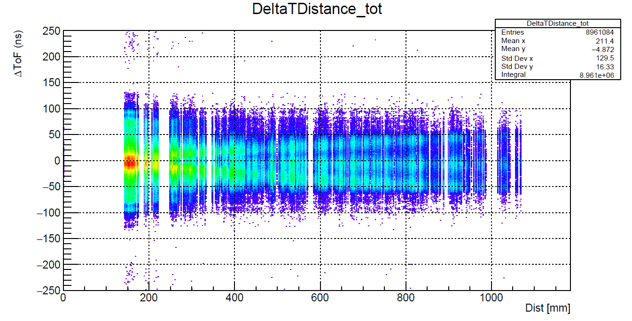
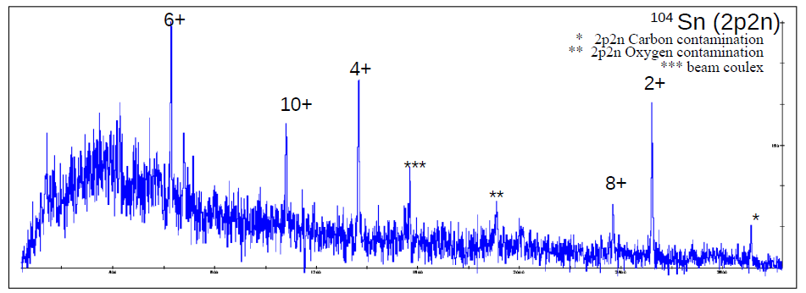
The NEDA setup : the 2n selectivity
Simulation
T. Huyuk and the NEDA collaboration,
Eur. Phys. J. A (2016) 52: 55 Page 5
¹⁰⁰Sn magicity
ON-LINE
⁵⁸Ni(⁵⁰Cr,2p2n)¹⁰⁴Sn

Slide 11
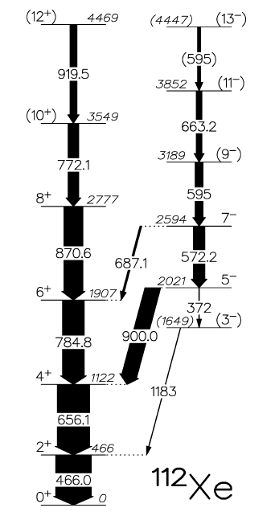
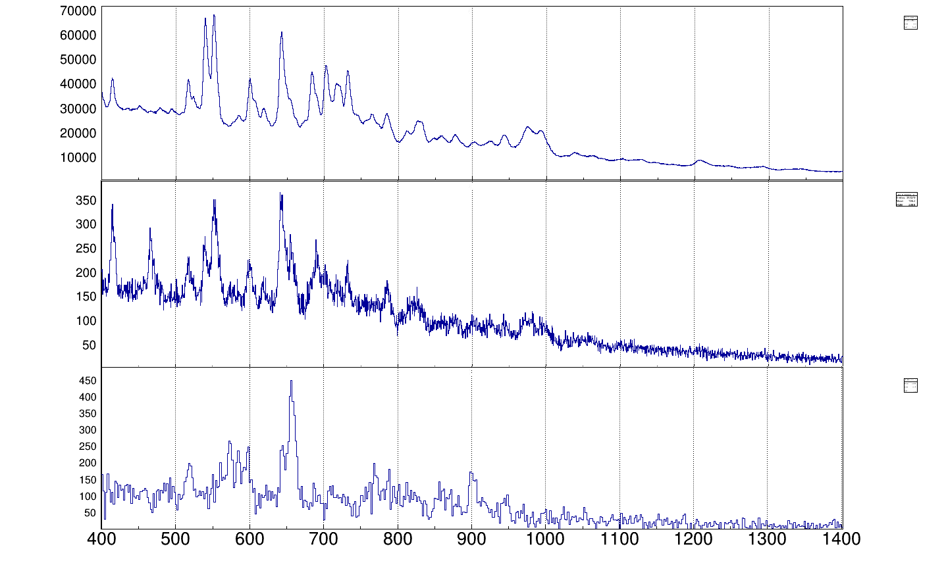
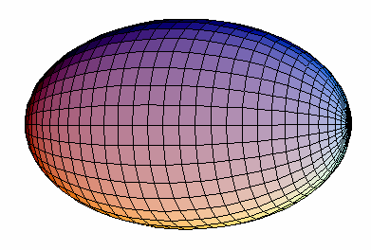
The NEDA setup : the 2n selectivity
Lifetime measurement ⁵⁸Ni+⁵⁸Ni at 250 MeV
1n2p
ON-LINE
2⁺
2n2p
7⁻
9⁻
4⁺
2n2p-2⁺ gated
6⁺
8⁺
5⁻
σ~100 μb
e⁺e⁻
3⁻ ?
D. Ralet, M. L. Jurado, EC et al,
OUPS Plunger, J. Ljungvall et al, NIM A 679 (2012) 61-66. Degrader mode

Slide 12
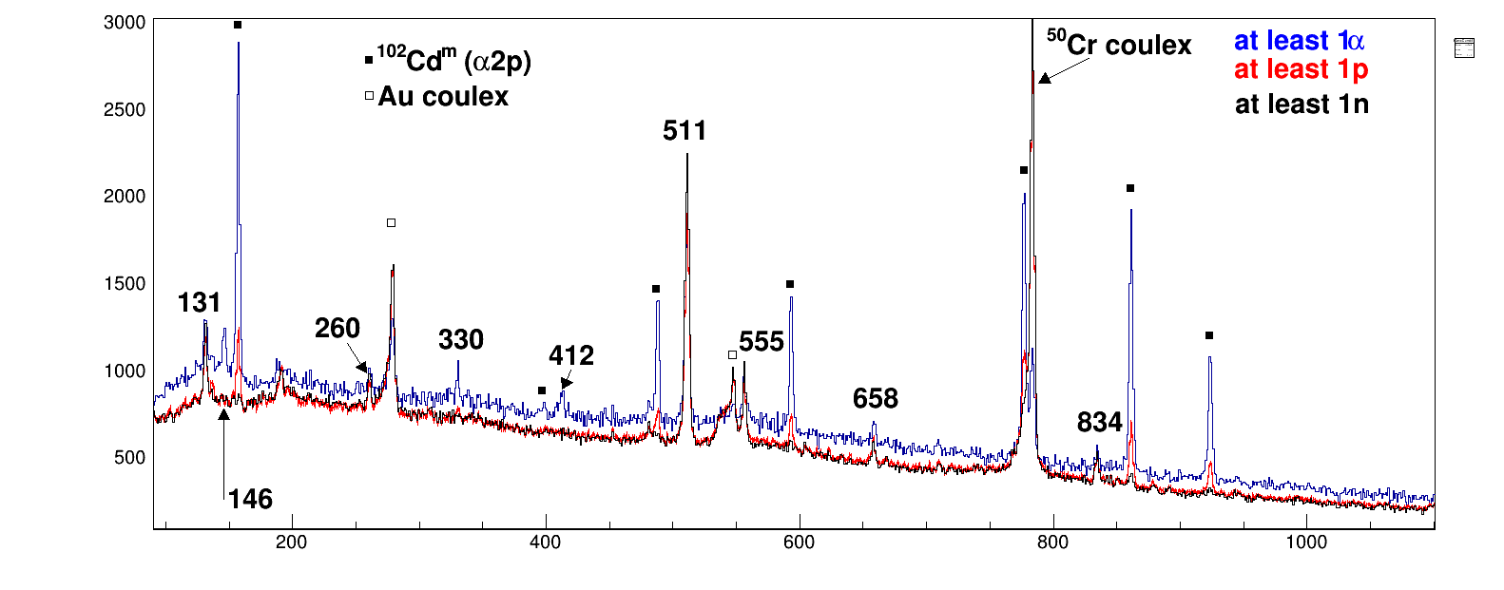
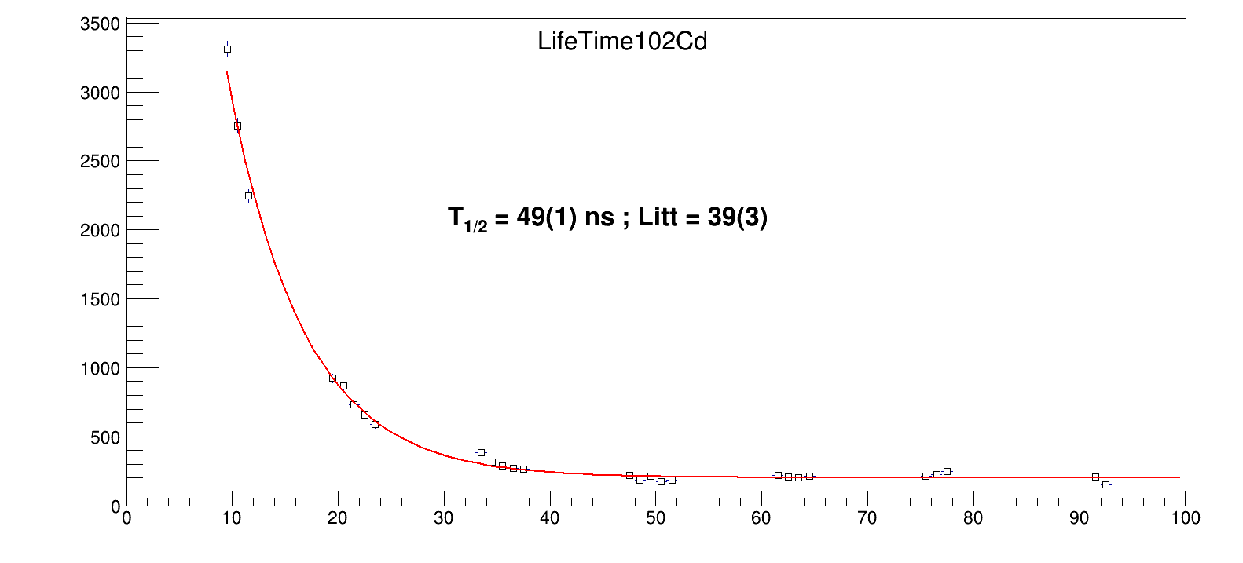
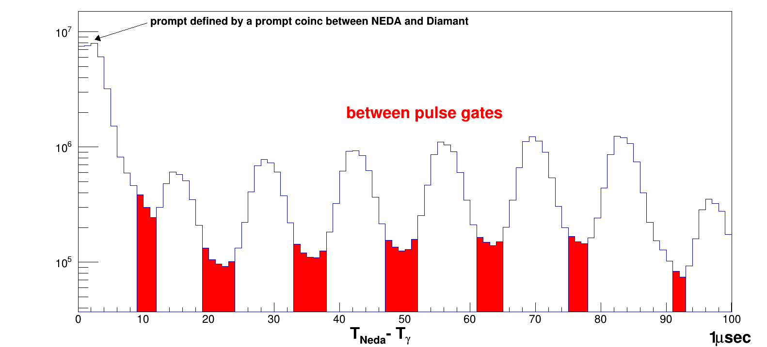
The NEDA setup : the isomer selectivity

Slide 13
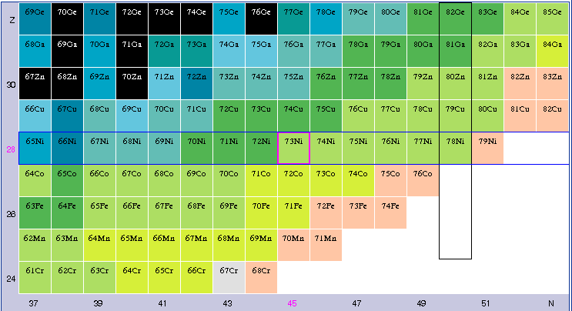
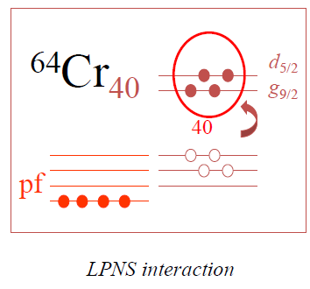
Shell evolution around Z=28
Interplay of the monopole terms of the interaction with multipole terms, like pairing and quadrupole, which determines the different phenomena we observe
Characterizing the islands of inversion, formed near the magic numbers.
These are new regions of deformation with configurations involving intruder orbitals from the above main shell.
While a signature of deformation is given by the energy of the first excited states, their lifetimes allow a better understanding of their properties by comparison with LSSM calculations

Slide 14
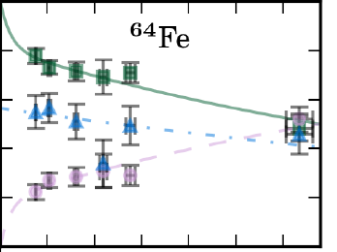
Shell evolution around Z=28
Interplay of the monopole terms of the interaction with multipole terms, like pairing and quadrupole, which determines the different phenomena we observe
Collecting spectroscopic data like transition probability constraining the theoretical description of the Island of inversion from N=28 to N=40 :
What is the influence of the νg9/2 and νd5/2 orbits ?
What is the influence of the proton excitations across Z=28 ?
How collectivity change when decreasing the number of proton in the f7/2 orbital
Lifetimes of the 4⁺ states in ^{62;64}Fe and the 11/2⁻ in ^{61;63}Co and ⁵⁹Mn
M. Klintefjord et al., PRC 95, 024312 (2017)

Slide 15
Shell evolution around Z=28
Interplay of the monopole terms of the interaction with multipole terms, like pairing and quadrupole, which determines the different phenomena we observe
Collecting spectroscopic data like transition probability constraining the theoretical description of the Island of inversion from N=28 to N=40 :
What is the influence of the νg9/2 and νd5/2 orbits ?
What is the influence of the proton excitations across Z=28 ?
How collectivity change when decreasing the number of proton in the f7/2 orbital
Lifetimes in ⁵⁴Ti and in neighboring isotopes have
been determined
4+
2+
A. Goldkuhle et al. to be submitted

Slide 16
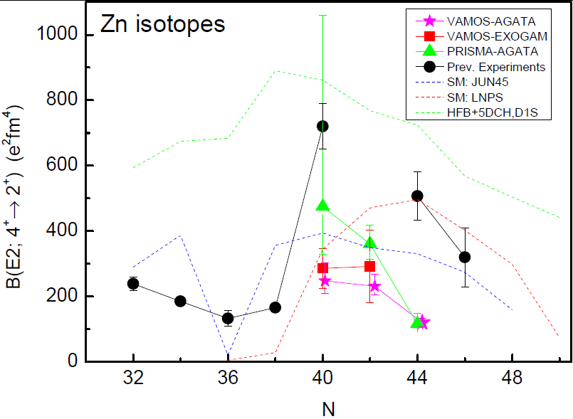
Shell evolution around Z=28
Interplay of the monopole terms of the interaction with multipole terms, like pairing and quadrupole, which determines the different phenomena we observe
Dirken et al., PRC 82 (2010) 064309
I. Čeliković, Ph.D. Thesis, GANIL 2013
C. Louchart et al., Phys. Rev. C, 87 054302 (2013)
⁷³Ga ground-state: 3/2⁻, 1/2⁻ doublet?
→ determine the M1 component of the first 5/2⁻
Obtained lifetime :
Fast M1 component in the decay of the first 5/2⁻ state.
Confirms 1/2⁻, 3/2⁻ g.s. doublet
I. Celikovic, C. Michelagnoli et al.

Slide 17
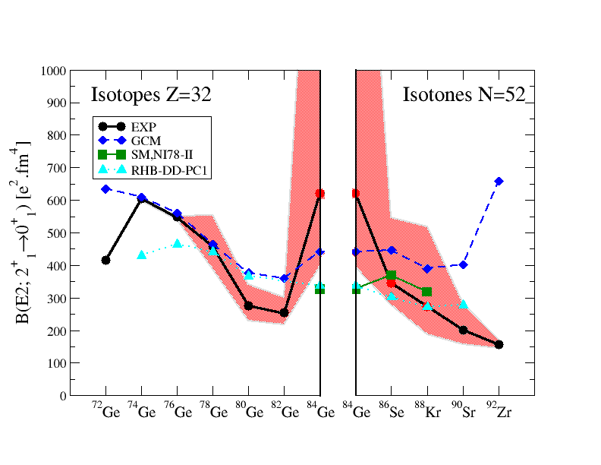
The quenching of the N=50 gap towards
⁷⁸Ni can be investigated looking at the
Spectroscopy of excited states involving particle-hole excitations across the N=50 gap
First lifetime of excited states measured in ⁸⁸Kr
Lifetime measured with better accuracy in ⁸⁶Se
First lifetime measured in the very exotic ⁸⁴Ge
Unexpected enhancement of collectivity in ⁸⁴Ge
Sudden rise of collectivity after the N=50 shell closure
… in contradiction with shell model calculation
⁸¹Ga spectroscopy
J. Dudouet et al, to be submitted
C. Delafosse et al., submitted to Phys. Rev. Lett.

Slide 18
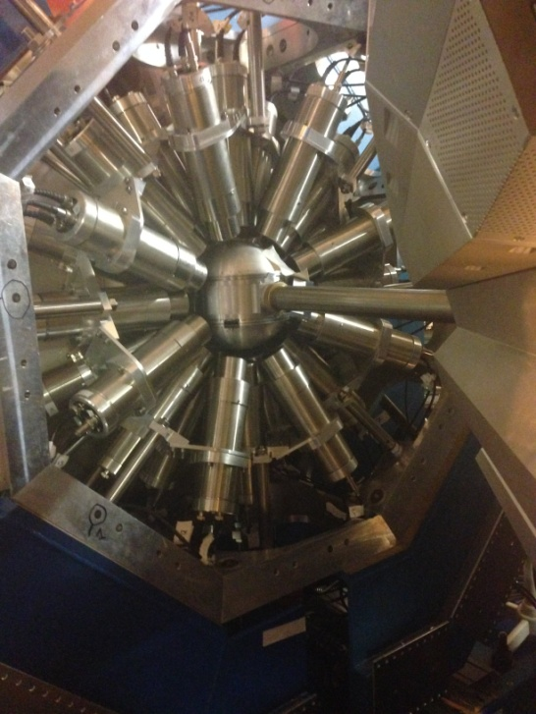
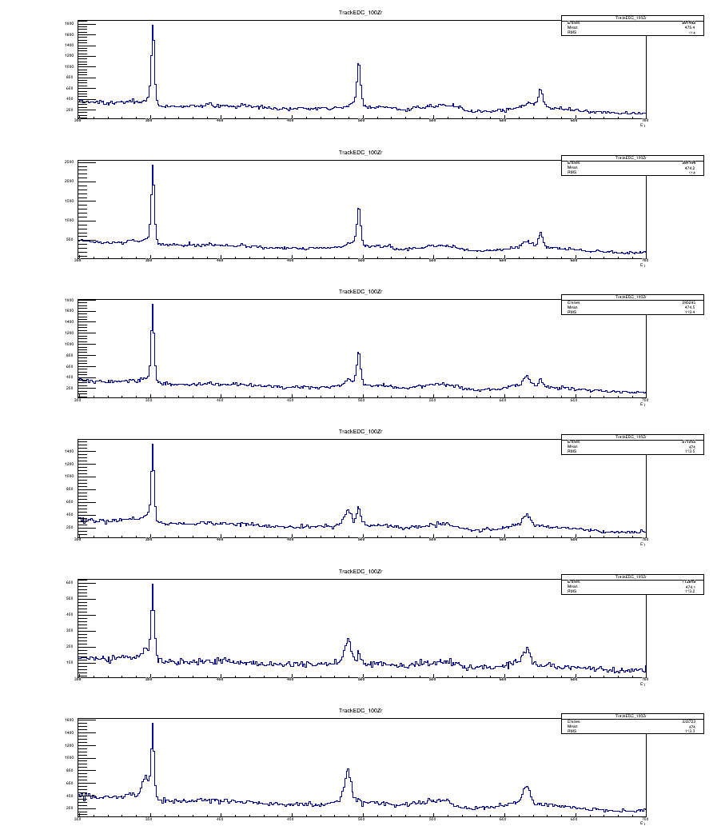
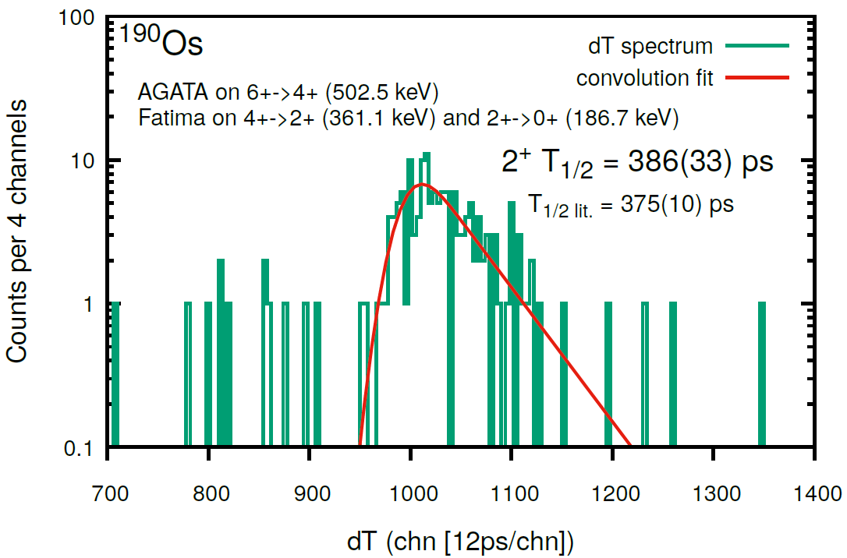
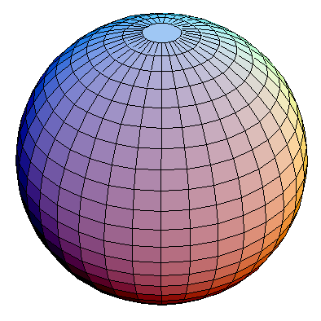
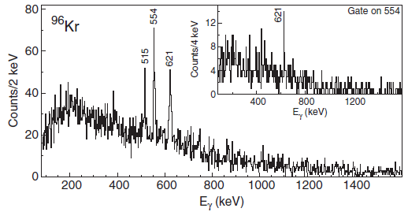
Shape evolution in fission fragments in the A~100 region
AGATA-VAMOS and a plunger + FATIMA for lifetime measurements using the ⁹Be(²³⁸U,FF) reaction
W. Korten, A. Görgen et al
Ph. John
¹⁰⁰Zr
On-line
On-line
High resolution spectroscopy of ⁹⁶Kr
J. Dudouet et al. Phys. Rev. Lett. 118, 162501 (2017)
+ Plunger (short lifetime I^{π} >4⁺)

Slide 19
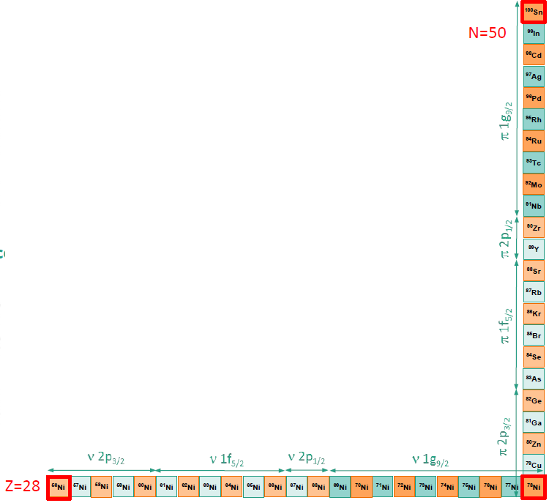
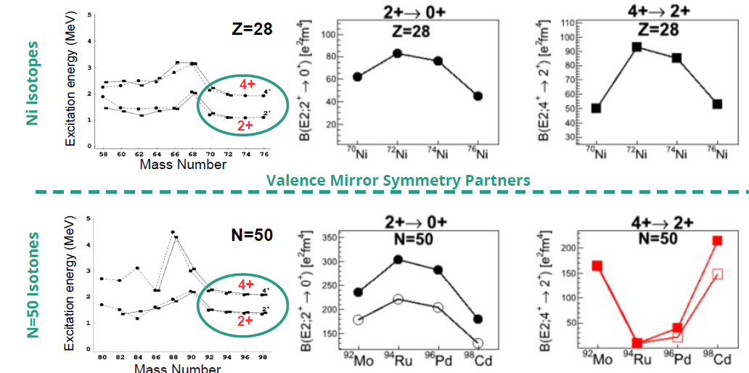
Shell evolution around ¹⁰⁰Sn
⁹²Mo and ⁹⁴Ru have similarities with Ni isotopes, filling the same orbitals than protons in N = 50 isotones.
Lisetskiy et al PRC (2004) :
courtesy of R. Perez Vidal
Notes:
Indeed, the energy of the lowest 2+ and 4+ states are quite similar for 70􀀀76Ni isotopes to those in 92Mo,94Ru,96Pd and 98Cd.

Slide 20
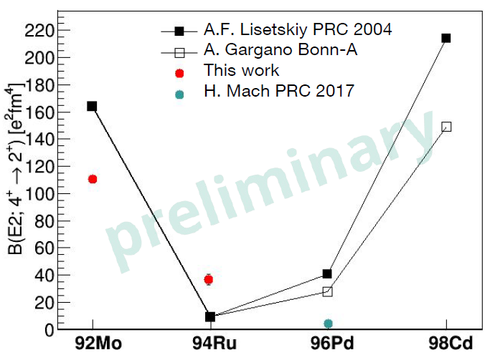
Shell evolution around ¹⁰⁰Sn
See also M. Siciliano’s results on Sn isotopes
courtesy of R. Perez Vidal

Slide 21
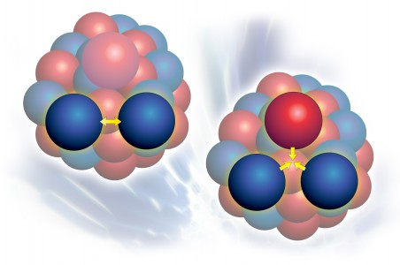
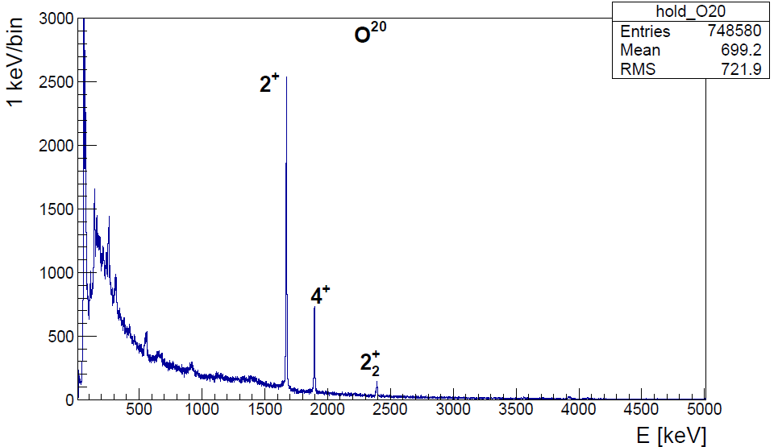
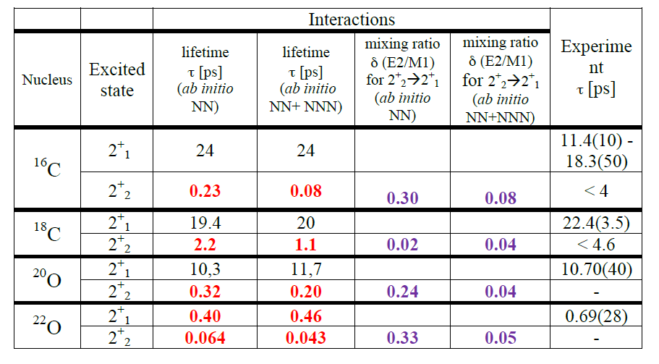

Lifetime in n-rich O and C
S. Leoni, B. Fornal, M. Ciemala et al.,
Lifetime measurement in the non-yrast excited states of neutron rich C and O isotopes. Branching ratio and E2/M1 using the PARIS LaBr3 array
The 2⁺₂ state corresponds to a neutron (d_{5/2})³(s_{1/2})¹ configuration
C. R. Hoffmanu et al .PRC 85, 054318 (2012)
T. Otsuka PRL 105, 032501 (2010)
¹⁹⁸Pt/Tl(¹⁸O, ^{16,18}C, ²⁰O)
n(d_{5/2})⁴
n(d_{5/2})³ (s_{1/2})¹

Slide 22
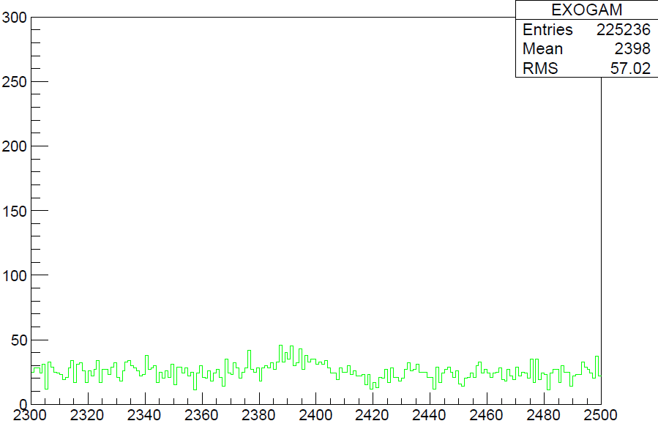
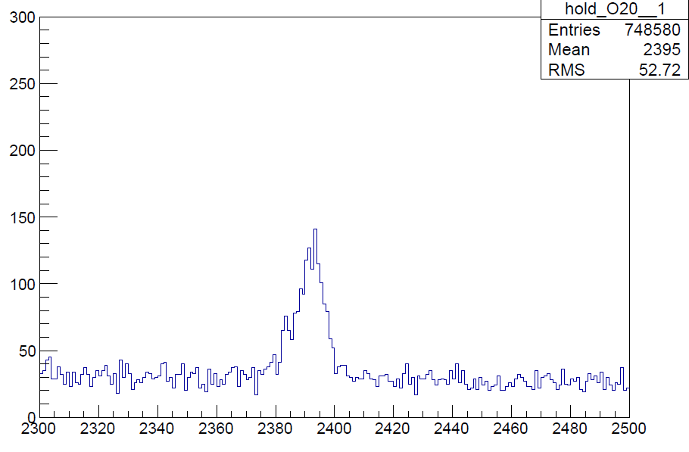
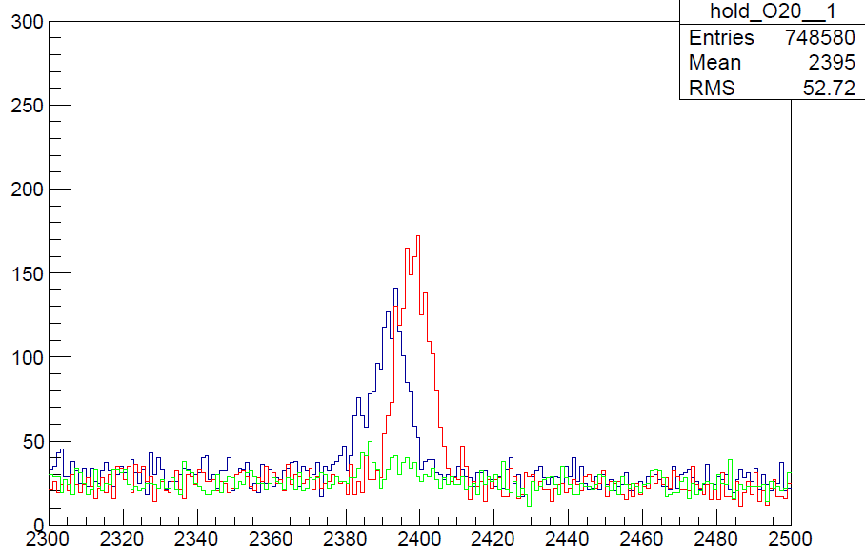
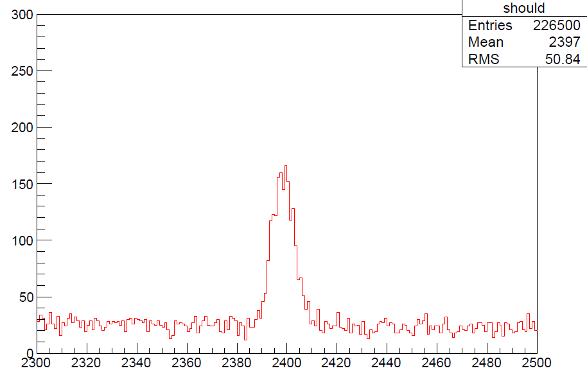
Performances of AGATA
AGATA-VAMOS++ (simulated if lifetime > 1 ps)
The lifetime is short; below ps
Ab-initio are in the good order of magnitude
EXOGAM-VAMOS (simulated)
AGATA-VAMOS++ (measured)
second 2⁺ → 2⁺ 2.4 MeV
2⁺ → G.S. 1.6 MeV
2⁺₂→2⁺₁
0.004
Preliminary
0.003
0.002
τ = 100 fs
CENTROID SHIFT
τ = 150 fs
0.001
τ = 200 fs
0.000
τ = 11 ps
130
140
150
160
170
Theta [degree]
S. Leoni, B. Fornal, M. Ciemala et al.,

Slide 23
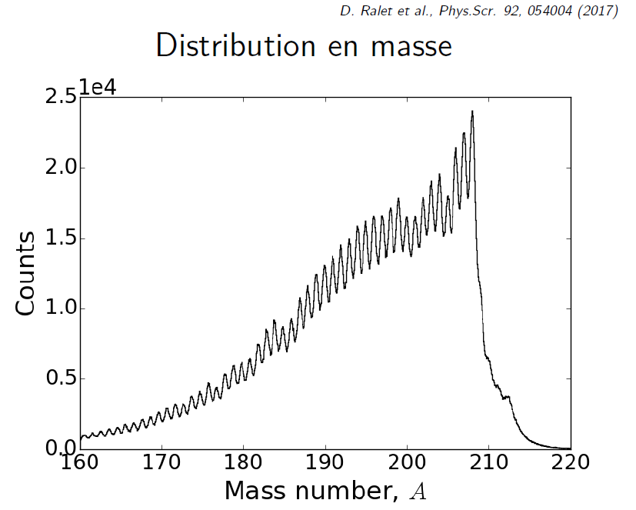
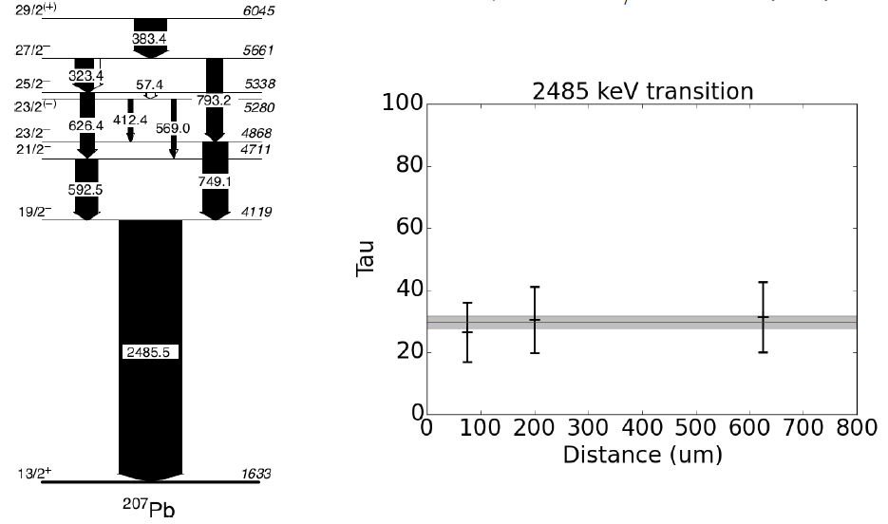
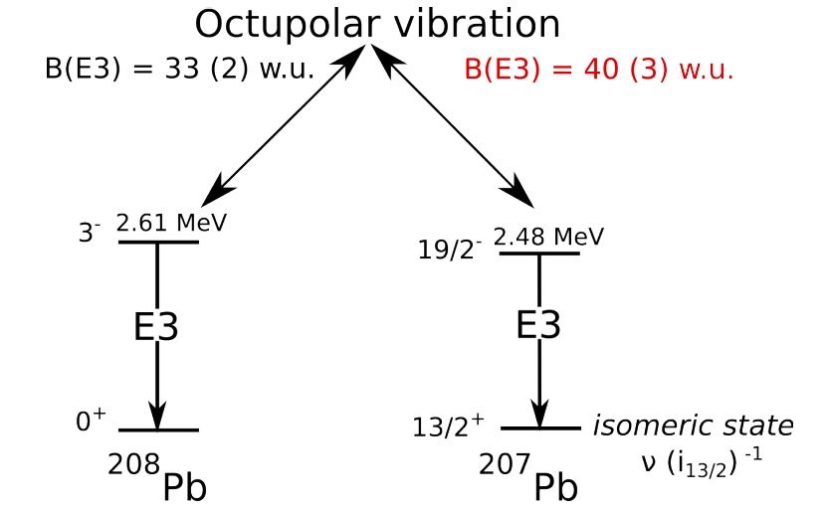
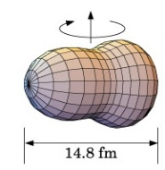
Shell evolution around ²⁰⁸Pb
Study of the two-phonon vibrational states in the ²⁰⁸Pb region
Case of the ²⁰⁷Pb ν(i_{13/2})⁻¹ state band structure
D. Ralet in preparation
D. Ralet et al., Phys.Scr. 92, 054004 (2017)

Slide 24
MUGAST campaign 2019
Nucleons transfer spectroscopy using the SPIRAL1 ISOL beams
Nuclear Astrophysics: spectroscopic factors of relevant resonances for nucleosynthesis studies in radiative capture reactions: (⁶Li,d), (³He,d), (d,p)
Shell evolution:
spectroscopic factors, s.p. energies (d,p), (t,p), (³He,n)
n-p pairing, clusterization
Lifetime measurement after single nucleon transfer
2018 call for proposal
PAC meeting in November
Start of the campaign in April 2019
Campaign manager : M. Assié (IPNO)

Slide 25
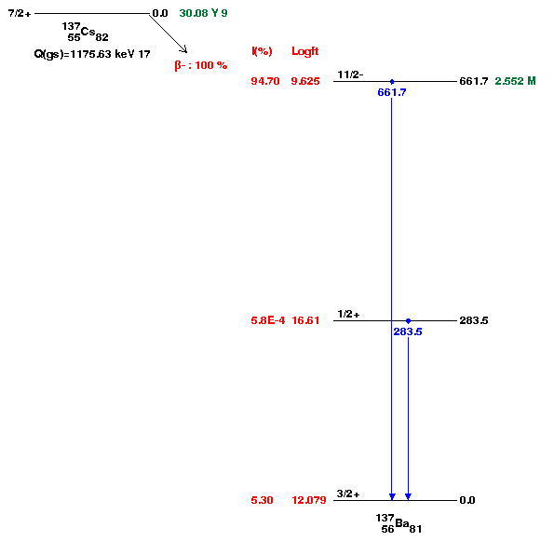
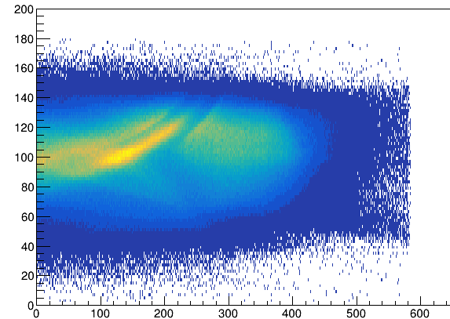

Double Gamma decay
D. Brugnara, A. Goasduff, JJ Vailente-Dobon et al.
Can decay as a cascade of two gamma (P ∞ 2 10⁻⁶ ) with a dominant M2-E2 and a minor E3-M1 contribution
The main point is to discriminate the real double gamma event candidates on top of the “background” of the Compton scattering.
“Tracking” should be able to reconstruct the Compton scattering and leave only candidate for the double events … Proof of principle ?
C. Walz et al., Nature volume 526, pages 406–409 (2015)
30-31 May 2018 : 49h of Continues Data
Compton not reconstructed
After Tracking – OFT Std
Prompt Track1+Track2 =
661 ± 1.5 keV, nbTrack=2
Compton Angle (Track1,Track2)
Vs Diff (ETrack1, ETrack2)
Remain to be understood in details
< 0.007% of events
¹³⁷Cs

Slide 26



Experiments performed in 2015-2018 at GANIL with AGATA
Search for Double Gamma decay in ¹³⁷Cs source
Reaction mechanism : Fission of Light Hg
Octupole – Quadrupole correlation in ¹¹²Xe
²⁰⁸Pb
Studies of excited states in ^{102,103}Sn
Octupole correlation in ²⁰⁷Pb
Evolution of collectivity around N=50: lifetime measurements ^{104,106}Sn
Exploration of alpha-cluster : the unique case of ²¹²Po (²⁰⁸Pb + α)
Evolution of collectivity around N=50: lifetime measurements ⁹⁴Ru
Shape transition in the neutron-rich W isotopes
Search for isoscalar pairing in the N=Z nucleus ⁸⁸Ru
Transition Quadrupole Moments in ^{166,168}Dy.
¹⁰⁰Sn
i_{13/2} single particle state in ¹³³Sn and high spin in ¹⁰⁸Zr
Isospin Symmetry Breaking in the A=63,71 mirror nuclei
¹³²Sn
Shape evolution in neutron rich fission fragments in the mass A~100 region
⁶⁸Ni
⁷⁸Ni
Shell evolution around N=50: ⁸¹Ga spectroscopy
Evolution of collectivity around N=52: lifetime measurements in ^{83,84}Ge
Evolution of collectivity around N=40: lifetime measurements in ^{73,75}Ga
⁴⁸Ca
Evolution of collectivity around N=40: lifetime measurements in ⁶⁴Fe
Evolution of the shell structure in the region of neutron-rich Ti isotopes
Lifetime measurements of excited states in neutron-rich C and O isotopes
The lifetime of the 7.786 MeV state in ²³Mg as a probe for classical novae models

Slide 27
Conclusion
AGATA is operated since 2014 at GANIL and 22 experiments have been performed
4 Papers published (2015-2016 data)
1 Submitted (2015 data)
5 Papers in preparation (2015, 2016 and 2017 data)
1Technical papers submitted
1Technical papers in preparation
16 Experiments under analysis (2016-2018)
3 PhD defended in 2017 and 7 in preparation using GANIL data
The number of detectors is increasing and stability of the system is improved year after year
Successful NEDA-DIAMANT-AGATA campaign in 2018
Many results are coming all along the nuclear chart for many different physics topics
Publications are important for GANIL and AGATA
Many thanks to all AGATA collaborators !
Notes:
4 Papers published (Kim, Dudouet, Klintefjord , Clément)
1 submitted (Delafosse)
4 in Preparation ( Damian, Siliciano, Duduouet2, Perez, Navin)
2 Technical in Preparation (Li, Michelagnoli)
(2016 - Alina, Celikovic, Navin, Michelagnoli)(2017 – Jungclauss, Regan, John, Korten, Leoni, Camaano, Schmitt ) (2018 Lenzi, Nyberg, Bo, Boso, Clement)
PhD (Klintefjord*, Delafosse, Siciliano*, Perez*, Alina, Celikovic’student, Alvaro, Dupont, Saba, MLuce)

