Slide 1

AGATA@GANIL
Status report
AGATA week 2019

Slide 2
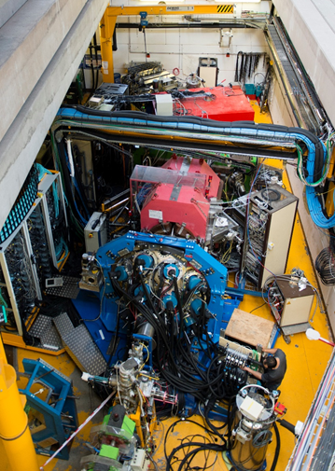
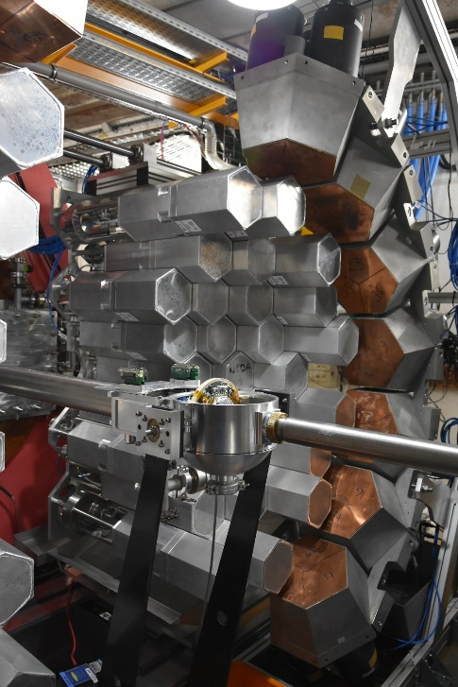
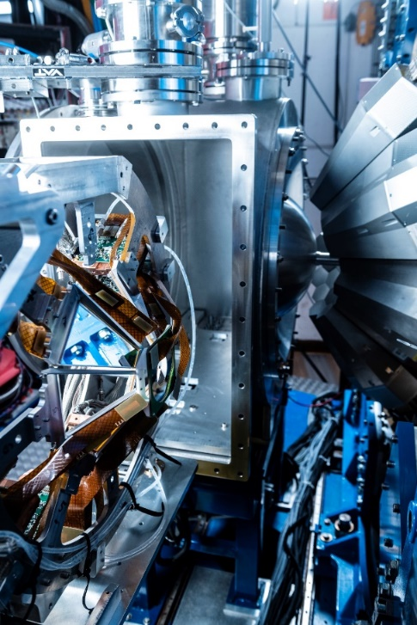
AGATA campaigns@GANIL
2015-2017
VAMOS Campaign
24-35 capsules
2018
NEDA/DIAMANT
Campaign
35 capsules
2019-2020
MUGAST Campaign
41-44 capsules
2021
?? Campaign
~ 44 capsules

Slide 3

The GANIL Campaign organization
The AGATA campaign at GANIL has been extend to 2017, 2018, 2020, 2021.
5th PAC in November 2018: call for MUGAST-AGATA-VAMOS experiments only
    5 MUGAST-AGATA-VAMOS experiments proposed
    2 experiments approved (E. Clément/A. Goasduff & A. Gottardo/M. Assié)
6th PAC 17-18 October 2019: call for MUGAST-AGATA-VAMOS experiments only
    3 MUGAST-AGATA-VAMOS experiments only proposed due to Spiral1 beam test canceled: ²⁴Ne(⁶Li,d), ²⁶Al(d,p) and ⁴⁷K(d,p)
899 UT have been already approved spanned on 33 experiments
709 UT have been spanned on 25 experiments
Backlog is
3 NEDA (+ DIAMANT, PARIS, FATIMA) 66 UT
4 VAMOS 92 UT
1 MUGAST 32 UT
2020 beam time should be ~3 months; starting first week of February
The 7th and LAST PAC in 2020 for the 2021 beam time is to be defined

Slide 4
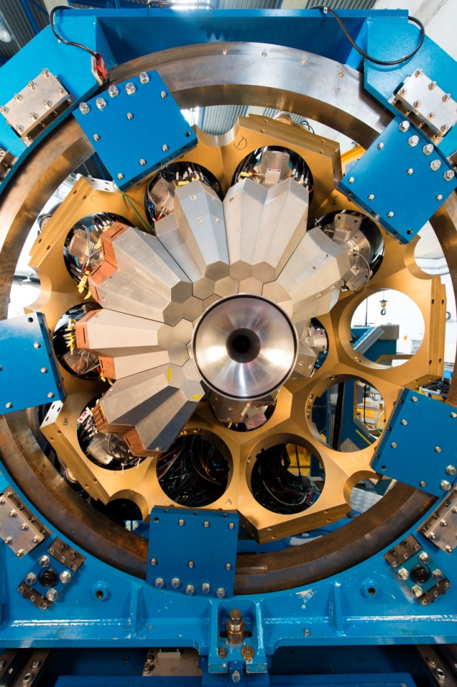
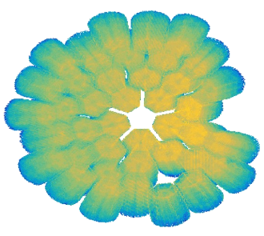
2019 Technical achievements
Operation
*We ran 25 experiments since 2015
    *In-beam data since 2014, the campaign is approved until 2021 (8 years operation )
    *Detectors maintained cold since October 2014
    *41 Detectors took data in 2019 in unstable conditions**
Upgrades
* DCOD upgrade with trigger soft, on-line event builder and AGASPY watchers
* 7 new GGP channels were installed and put in operation from the 2nd production batch, 5 more are installed in the last workstation delivery batch. 24 ATCA** channels + 23 GGP channels are delivered at GANIL
* Delivery of the last batch of workstation for the next GGP production
∗Several maintenance and re-ordering in the DAQ-box
*Migration of the Muscade client to Java OpenJDK for the Autofill
*Continus upgrades of the data-analysis tool (femul upgrade, Cubix, AGATASPY, GRID …)
*All the hardware is delivered at GANIL for the 1π
41 detectors on-line in 2019
AGATA@GANIL

Slide 5
Cumulative [TB]
0.5 PB !!
2019
2018*
2017
2016
2015
*Without Traces
** Commissionning
2014**

Slide 6
2019 Technical Problems Summary
Relatively easy GTS and DAQ coupling between AGATA-VAMOS-MUGAST
EXOGAM2 TP is not 100% reliable at > 25kHz/core due to non-ordered request from GGP’s.
The 2019 run was performed in TriggerLess
Aging of the V0 electronic (several digitizers with sever problems and first ATCA carrier off)
2/3 of the experiments performed with the CEPH spear
GTS instabilities during the 2nd experiment (12h lifetime) solved after a complete disassembly of the GTS Tree
More and more detectors are requesting a refill before the 6h period

Slide 7
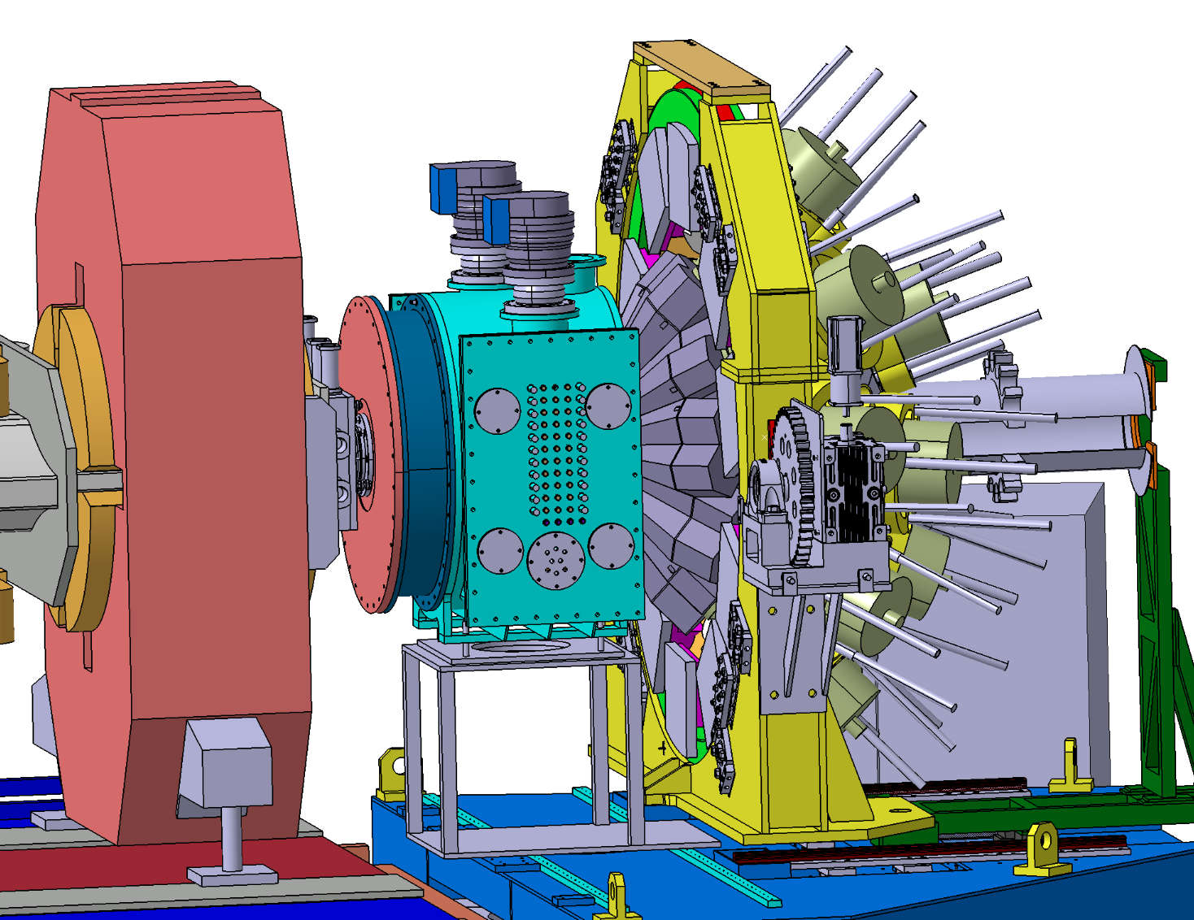
The MUGAST–AGATA-VAMOS setup
AGATA
Spiral1
radioactive
beams
VAMOS
MUGAST
BTD

Slide 8
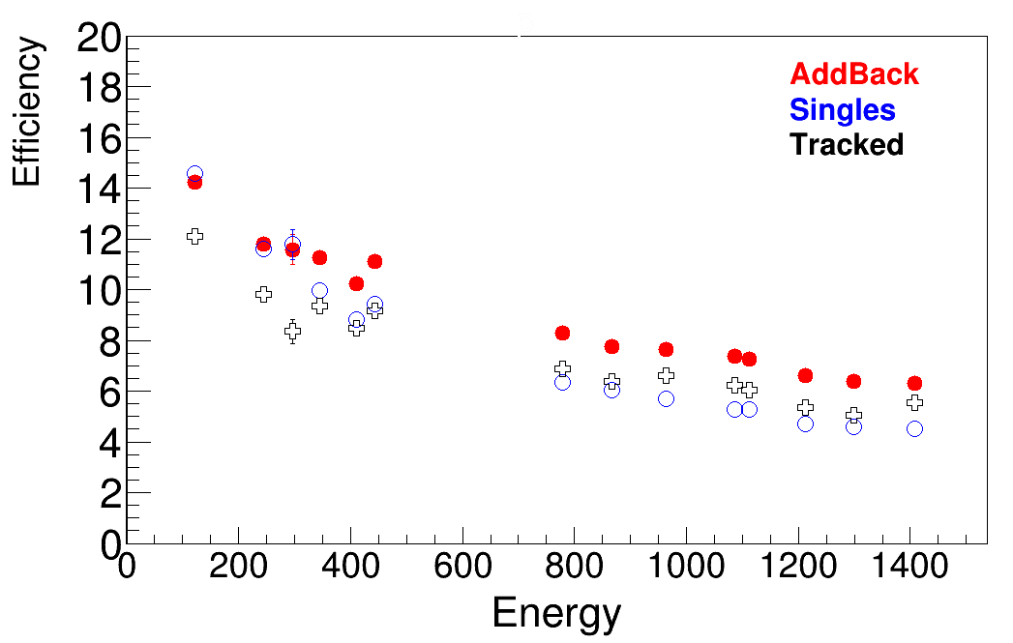
Commissioning / E744 efficiencies : 37 capsules
AGATA is approached by 51 mm for the MUGAST campaign
Efficiencies @ 1.4 MeV
AddBack 6.3(1)%
Tracked 5.5(1)%
According to G4 with adjusted crystal relative efficiencies
No loss at low energy was measured due to MUGAST

Slide 9
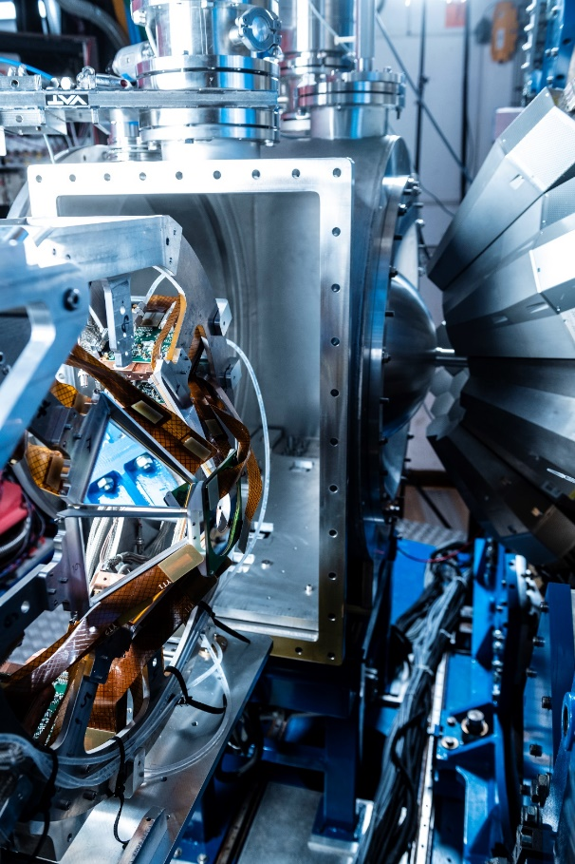
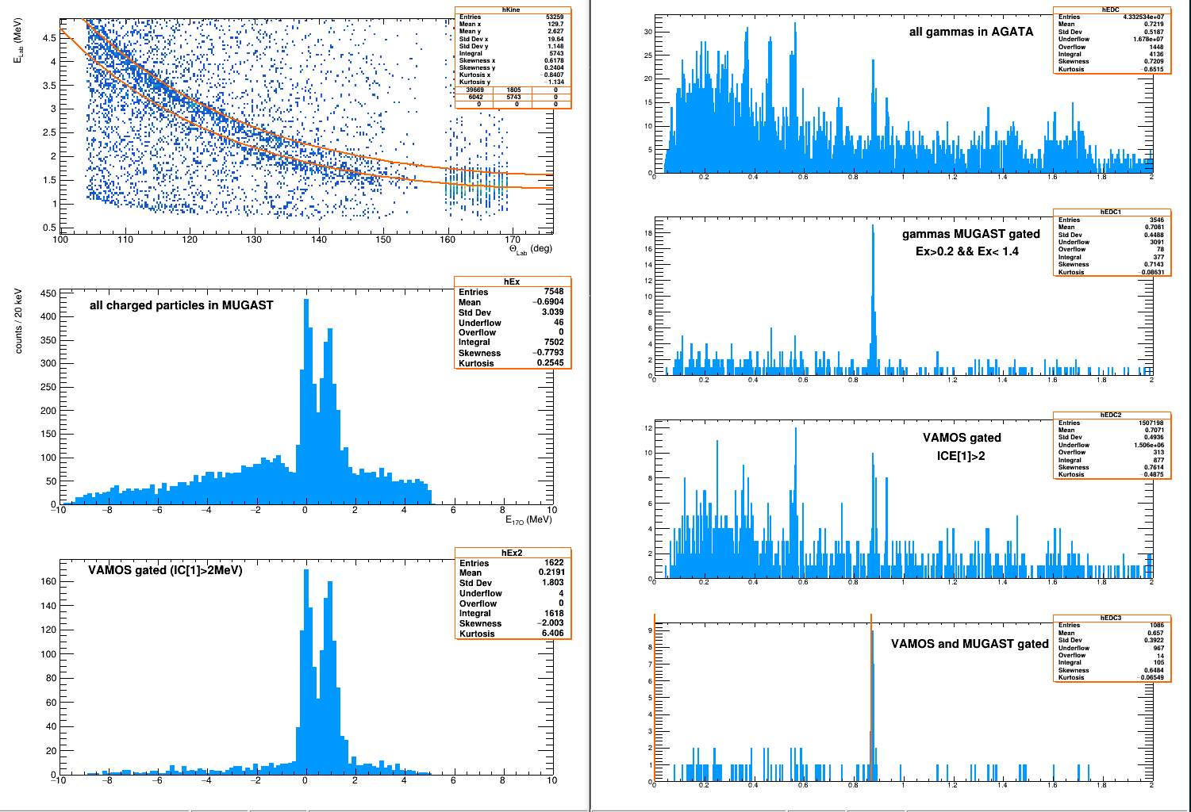

MUGAST commissioning
¹⁶O(d,p)¹⁷O commissioning
AGATA in full trigger less
→ In-beam efficiencies
AddBack efficiencies
867 keV:: 152Eu= 7.7(2)%.
870 keV ¹⁷O = 7.8%.
Geant4 = 7.5%

Slide 10
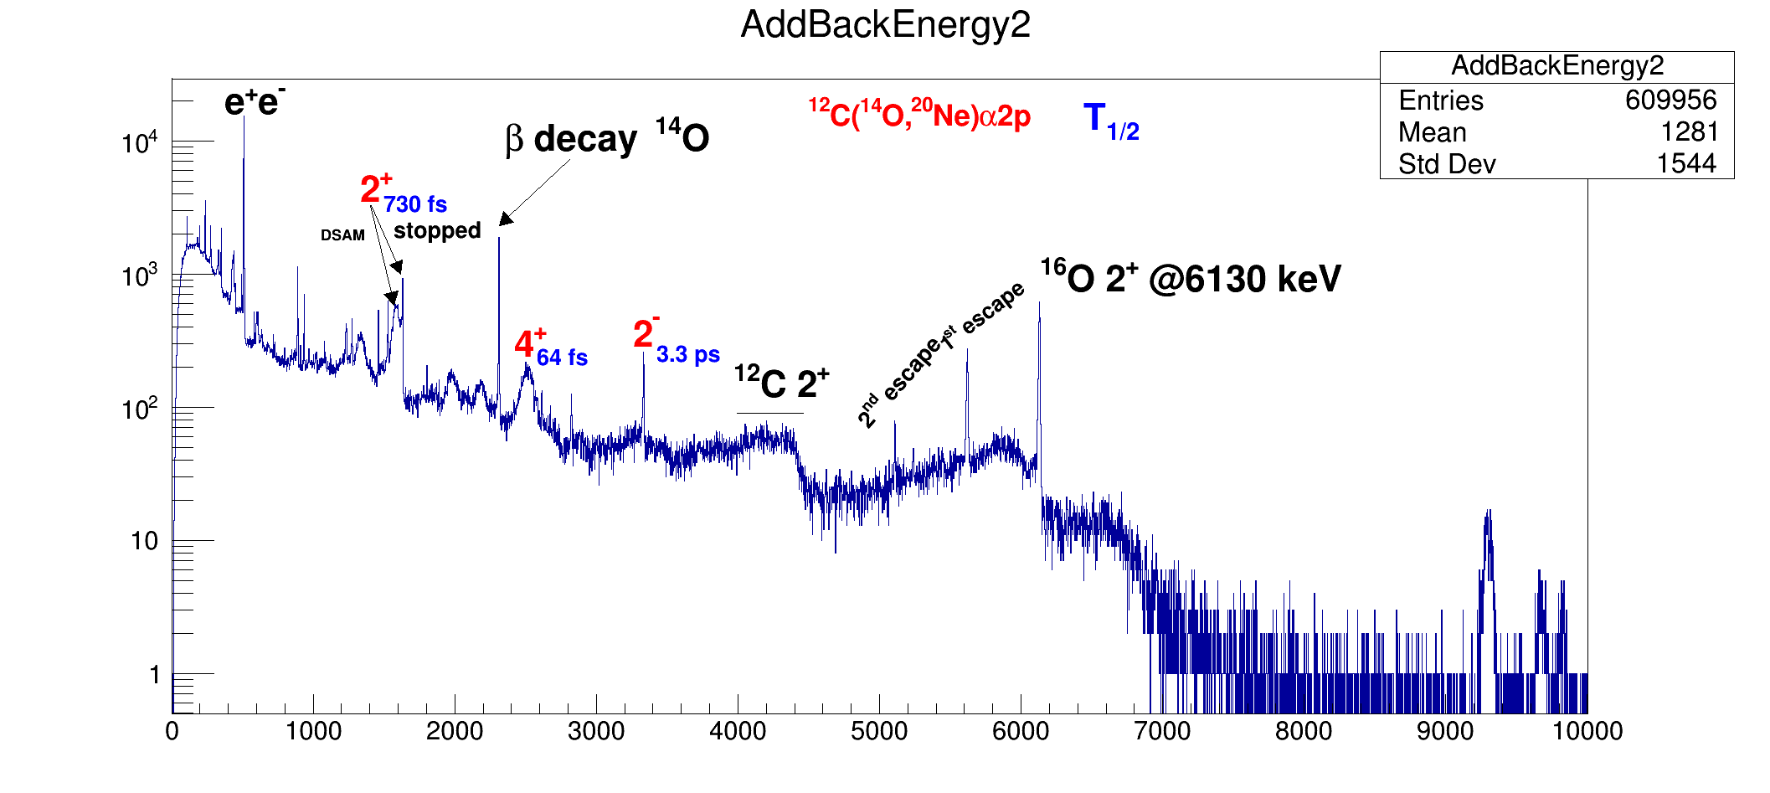
MUGAST campaign 2019
UNBOUND STATES
Above barrier narrow resonances in ¹⁵F
¹⁴O(p,p’) inelastic scattering
- Search for new negative parity states
Type of two-proton decay
Gamma transition within unbound nucleus (extremely rare)
I. Stefan (IPN), F. de Oliveira (GANIL)
→ Expected γ-rays not seen (would have been a real discovery)
fs scale sensitivity
Eu energies calibration calibrate well the 6.1 MeV line of ¹⁶O

Slide 11
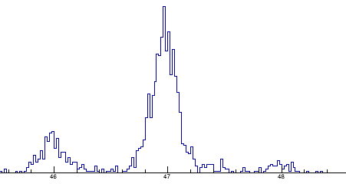
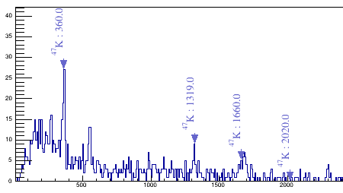
MUGAST campaign 2019
SHELL MODEL
Is there a problem with protons in N=28 nucleus ⁴⁶Ar ?
⁴⁶Ar(³He,d)⁴⁷K to probe proton WF and study vacancies in s_{1/2} and d_{3/2} shells.
³He cryogenic target !
A. Gottardo INFN, M. Assié IPN
K masses isotopes in coincidence with particle at backward angle
46
47
48
s_{1/2} state
d_{5/2} state
Cubix®

Slide 12
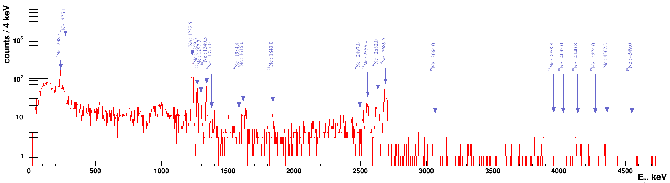
MUGAST campaign 2019
NUCLEAR ASTROPHY.
Determining the α+¹⁵O radiative capture rate
¹⁵O(⁷Li,t)¹⁹Ne indirect measure
Important reaction for breakout from Hot-CNO cycle to rp-process in Type I X-ray bursts
C. Diget (York), N De Séréville (IPN)
Expected transition not seen
It is a result, ie that the C_{s}α is small
Cubix®
AGATA spectrum in triple coincidence with MUGAST and ¹⁹Ne

Slide 13
Recent Publication from past campaigns

Slide 14
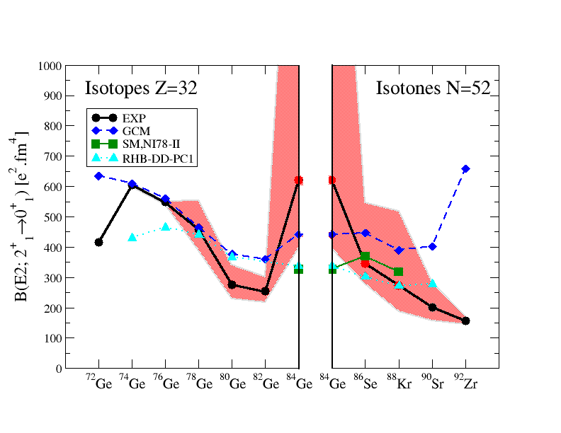
The quenching of the N=50 gap towards
⁷⁸Ni can be investigated looking at the
Spectroscopy of excited states involving particle-hole excitations across the N=50 gap
First lifetime of excited states measured in ⁸⁸Kr
Lifetime measured with better accuracy in ⁸⁶Se
First lifetime measured in the very exotic ⁸⁴Ge
Unexpected enhancement of collectivity in ⁸⁴Ge
Sudden rise of collectivity after the N=50 shell closure
… in contradiction with shell model calculation
⁸¹Ga spectroscopy
J. Dudouet et al, Phys.Rev. C 100, 011301 (2019)
C. Delafosse et al., Phys.Rev.Lett. 121, 192502 (2018)

Slide 15
Effects of one valence proton on seniority and angular momentum of neutrons in neutron-rich ^{122–131}Sb isotopes
LSSM calculations in the ¹³²Sn vicinity constrained by combined prompt-spectroscopy, isomer spectroscopy and related B(E2) in Sb isotopes
Modifications of several components
of the shell-model interaction were introduced to obtain a consistent agreement in neutron-rich Sn and Sb isotopes
¹³¹Sb
S. Biswas et al. Phys. Rev. C 99, 064302 (2019)

Slide 16
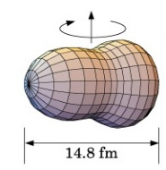
Shell evolution around ²⁰⁸Pb
Study of the two-phonon vibrational states in the ²⁰⁸Pb region
Case of the ²⁰⁷Pb ν(i_{13/2})⁻¹ state band structure
B(E3) = 40(8) W.u
Evidence of octupole-phonons at high spin in ²⁰⁷Pb
The measured reduced transition probability is compatible with a contribution from the two-to-one-octupole-phonon E3 transition.
Further information on the double-octupole-phonon state can be obtained by a more precise lifetime measurement of the 19/2⁻state in ²⁰⁷Pb
D. Ralet et al Physics Letters B 797 (2019) 134797

Slide 17
Cumulative number of publications (Technical excluded)
Up-to-date 1st of September 2019
#Years after the first experiment
→ On good track

Slide 18
Conclusion
AGATA is operated since 2014 at GANIL and 25 experiments have been performed
The number of detectors is approaching the 1π
In 2019, we observed a clear aging of the electronic and detectors
Successful start of the MUGAST-VAMOS-AGATA campaign in 2019 to be continued in 2020
Many results are coming all along the nuclear chart for many different physics topics
Publications are important for GANIL and AGATA
Many thanks to all AGATA collaborators !

