Slide 1


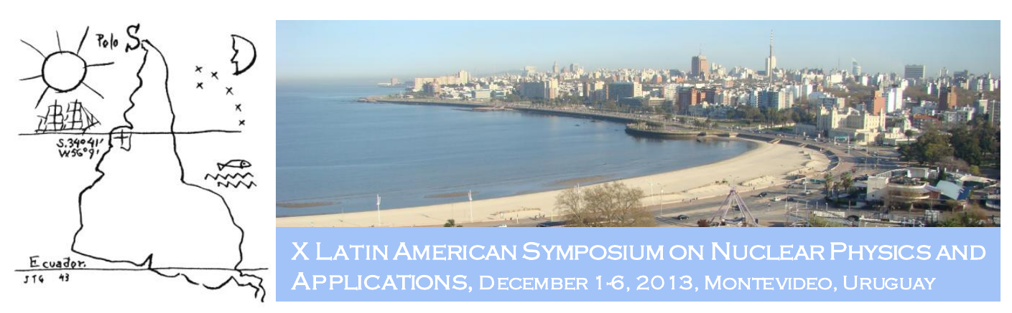

In-beam γ-ray Spectroscopy at Relativistic Energies
First Results from the PreSPEC-AGATA Campaign
D. Rudolph
Lund University
On behalf of the PreSPEC-AGATA Collaboration

Slide 2
The PreSPEC–AGATA Campaign:
Research Combined with FAIR Developments
D. Rudolph
Lund University
On behalf of the PreSPEC-AGATA Collaboration

Slide 3
The PreSPEC-AGATA Campaign
The FAIR Context
γ-ray Spectroscopy at Relativistic Energies
Commissioning 2012
Performed Experiments 2012
(No Experiments in 2013)
Planned Experiments 2014
Summary & Outlook

Slide 4

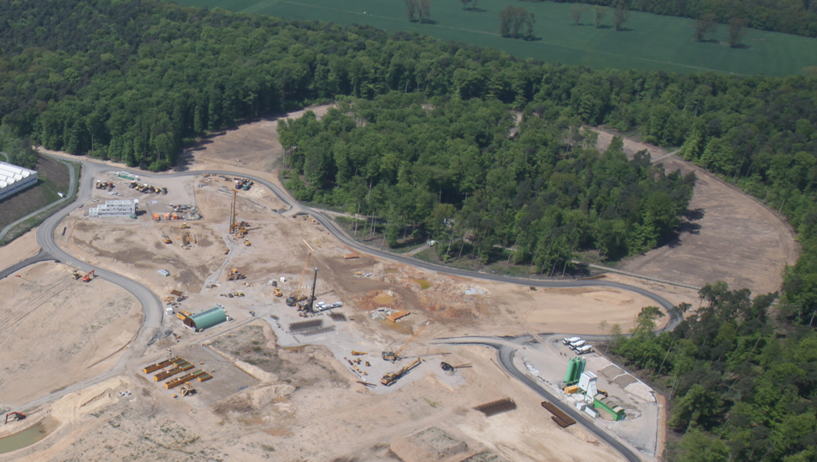
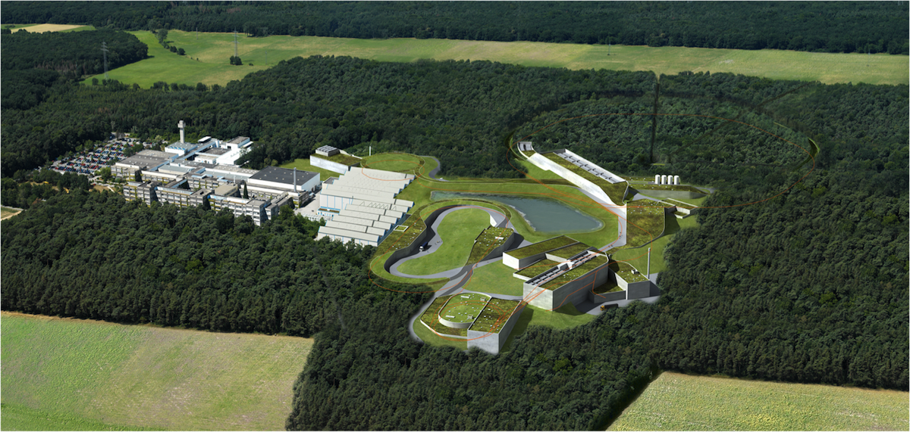












The FAIR Context
Facility for Antiproton and Ion Research in Europe GmbH.
ESFRI approved Large Scale Facility with four science pillars.
Convention signed by shareholder countries in 2010.
Placed at the GSI site in Darmstadt, Germany.
Modularised Start Version (MSV, 1000 MEUR) to be completed 2019.
Areal view May 2013
WEB cam at the FAIR site
Atomic, applied and plasma physics – APPA ions, antiprotons
http://www.fair-center.eu/
  Nuclear matter - CBM
  relativistic nuclear collisions
Hadron physics - PANDA
antiproton beams
Nuclear structure, astrophysics & reactions
radioactive ion beams
Slovenia
UK
05.05.2013
Finland
Germany
India
Poland
Romania
Russia
Slovenia
Sweden
UK
Finland
Germany
India
Poland
Romania
Russia
Sweden
France
France

Slide 5
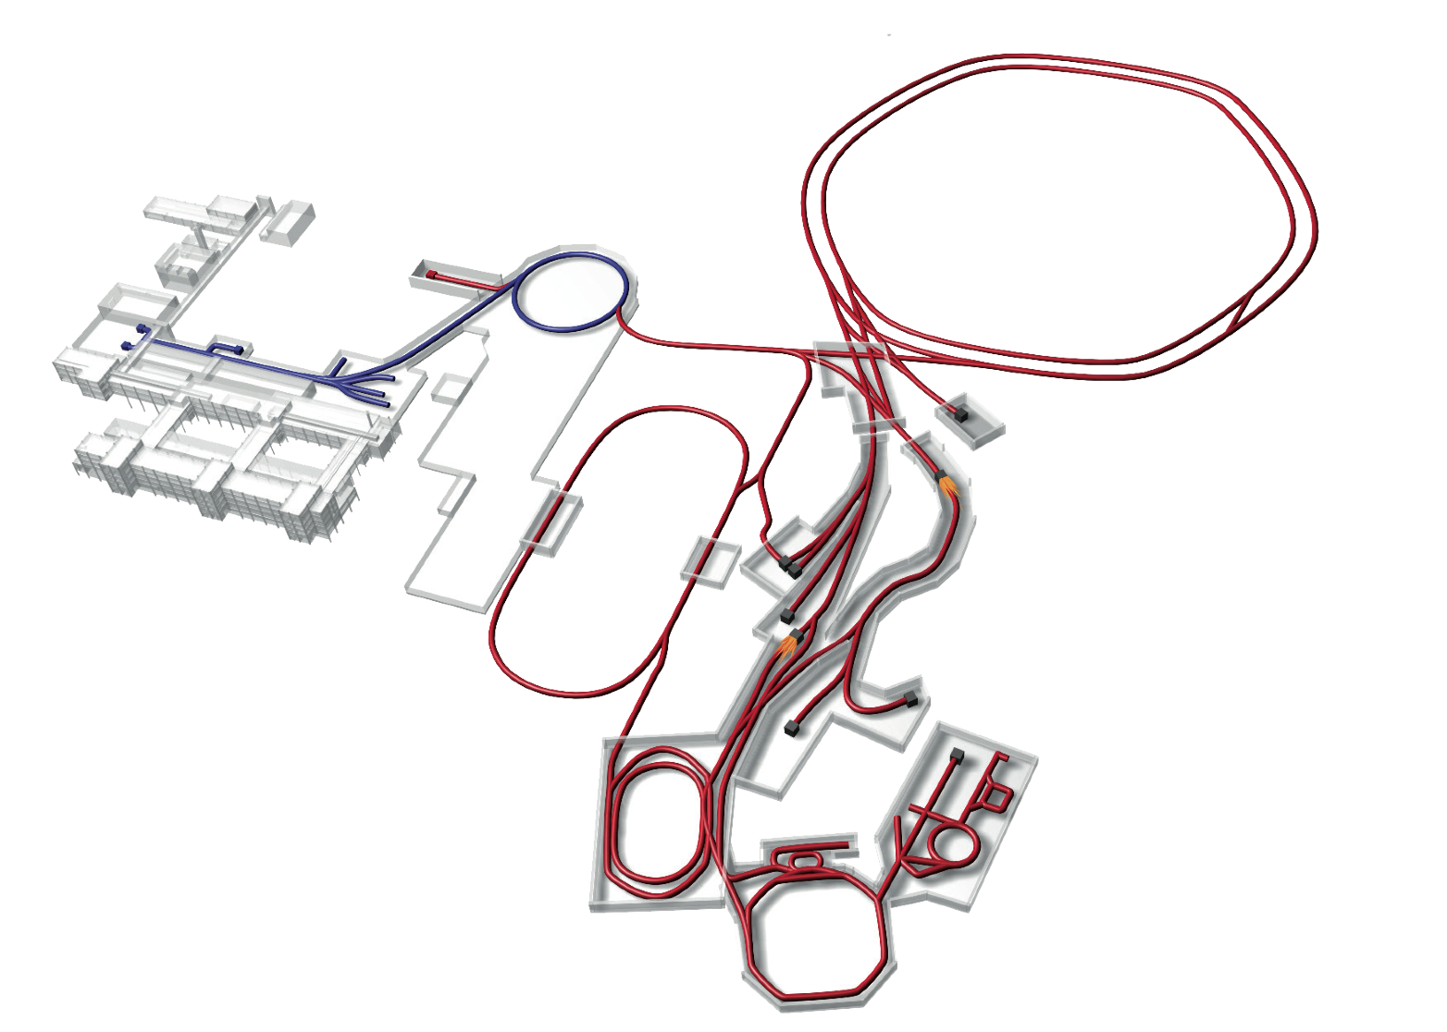
FAIR Project
p-Linac
SIS18
SIS100/300
UNILAC
HESR
Rare-Isotope
Production Target
Superconducting Fragment Separator
LEB
CR &
RESR
HEB
Cryring
NESR
100 m

Slide 6
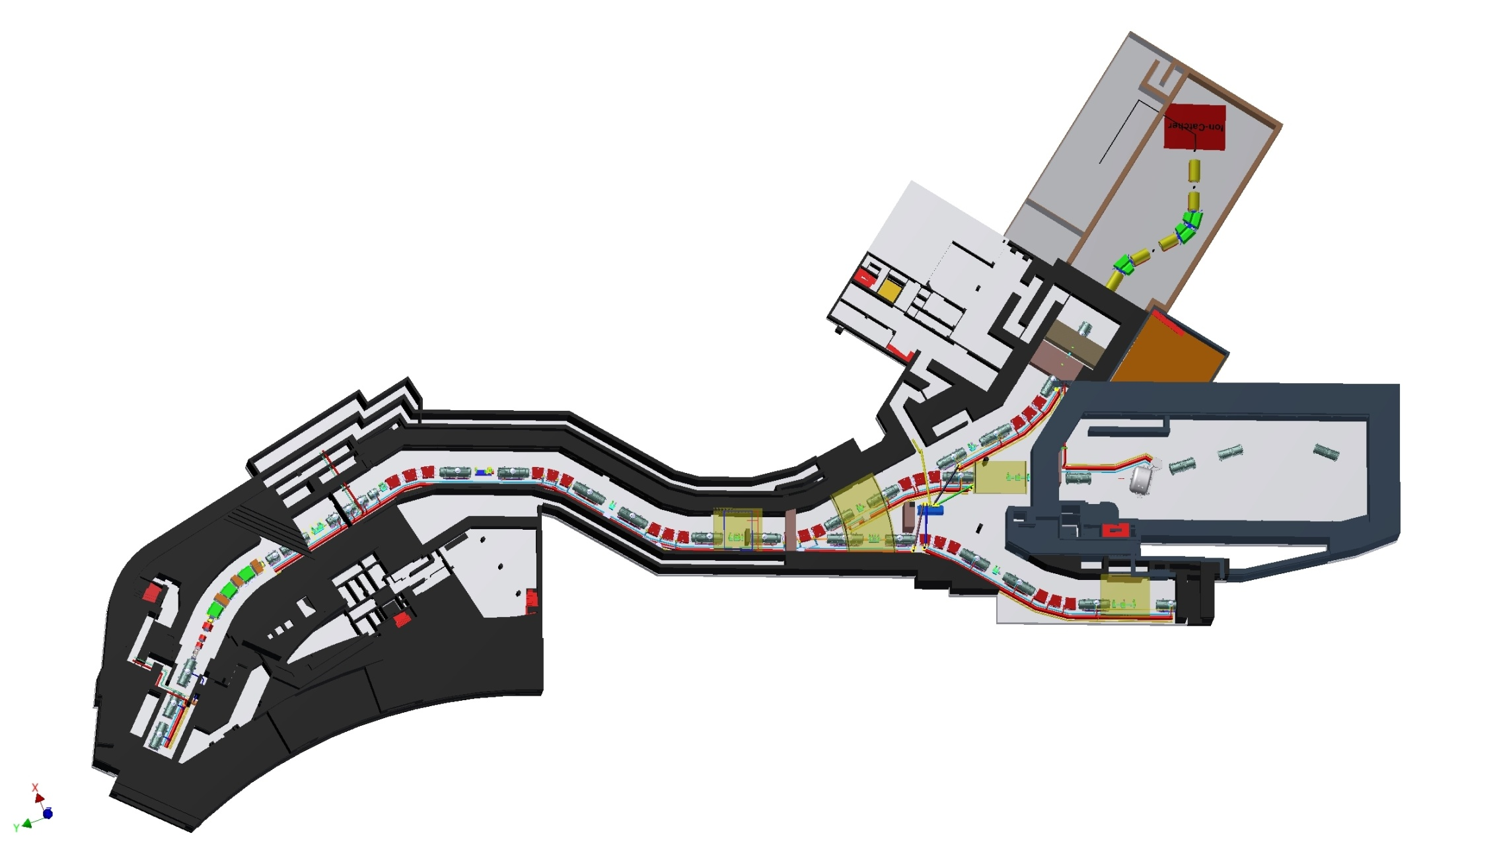
The Super-FRS, LEB & HEB
Low-energy branch (LEB):
HISPEC – High-resolution in-flight spectroscopy
DESPEC – Decay spectroscopy
MATS – Precision mass measurements
LASPEC – Laser spectroscopy
LEB
MSV:
12,40 m x 11,40 m
main separator
pre-separator
HEB R3B
50 m
ring branch
production target

Slide 7
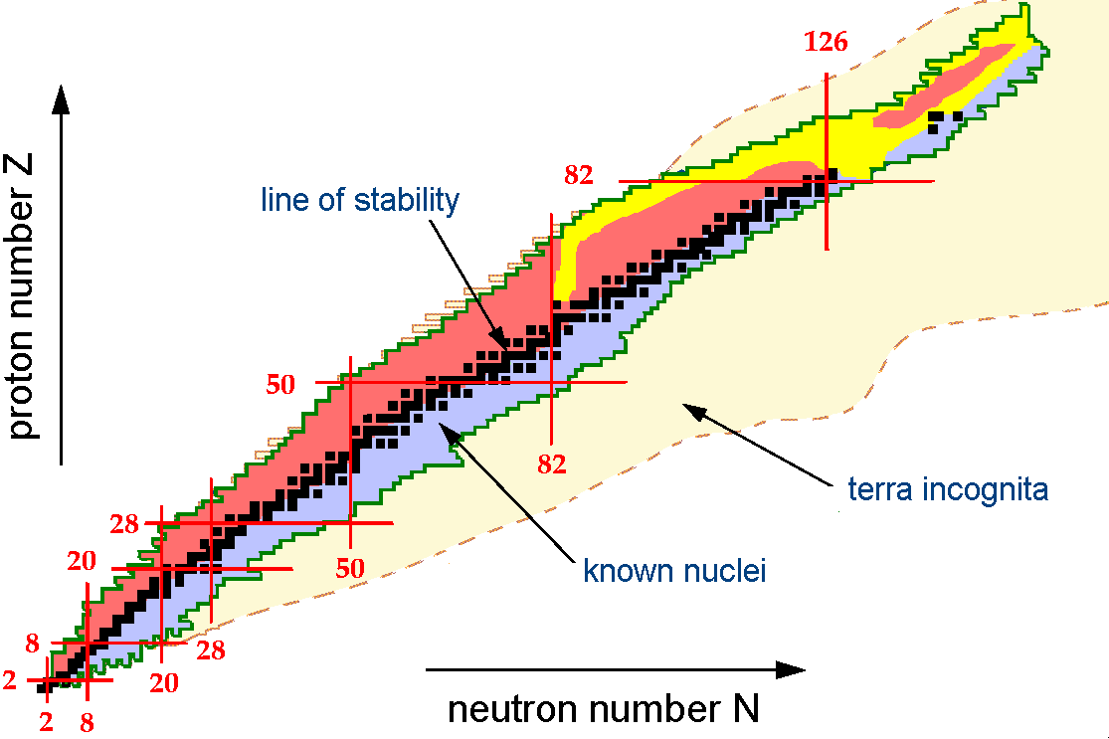
HISPEC Physics Goals
Nuclear Structure, Astrophysics and Reactions
by means of high-resolution γ-ray spectroscopy
Relativistic Coulomb excitation (Au, Pb targets)
Secondary fragmentation (H₂, Be targets)
at typically 100-200 MeV/u (v/c ̴0.4)
…
towards the outskirts of the
nuclear landscape
…
and likely inside the
NUSTAR LEB cave 2020+!

Slide 8
γ-ray Spectroscopy at Relativistic Energies

Slide 9
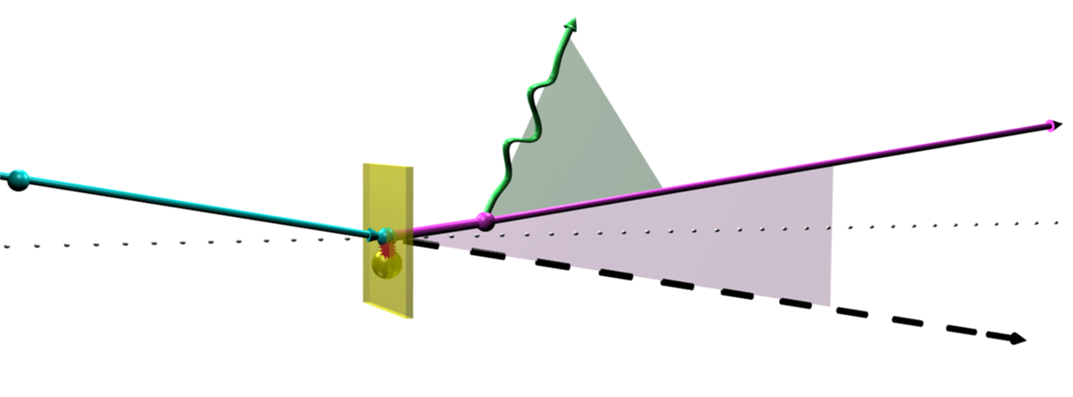
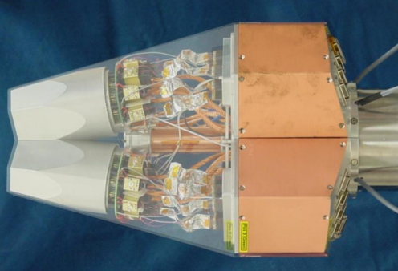

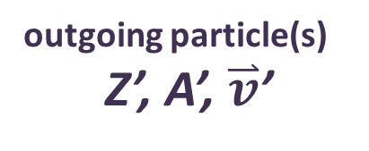
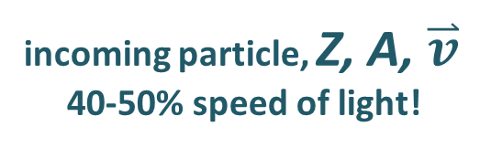
Generic: Doppler Correction
Doppler-shifted γ ray
outgoing particle(s)
Z’, A’, $\overset{⃑}{v}$’
incoming particle, Z, A, $\overset{⃑}{v}$
40-50% speed of light!
θ
origin
α
optical axis
reaction
secondary target
Handle Z, A, $\overset{⃑}{v}$:
Fragment separator with particle ID detector suite
Handle γ-ray origin and θ :
Granular segmented Germanium Tracking Array
Handle α and Z’, A’, $\overset{⃑}{v}$’:
Granular calorimeter-ToF combination or fragment spectrometer

Slide 10
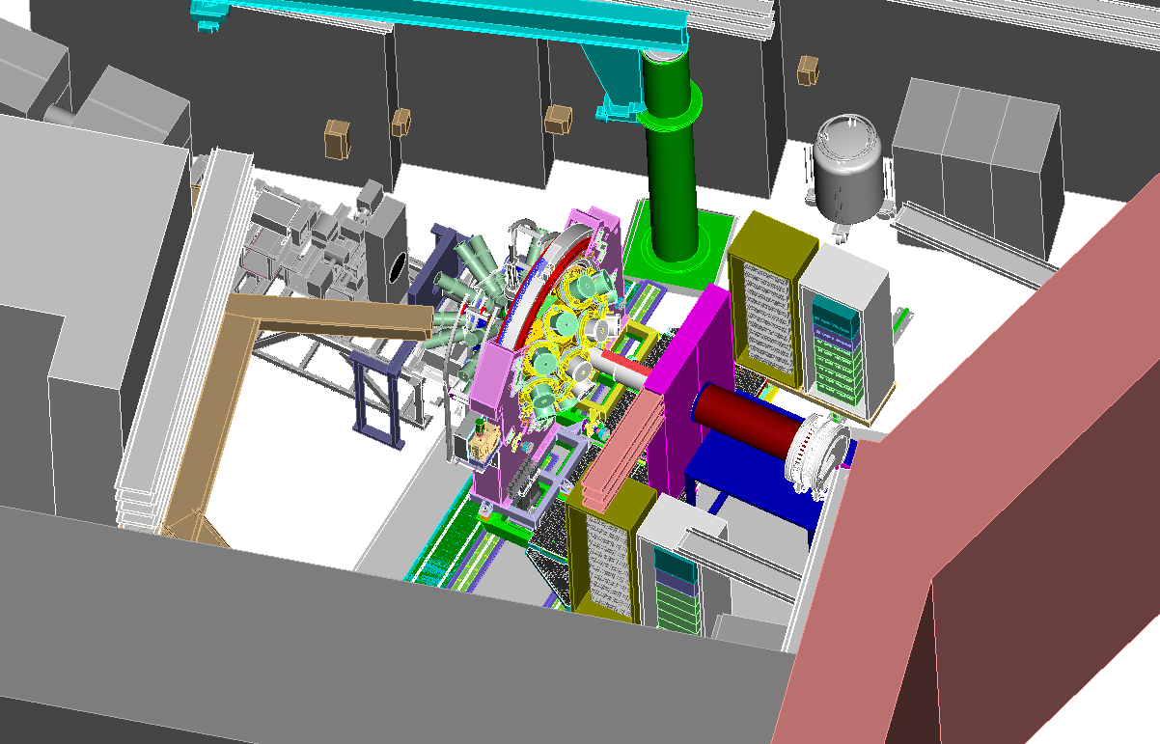

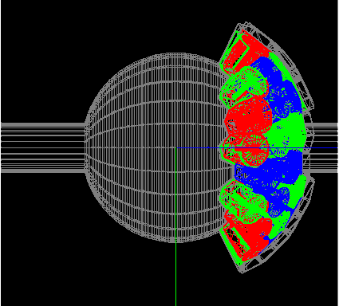
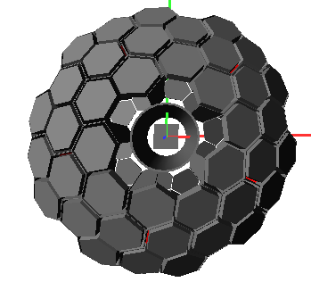
PreSPEC-AGATA Set-up = Early Implementation of HISPEC
@
relativistic radioactive heavy-ions from the GSI Fragment Separator
Up to 1GeV/A ²³⁸U, 50% v/c !
FRS-detector suite yields A and Z of incoming beam and provides x,y tracking
HECTOR+
Large BaF₂ and LaBr₃ detectors for high-energy γ rays
Advanced Gamma-ray
Tracking Array (AGATA)
up to 5 x 2+10 x 3 = 40
segmented HP Ge-crystals
d ~ 20 cm
ε_{Ph} ≈ 17%
ΔE ≈ 0.4%
Lund-York-Cologne
CAlorimeter (LYCCA)
A and Z particle-ID after secondary target by means of
x,y tracking
ΔE-E (Si-CsI)
Time-of-flight (plastic)
Notes:
10
10

Slide 11
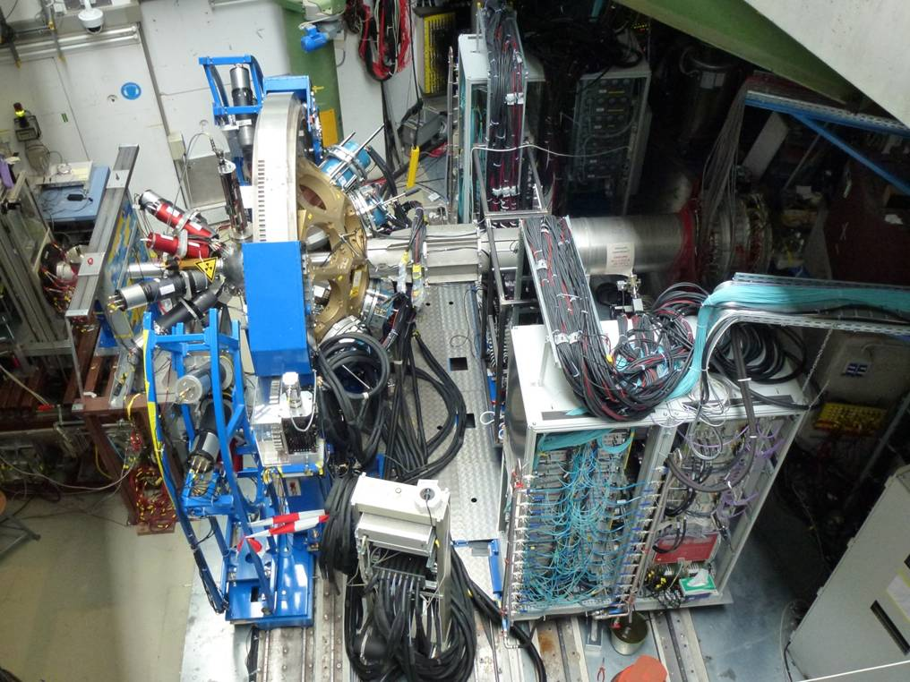
The 2012 & 2014 Set-up in Reality
HECTOR
AGATA
LYCCA
chamber

Slide 12
PreSPEC-AGATA Timeline
2010: Contract between AGATA & GSI: ≥ 12 weeks beamtime!
Discussion of 36 Letters of Intent (LoI) (Istanbul meeting)
In-beam PreSPEC experiments with EB Cluster + LYCCA-0
2011: In-beam PreSPEC experiments with EB Cluster + LYCCA-0
Plunger and LH₂ commissioning experiments
Internal LoI revision, pre-selection of first 12 physics cases
GSI G-PAC meeting, 8 expts. plus comm. approved (~7 weeks)
2012: PreSPEC-AGATA + LYCCA-1 commissioning
September: performance commissioning
October-November: 5 out of 8 experiments
>3 weeks backlog
December: Discuss (revised and new) LOIs for the 2nd round
3/2013: Spring: Internal pre-selection and evaluation 2nd round
Fall: Backlog and new experiments, about 8-9 remaining weeks
Starting 2012 … BMBF: GSI must prioritize FAIR!
4/2013: BMBF: no beamtime at GSI in 2013!
5/2013: GSI promises 4 weeks in early 2014!
9/2013: about 4 weeks realized in 2014 schedule!
11/2013: only 3 weeks left in 2014 schedule!

Slide 13
Commissioning 2012

Slide 14
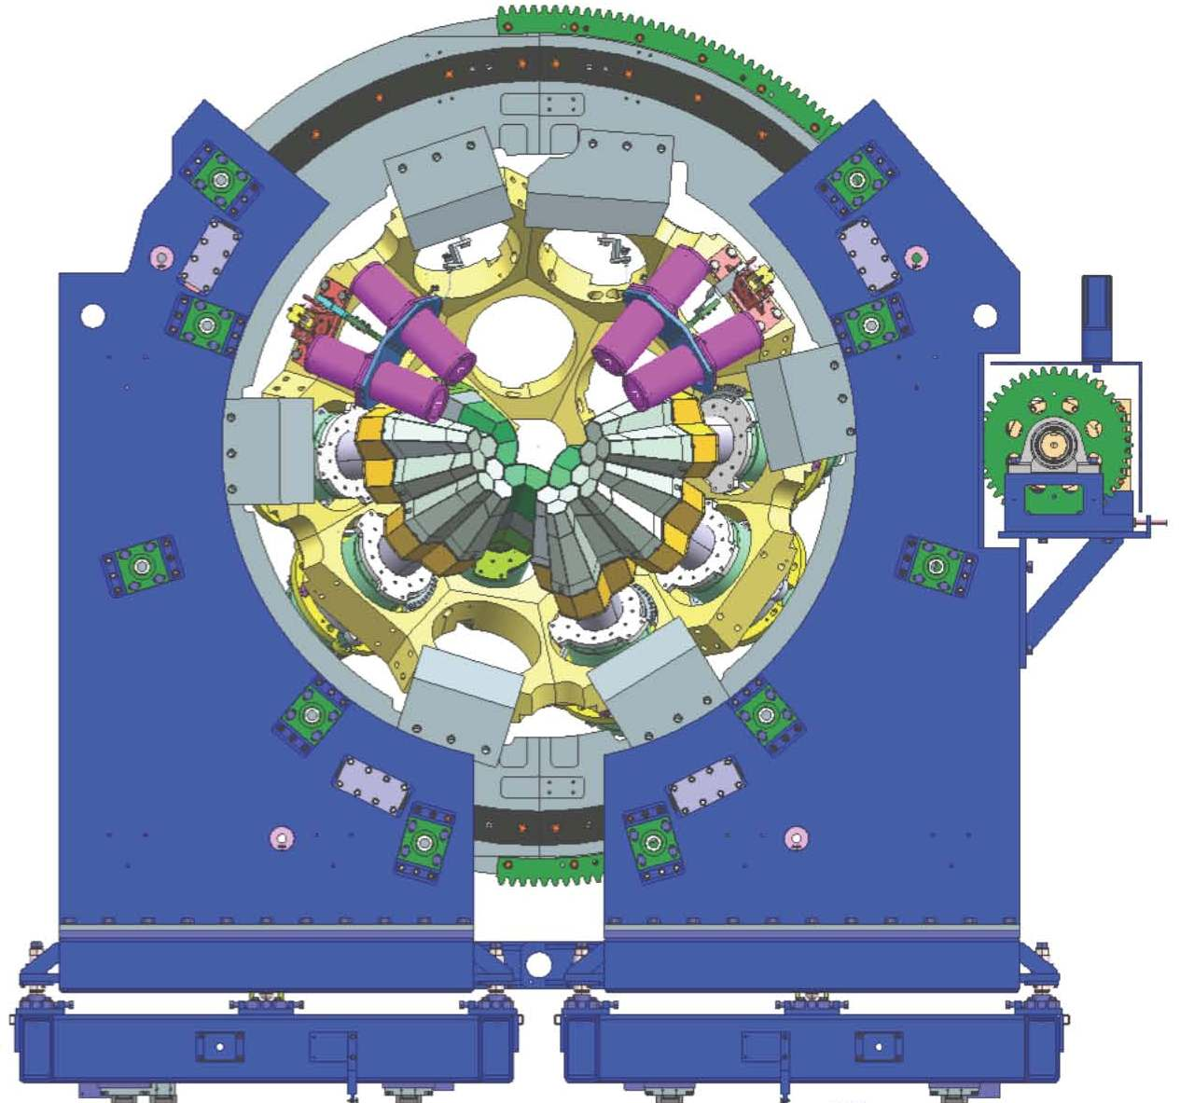

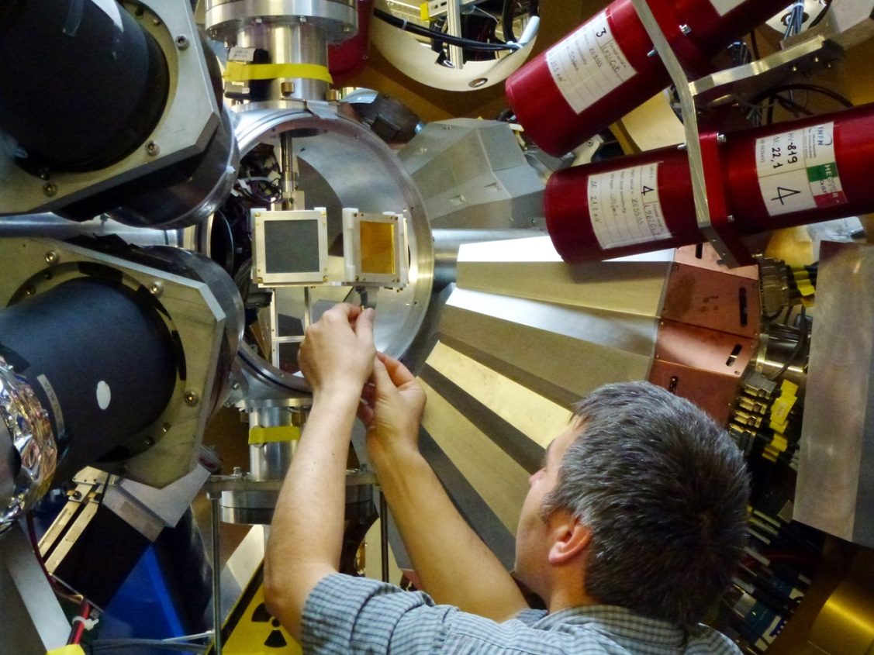
AGATA at PreSPEC 2012
19 AGATA crystals (out of 25)
(with 37 high-resolution Ge channels each)
AGATA holding structure
New HISPEC target chamber
Plamen Boutachkov

Slide 15
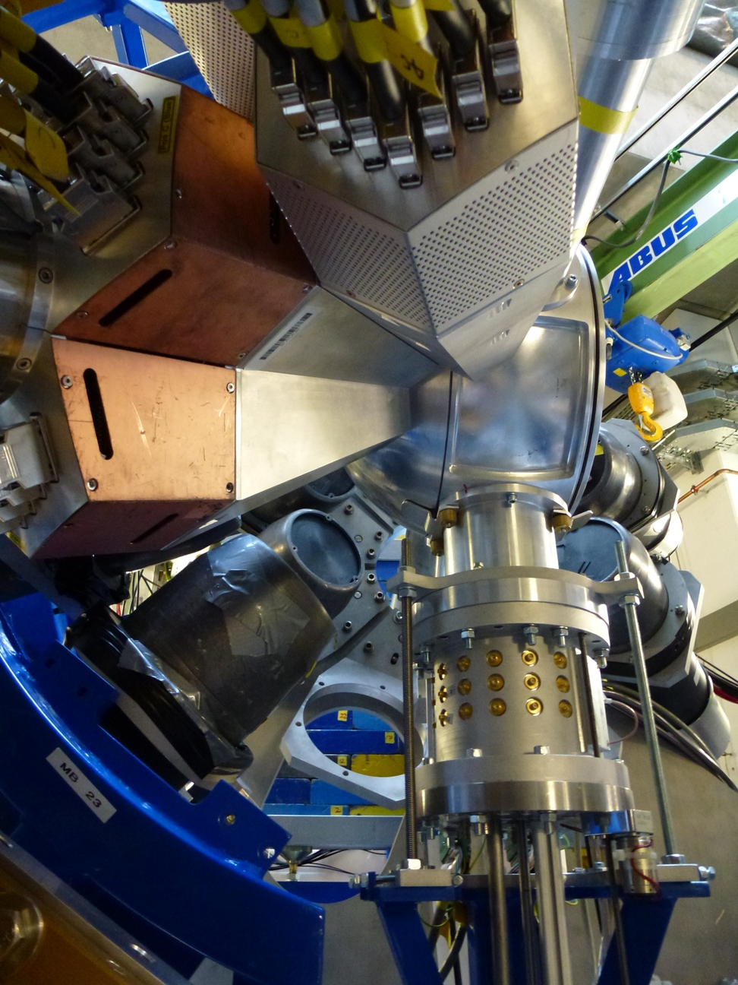
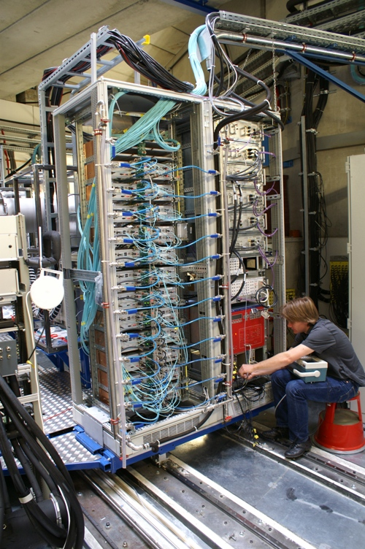
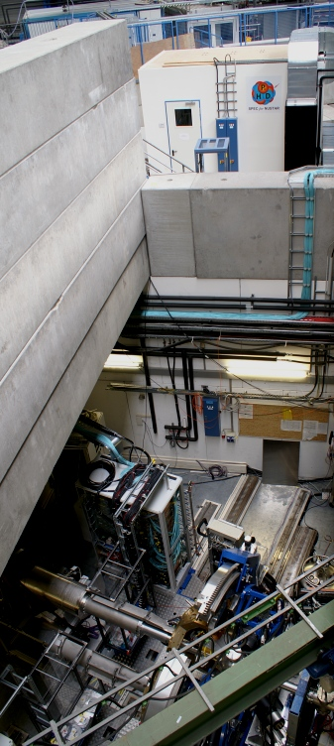
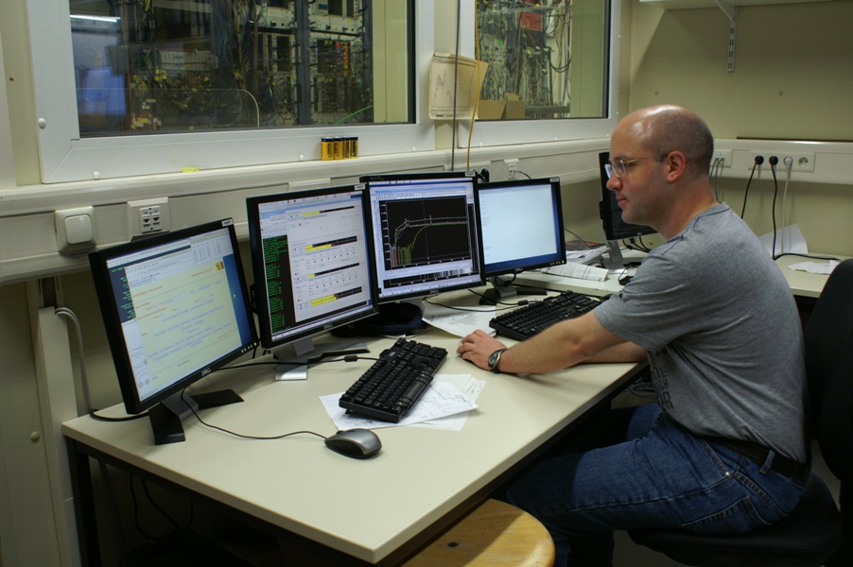
AGATA at PreSPEC 2012
AGATA
preprocessor
computer farm
digitiser
Damian Ralet
Stephane Pietri

Slide 16
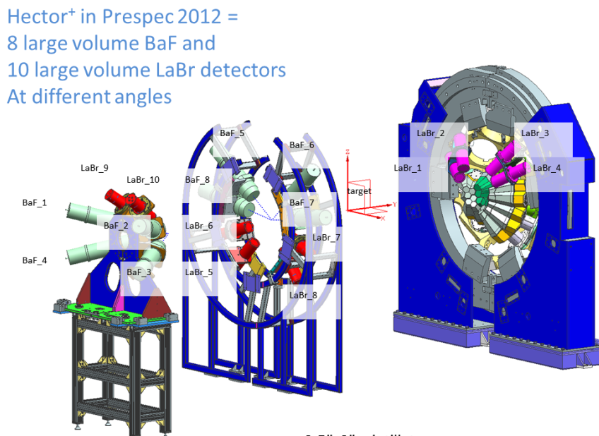

HECTOR+ at PreSPEC 2012
8 large-volume BaF₂ and
10 large volume LaBr₃ scintillators
at various angles …
INFN Milano

Slide 17



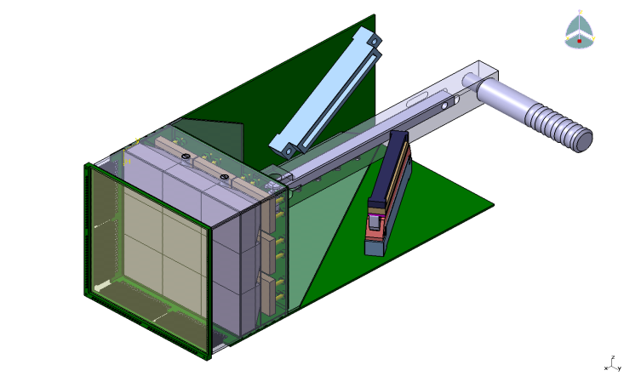
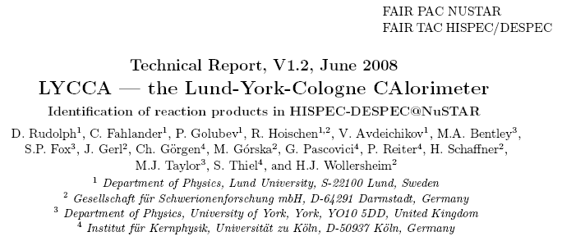
LYCCA-1 at PreSPEC 2012
Lund-York-Cologne CAlorimeter
16 ΔE-E modules
1 target DSSSD
3 plastic multi-PMT Time-of-Flight
1240 detector channels
P. Golubev et al.,
Nucl. Instr. Meth. A 723, 55 (2013)
FAIR TDR approved 2008
Used in PreSPEC since 2010
Constantly upgraded towards
HISPEC-FAIR
FAIR in-kind

Slide 18
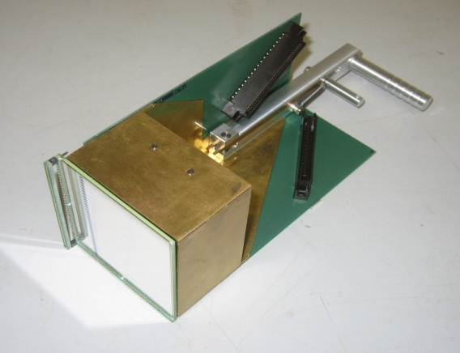
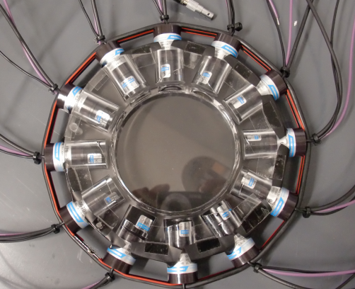
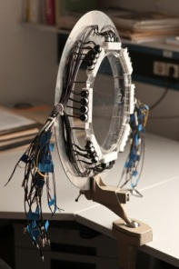
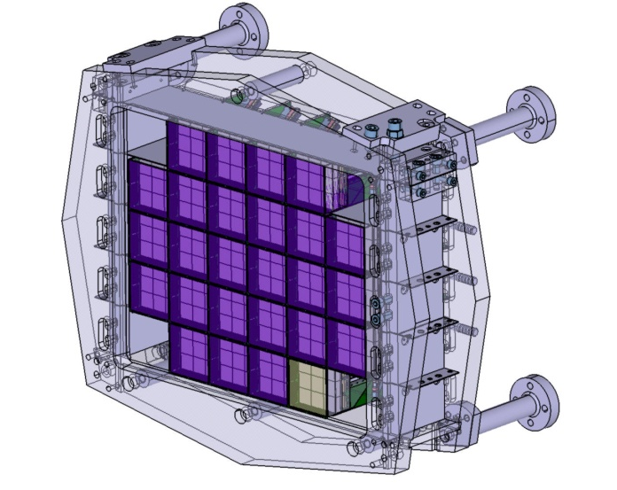
LYCCA-1 at PreSPEC 2012
Lund-York-Cologne CAlorimeter
16 ΔE-E modules
1 target DSSSD
3 plastic multi-PMT Time-of-Flight
1240 detector channels
DSSSD
CsI
plastic multi-PMT ToF:
Δt < 30 ps FWHM!
R. Hoischen et al., NIM A654, 354 (2011)
RIB from FRS
TARGET
plastic
STOP
plastic
secondary
target
ΔZ/Z ̴ 1%
ΔA/A ̴ 1%
START plastic
(x, y)
DSSSD
(E)
TOF
(ΔE, x, y)
TOF1
TOF2
P. Golubev et al., Nucl. Instr. Meth. A723, 55 (2013)

Slide 19
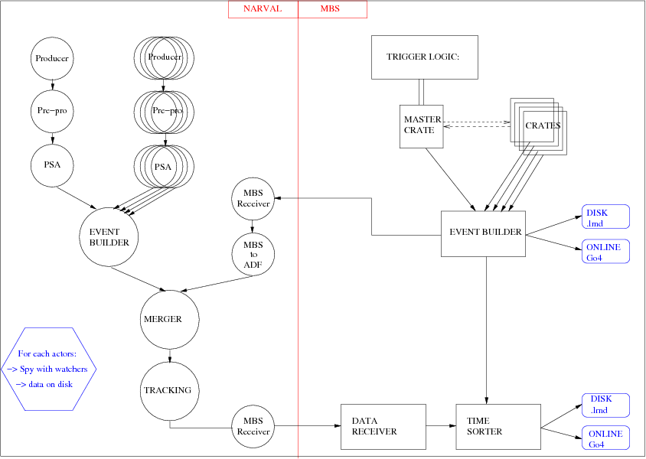

EDAQ PreSPEC-AGATA 2012
NARVAL
MBS
… while not forgetting about the FRS detector systems …
About 800 high-resolution Ge-detector channels with digitized traces, PSA, tracking, PC farm etc.
… more than 1500 detector channels in 11 VME crates placed at S2, S4, and FRS Messhütte

Slide 20
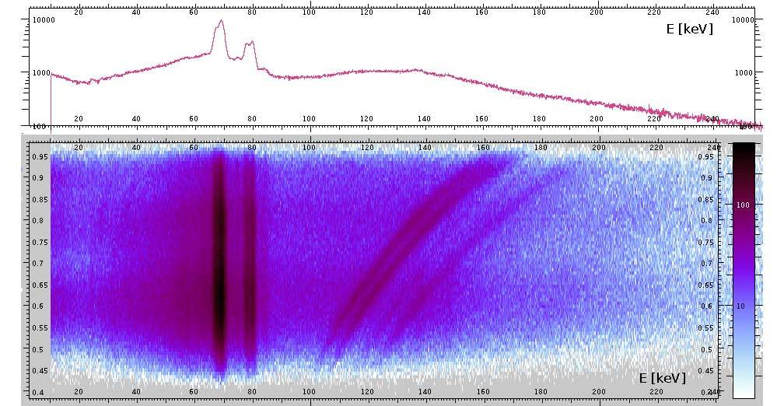
Particle-AGATA Correlations
Scattering of 183 AMeV ²³⁸U on a 0.4g/cm² Au target foil: no Doppler correction
cos θ_{γ}
66.372 | 79 Au | K_{α3} | 0.033
66.991 | 79 Au | K_{α2} | 27.5
68.806 | 79 Au | K_{α1} | 46.4
77.577 | 79 Au | K_{β3} | 5.57
77.982 | 79 Au | K_{β1} | 10.70
80.130 | 79 Au | K_{β2} | 3.84
Michael Reese
http://ie.lbl.gov/atomic/x2.pdf

Slide 21
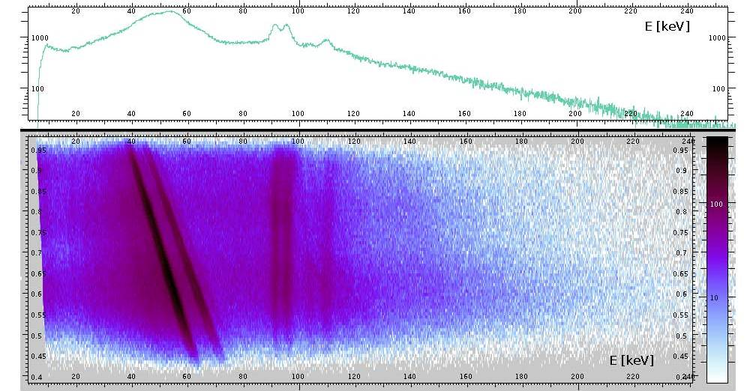
Particle-AGATA Correlations
Scattering of 183 AMeV ²³⁸U on a 0.4g/cm² Au target foil: Doppler corrected
cos θ_{γ}
93.844 | 92 U | K_{α3} | 0.099
94.654 | 92 U | K_{α2} | 28.2
98.434 | 92 U | K_{α1} | 45.1
110.421 | 92 U | K_{β3} | 5.65
111.298 | 92 U | K_{β1} | 10.70
114.445 | 92 U | K_{β2} | 4.15
Michael Reese
http://ie.lbl.gov/atomic/x2.pdf

Slide 22
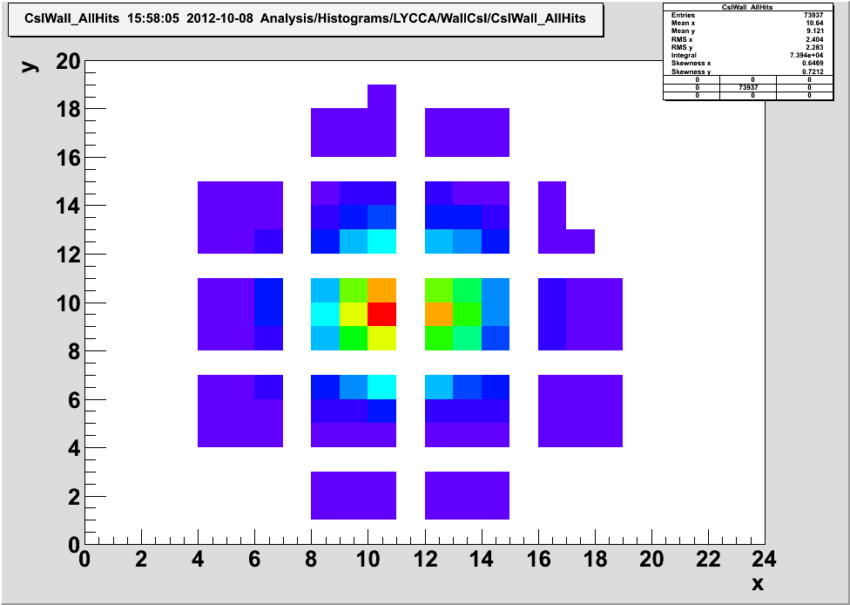
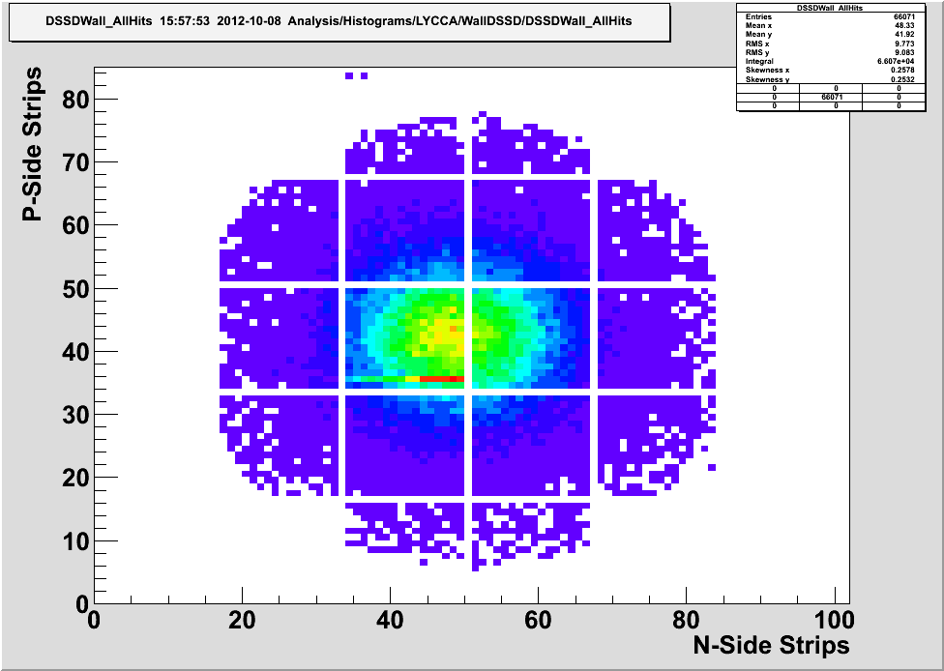
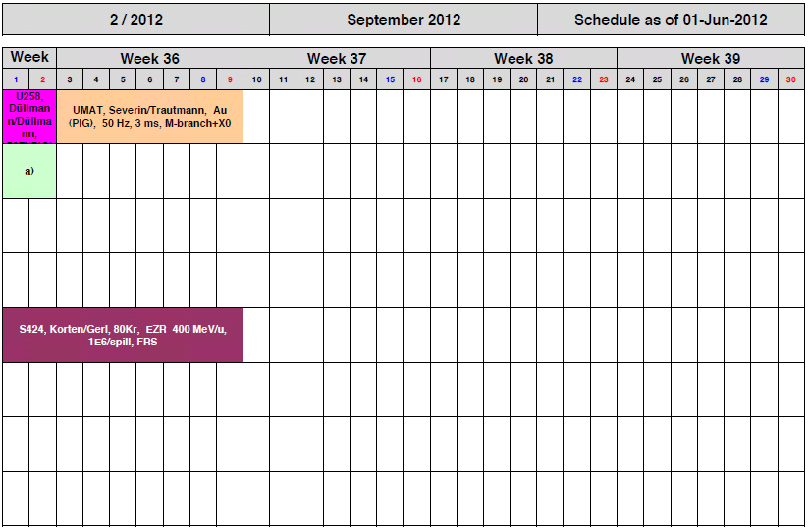
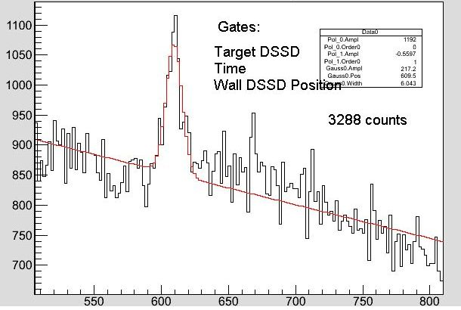
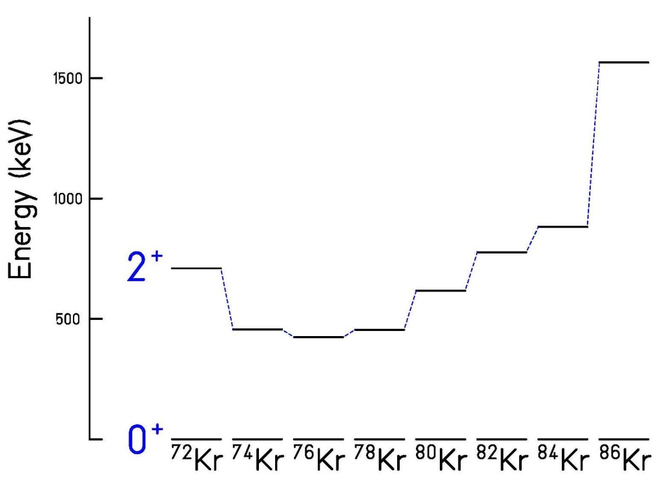

Performance Commissioning
Coulomb excitation of ⁸⁰Kr
LYCCA CsI and DSSSD-Wall hitpattern
50
AGATA spectrum
t_{½} =0.31ps
∆E_{γ}=2.5% (no tracking)
4.1ps
3.1ps
4.5ps
8.3ps
23ps
25ps
22ps
617 keV
exp. conditions:
target DSSSD, LYCCA, AGATA time
E_{γ} [keV]
Edana Merchan, Namita Goel

Slide 23
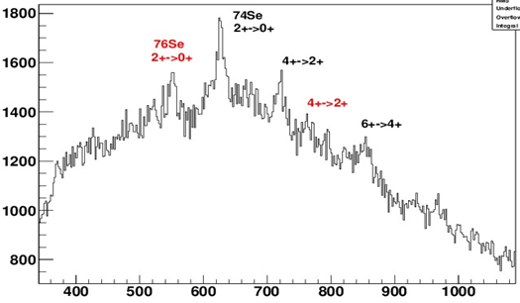
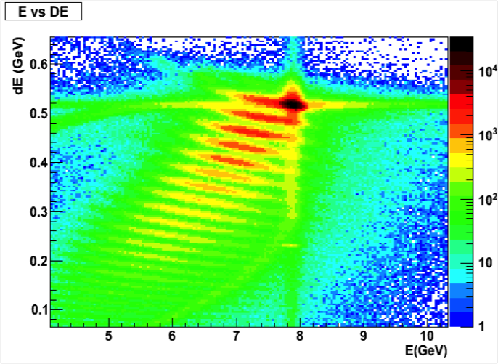
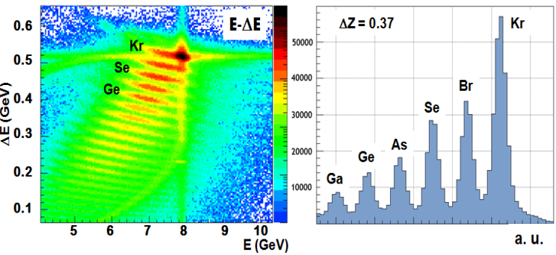
Performance Commissioning
“Secondary” fragmentation of ⁸⁰Kr
50
AGATA spectrum
Kr
Se
Se
Ge
Se
Se Z=34
E_{γ} [keV]
exp. conditions:
target DSSSD, LYCCA, AGATA time
P. Singh, GSI AnnRep 2012
Edana Merchan, Namita Goel

Slide 24
2012 Experiments

Slide 25
Approved 2012 Proposals
S424: Korten/Gerl (4 days, 9/2012)
Performance commissioning (PreSPEC-AGATA- LYCCA)
S429: Rudolph / Podolyák / Gerl (6 days, 10/2012)
Quadrantic evolution of collectivity around ²⁰⁸Pb
S430: Wieland / Górska (5/7 days, 10/2012)
Pygmy dipole resonance in ⁶⁴Fe and the properties of neutron skin
S426: Pietralla / Rainovski / Gerl (1/8 days, 2014)
Relativistic M1-Coulomb excitation of ⁸⁵Br
S433: Gadea / Górska (5 days, 10/2012)
Coulomb excitation of the band-terminating 12⁺ yrast trap in ⁵²Fe
S431: Boutachkov / Korten (3/4 days, 11/2012)
Proton hole states in ¹³²Sn and N=82 shell structure
S428: Pietri (3/4 days, 11/2012)
Shape evolution in neutron-rich Zr
S427: Sahin / de Angelis (5 days, 2014)
Study of the Tz=-1 nucleus ⁷⁰Kr (isospin symmetry A=70)
S434: Recchia / Bentley (5 days, 2014)
Transition rates and mirror energy differences in isobaric multiplets

Slide 26
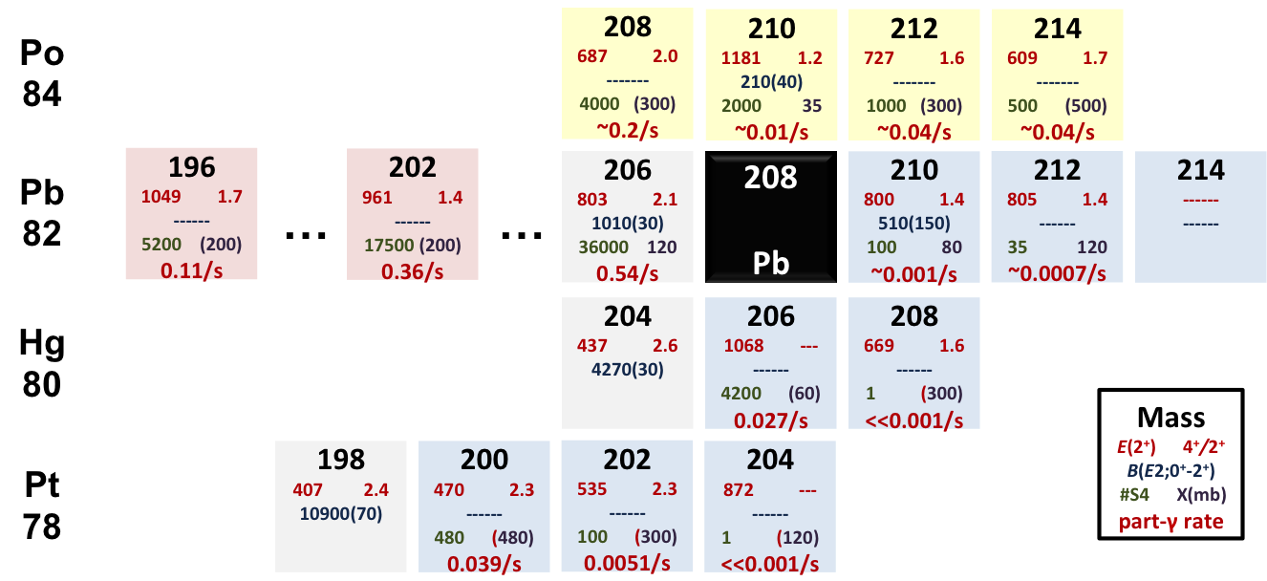
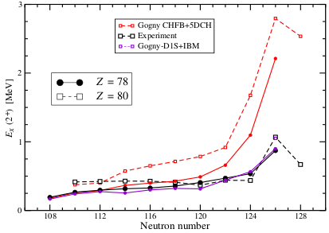
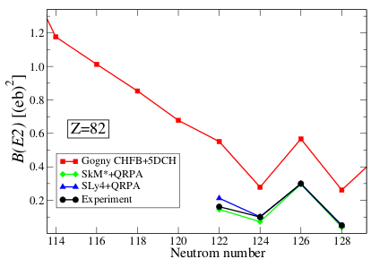
S429
Quadrantic Evolution of Collectivity Around ²⁰⁸Pb
B(E2;0⁺→2⁺) transition strengths in the vicinity of ²⁰⁸Pb
D. Rudolph, Z. Podolyak, J. Gerl et al.
Lack of experimental information!
Staged programme:
Z=82 and N=126 isomers: RISING Stopped
¹⁹⁸⁻²⁰⁶Pb, ²⁰⁶Hg and ^{200,202}Pt: ²⁰⁸Pb beam GSI
²⁰⁸⁻²¹⁴Po, ²¹⁰Pb: ²³⁸U beam GSI
²⁰⁴Pt, ²⁰⁸Hg, ^{21X}Pb : ²³⁸U beam HISPEC-FAIR

Slide 27
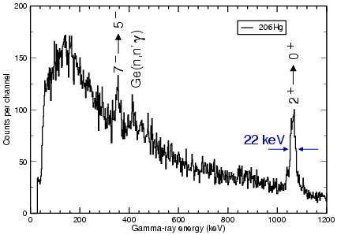
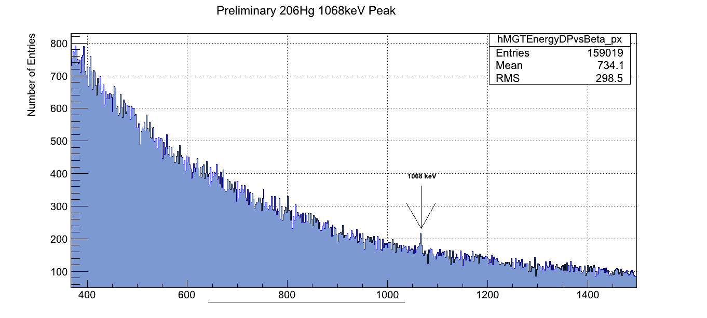
S429
Quadrantic Evolution of Collectivity Around ²⁰⁸Pb
B(E2;0⁺→2⁺) transition strengths in the vicinity of ²⁰⁸Pb
D. Rudolph, Z. Podolyak, J. Gerl et al.
206
1068 ---
------
4200 (60)
0.027/s
2466 7⁻
Lack of experimental information!
Staged programme:
Z=82 and N=126 isomers: RISING Stopped
¹⁹⁸⁻²⁰⁶Pb, ²⁰⁶Hg and ^{200,202}Pt: ²⁰⁸Pb beam GSI
²⁰⁸⁻²¹⁴Po, ²¹⁰Pb: ²³⁸U beam GSI
²⁰⁴Pt, ²⁰⁸Hg, ^{21X}Pb : ²³⁸U beam HISPEC-FAIR
Hg
80
364
2.15 μs
isomer!
2102 5⁻
1068 2⁺
1068
0 0⁺
preliminary spectrum
T. Alexander, U Surrey
full simulation by
M. Reese, TUD & GSI

Slide 28
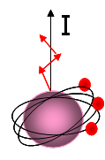
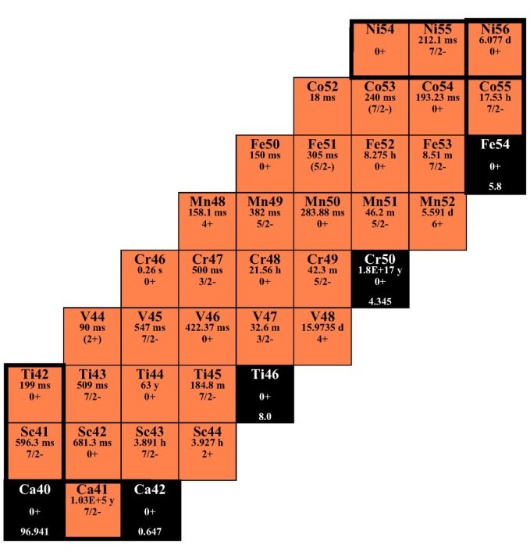



S433 Coulomb Excitation of the
Band-terminating 12⁺ Yrast Trap in ⁵²Fe
A. Gadea, C.Ur et al.
I
28
π and ν:
[312]5/2⁻ [303]7/2⁻
π(f_{7/2})⁻² x ν(f_{7/2})⁻²
52
Fe
⁵²Fe
28
T_{½}=45.9 s
Production of isomeric beams:
K=6
2qp
N=Z
N=Z
abrasion
ablation
in 20% of all cases the fragment is excited
K=2
γ-band
t_{½}=8 ps
β≈0.23
A.Gadea et al., Phys.Lett.B619, 88 (2005).
K.L. Yurkewicz et al., Phys. Rev. C70, 034301 (2004).
K=0
Notes:
The SM calculations do not reproduce the very low B(E4,12+->8₁+)=5·10⁻⁴ Wu and B(E4,12+->8₂+)=4·10⁻³ Wu . Best agreement with the more collective 12+ calculated with FPD6. Oblate deformation for 12+ and 14+ state Q=-53 fm2 and -218 fm2.

Slide 29
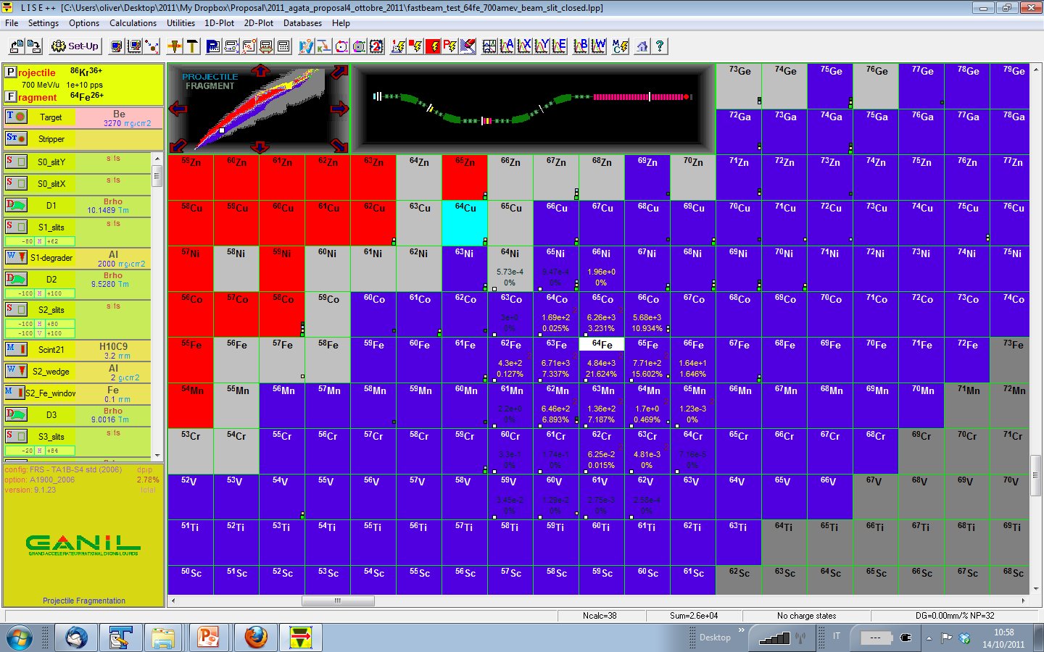
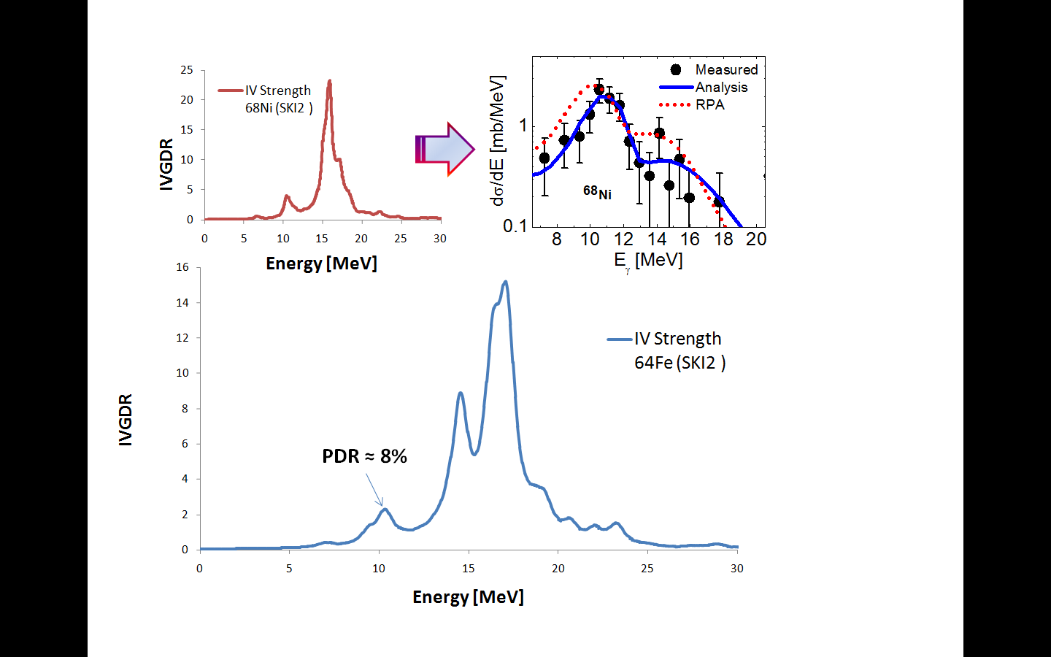
S430
Fine Structure of the Pygmy Resonance in ⁶⁴Fe
68
Ni
O. Wieland, M. Kmiecik et al.
Properties of the PDR in ⁶⁴Fe and
the neutron skin, following the line of the 2005 RISING experiment on ⁶⁸Ni
LISE⁺⁺
64
Fe
RPA predictions:
SKL2, SLY5, …
calculations for ⁶⁴Fe.
GDR
RISING
O.Wieland et al., PRL 102, 092502 (2009)

Slide 30
2013 Experiments
N/A

Slide 31
2014 Experiments
Remainders from 2012 part of the Campaign

Slide 32
Conclusions & Outlook
Core ingredients (and more!) of HISPEC successfully
commissioned in phase with original FAIR timeline
PreSPEC-HISPEC-DESPEC equipment ‘readily’ available
for Super-FRS commissioning … in 2019+
5 out of 8 approved PRESPEC-AGATA experiments conducted 2012,
at least 4 with anticipated physics results, cf. conferences 2014/2015
3 remaining: new type of M1-Coulex and 2x isospin symmetry across N=Z
2014: These and/or more statistics on some 2012 data sets
15 new/revised LoIs for PRESPEC-AGATA 2013+ –
many with technically and technologically HISPEC relevant R&D ideas
LH₂ target (p,p’), (p,n), new plunger/DSAM-style lifetime techniques at relativistic energies
isomer tagging, large area plastic position, implementation of NUSTAR electronics, etc. pp.
Irrelevant for the GSI PreSPEC-AGATA Campaign, must await FAIR beams!
Acknowledgements to … the GSI and AGATA teams
… substantial ENSAR TNA support

