Slide 1
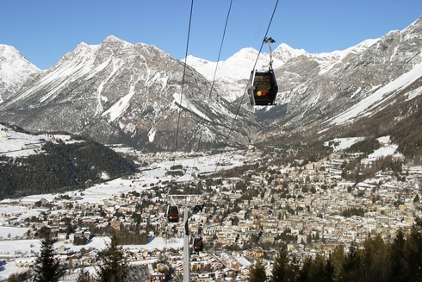
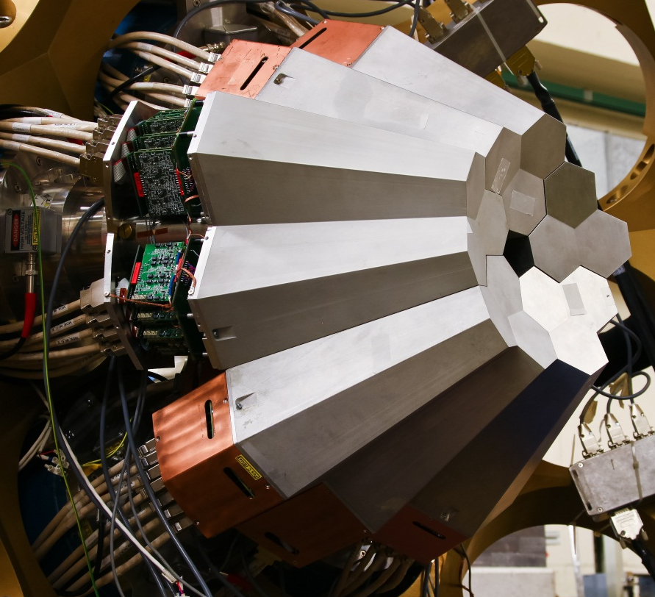
The AGATA Project;
Status and Plans
John Simpson
Nuclear Physics Group
STFC Daresbury Laboratory
Bormio 2012

Slide 2
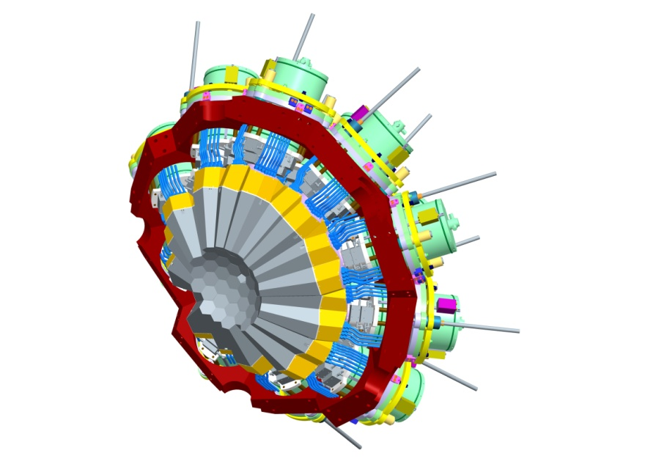
AGATA: Advanced Gamma Tracking Array
Concept of gamma-ray tracking in Ge semiconductor detectors
Huge increase in efficiency and sensitivity
Notes:
Introduction
Overview of the system
Physics outcomes from this meeting important
define physics case
experimental constraints
range of experiments
key experiments demonstrator/full array
meeting
Key design parameters Before too late
120/180 decision

Slide 3
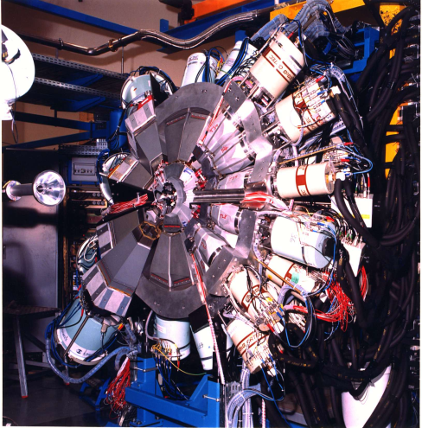
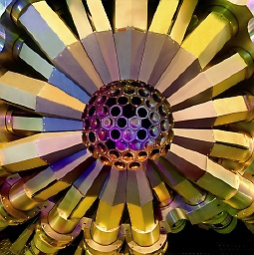
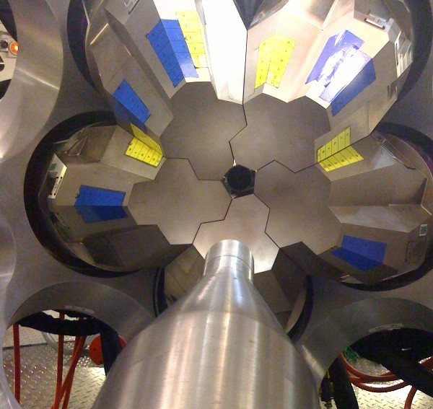
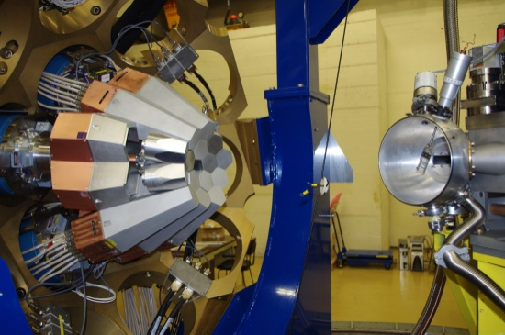
Idea of γ-ray tracking
Large Gamma Arrays based on
Compton Suppressed Spectrometers
Tracking Arrays based on
Position Sensitive Ge Detectors
EUROBALL
GAMMASPHERE
AGATA
GRETINA/GRETA
ε ∼ 10 — 5 %
( M_{γ}=1 — M_{γ}=30)
ε ∼ 40 — 20 %
( M_{γ}=1 — M_{γ}=30)
Huge increase in sensitivity
Notes:
Previous array
Compton suppression
Eff max at 10% good resolution
Exogam, Miniball, high efficiency for medium multiplicity
Limited by solid angle subtended by the shields
50% coverage
Throw away suppression shields
Track every event
Reconstruct the full energy
2 major projects AGATA and GRETA
Eff 40% and multiplicity 1
Even 20% at multiplicity 30

Slide 4
Why do we need AGATA?
FAIR
SPIRAL2
SPES
REX-ISOLDE
EURISOL
HI-Stable
Low intensity
High background
Large Doppler broadening
High counting rates
High γ-ray multiplicities
High efficiency
High sensitivity
High throughput
Ancillary detectors
Harsh conditions!
Need instrumentation with
Conventional arrays will not suffice!

Slide 5

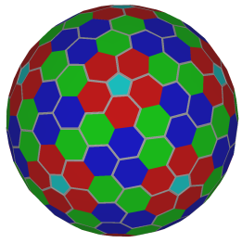













The AGATA Collaboration
Bulgaria: Univ. Sofia
Denmark: NBI Copenhagen
Finland: Univ. Jyväskylä
France: GANIL Caen, IPN Lyon, CSNSM Orsay, IPN Orsay,
CEA-DSM-DAPNIA Saclay, IPHC Strasbourg, LPSC Grenoble
Germany: GSI Darmstadt, TU Darmstadt, Univ. zu Köln, TU München
Hungary: ATOMKI Debrecen
Italy: INFN-LNL, INFN and Univ. Padova, Milano, Firenze, Genova, Napoli,
Poland: NINP and IFJ Krakow, SINS Swierk, HIL & IEP Warsaw
Romania: NIPNE & PU Bucharest
Sweden: Univ. Göteborg, Lund Univ., KTH Stockholm, Uppsala Univ.
Turkey: Univ. Ankara, Univ. Istanbul, Technical Univ. Istanbul
UK: Univ. Brighton, STFC Daresbury, Univ. Edinburgh, Univ. Liverpool,
Univ. Manchester, Univ. West of Scotland, Univ. Surrey, Univ. York
Spain: IFIC Valencia, IEM-CSIC Madrid, LRI Univ. Salamanca
13 Countries +EU
>40 Institutions

Slide 6


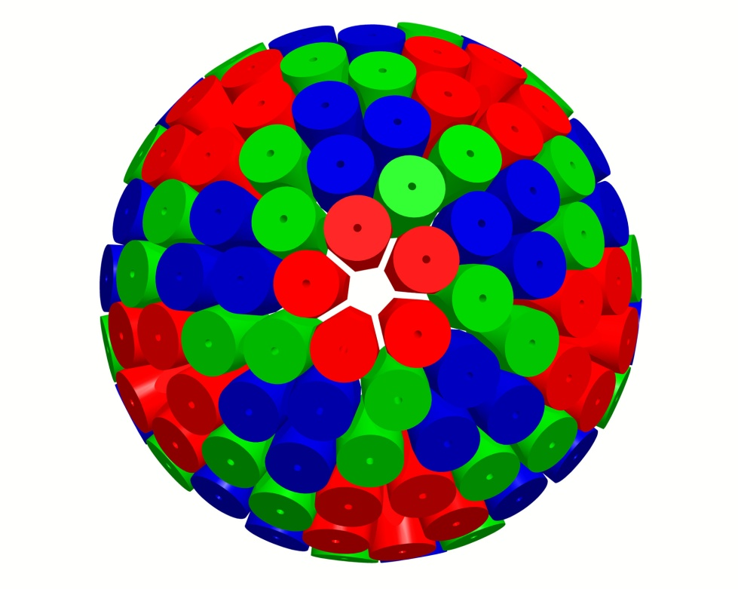


AGATA
(Design and characteristics)
4π γ-array for Nuclear Physics Experiments at European accelerators providing radioactive and stable beams
Main features of AGATA
Efficiency: 43% (M_{γ} =1) 28% (M_{γ} =30)
today’s arrays ~10% (gain ~4) 5% (gain ~1000)
Peak/Total: 58% (M_{γ}=1) 49% (M_{γ}=30)
today ~55% 40%
Angular Resolution: ~1º →
FWHM (1 MeV, v/c=50%) ~ 6 keV !!!
today ~40 keV
Rates: 3 MHz (M_{γ}=1) 300 kHz (M_{γ} =30)
today 1 MHz 20 kHz
180 large volume 36-fold segmented Ge crystals in 60 triple-clusters
Digital electronics and sophisticated Pulse Shape Analysis algorithms allow
Operation of Ge detectors in position sensitive mode → γ-ray tracking
Notes:
Summary
List few items
Agata very powerful instrument for nuclear spectroscopy
Exciting science programme subject of this meeting
Aim to propose and start realisation of the full AGATA from 2008

Slide 7
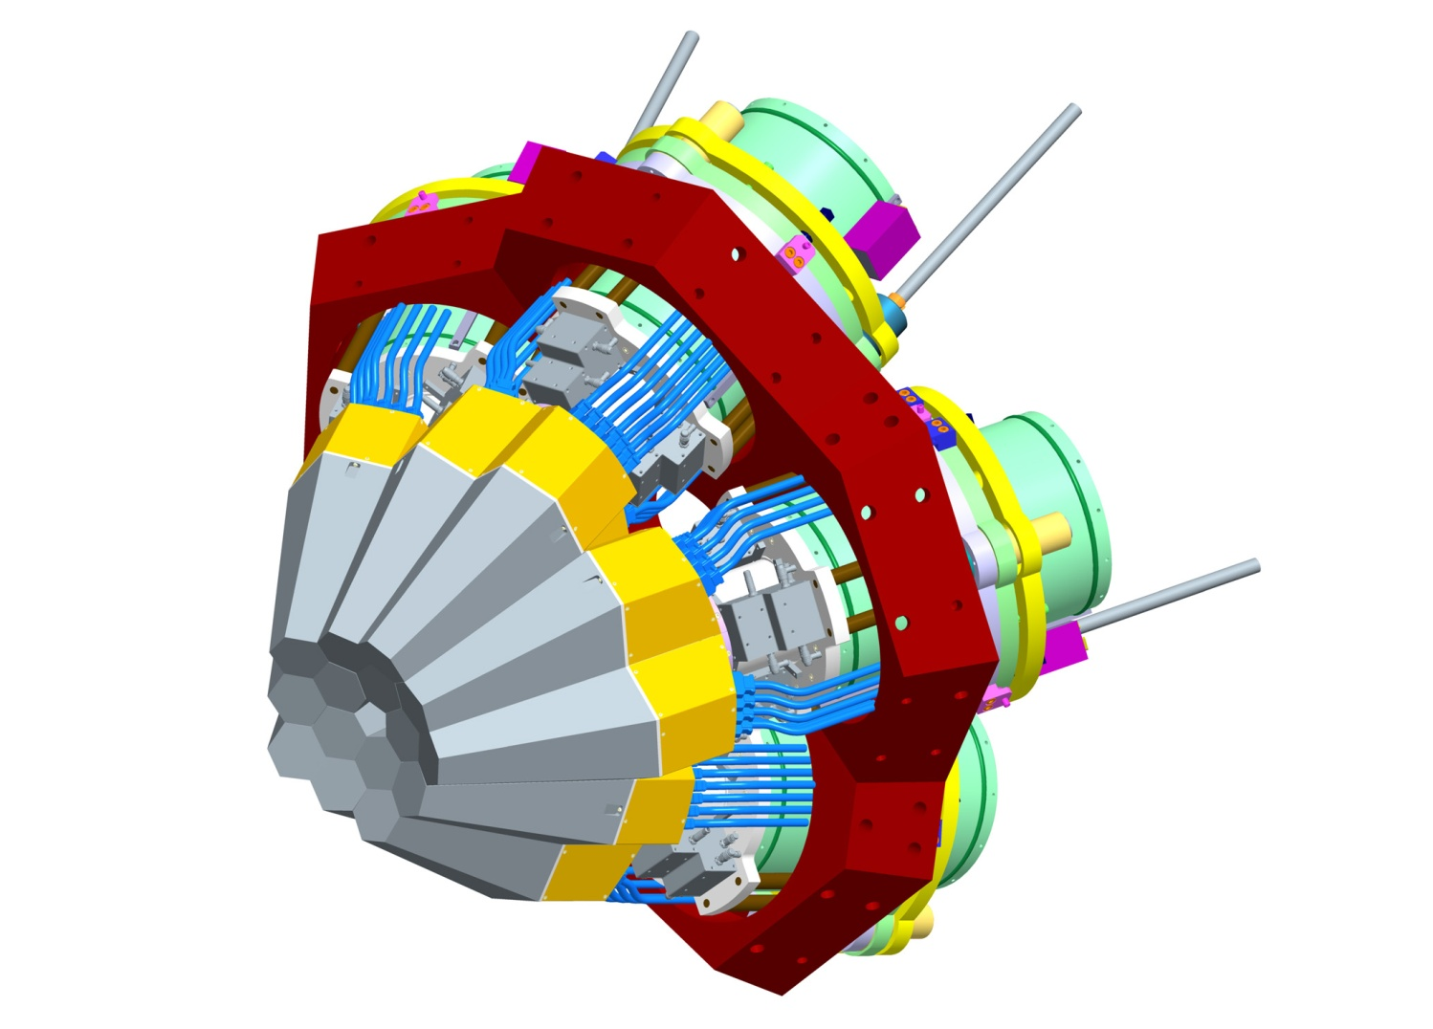
The First Step:
The AGATA Demonstrator
1 symmetric triple-cluster
5 asymmetric triple-clusters
36-fold segmented crystals
540 segments
555 digital-channels
Eff. 3 – 8 % @ M_{γ} = 1
Eff. 2 – 4 % @ M_{γ} = 30
Full EDAQ
with on line PSA and γ-ray tracking
In beam Commissioning
Technical proposal for full array
Cost 6.7 M€ Capital
Notes:
Powerful array in its own right
Still to decide where to site
Still to decide the key test experiments

Slide 8

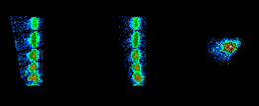
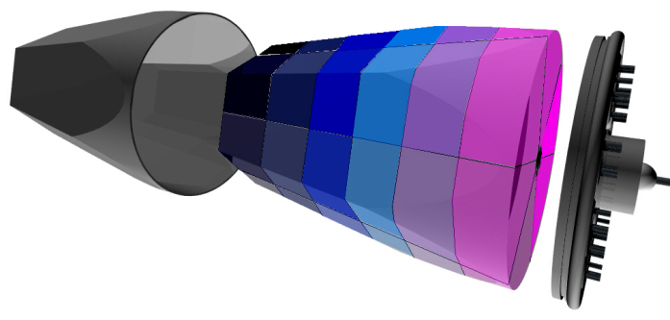
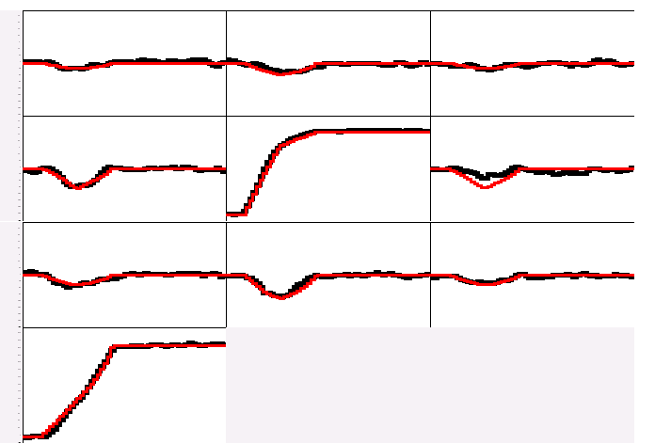
γ-ray Tracking Arrays
Electrically segmented HPGe detectors
Identification of the individual interaction points
Reconstruction of tracks
evaluating permutations
of interaction points
•
(x,y,z,E,t)_{i}
•
•
•
•
•
•
•
Deconvolution of the recorded waves through comparison with reference signals
γ
A3
A4
A5
Digital electronics
to record and
process segment signals
B3
B4
B5
C3
C4
C5
measured
calculated
Energy and direction of γ-rays
CORE

Slide 9
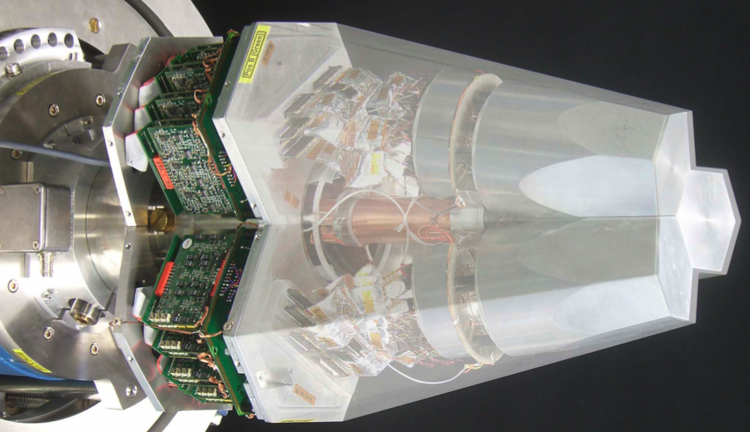
Agata Triple Cluster
- integration of 111 high resolution
spectroscopy channels
- cold FET technology for all signals
-development of 36-fold segmented
- encapsulated detectors
Challenges:
- mechanical precision
- heat development
- LN2 consumption
- microphonics
- noise, high frequencies
A. Wiens et al. NIM A 618 (2010) 223–233; D. Lersch et al. NIM A 640(2011) 133-138

Slide 10
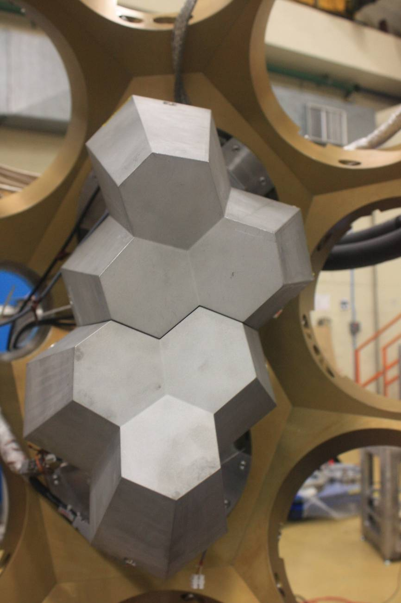
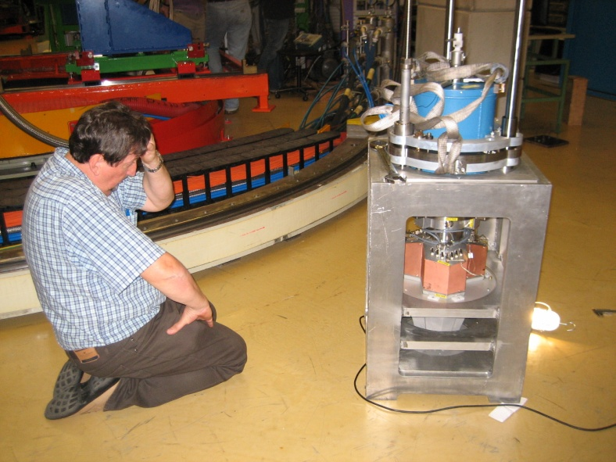
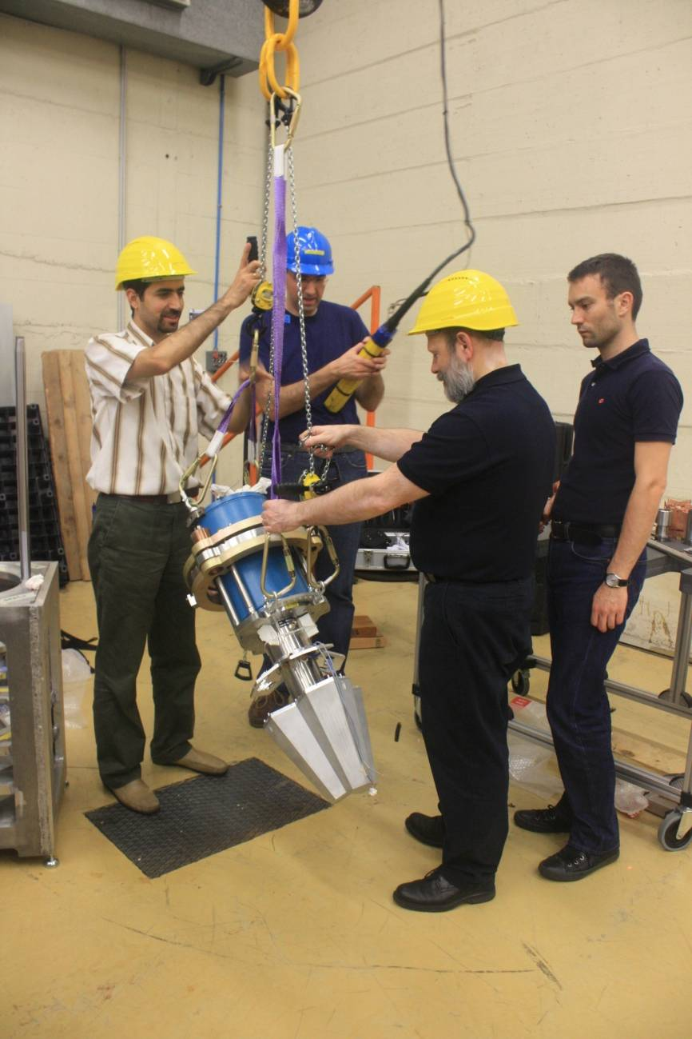
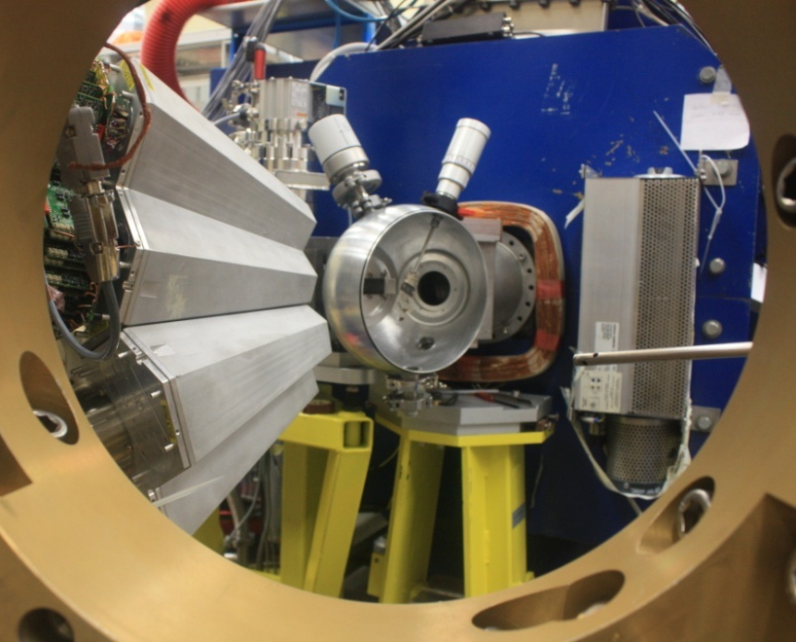

Slide 11
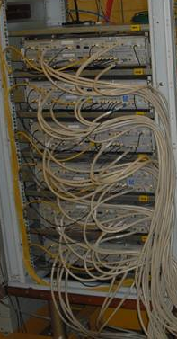
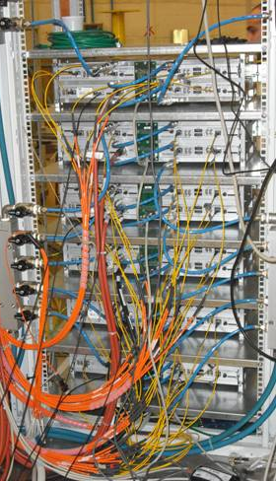
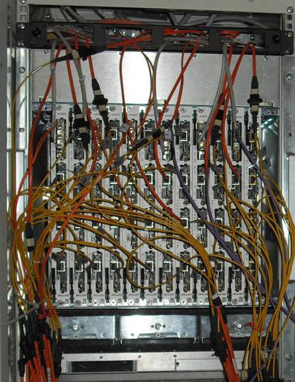
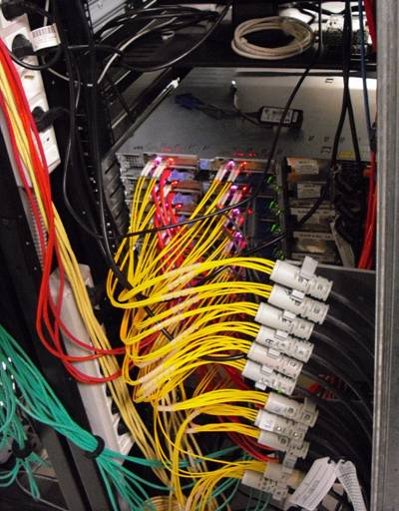
AGATA: Digital Electronics
Digitisers
in the experimental hall
Digital proc. electronics
in the users area
Computer farm
in the computing room
10 m long MDR cables
80 m long optical fibers
20 m long optical fibers
LAN to the disk servers
100Mhz, 14 bit
Synchronous &
continuous
Triggering
Energy
Trace capture
Preprocessing
PSA
Tracking
(7.6GB/s/crystal)
(10 kB/evt/crystal)
Global
Triggering
System
GTS
Clock &
Trigger validation

Slide 12
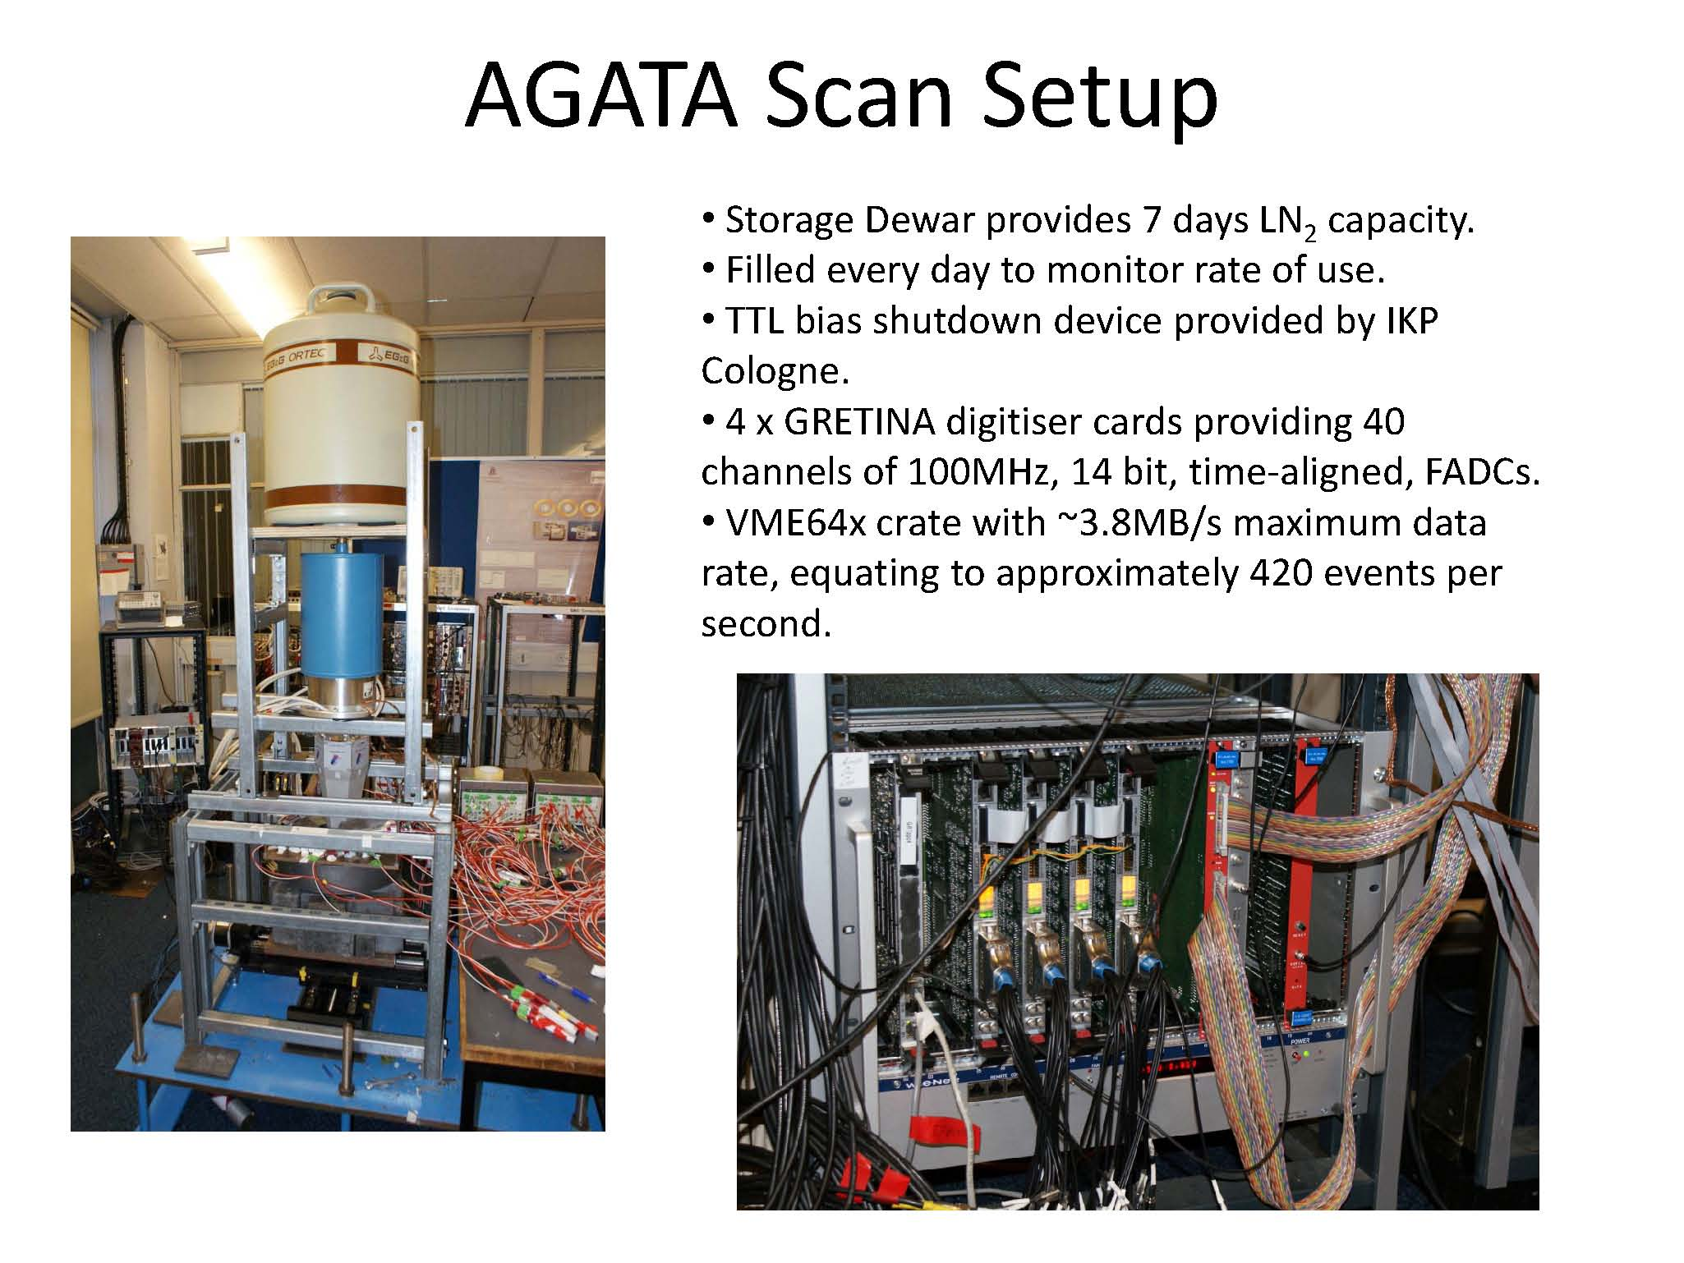
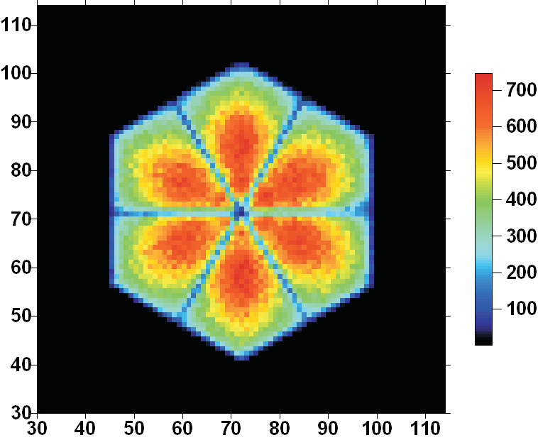
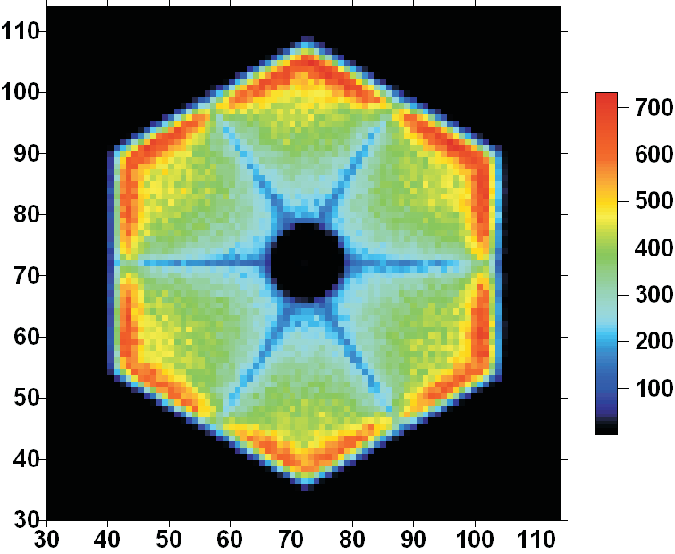
Two symmetric and two asymmetric crystals scanned at
University of Liverpool
Scanning systems, CSNSM Orsay, Strasbourg, GSI

Slide 13
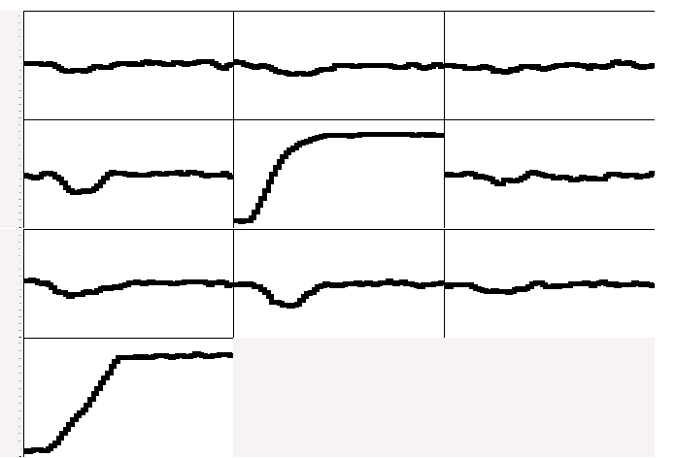
Pulse Shape Analysis concept
A3
A4
A5
(10,10,46)
B3
B4
B5
(10,30,46)
C3
C4
C5
y
CORE
C4
B4
measured
D4
A4
x
791 keV deposited in segment B4
E4
F4
z = 46 mm

Slide 14
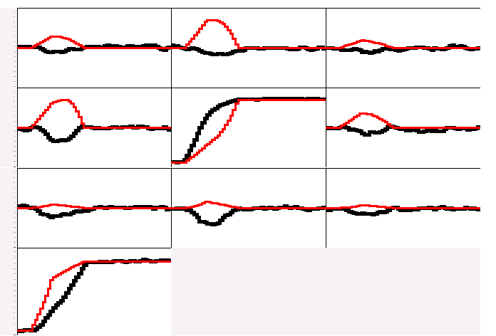
Pulse Shape Analysis concept
A3
A4
A5
B3
B4
B5
(10,10,46)
C3
C4
C5
y
CORE
C4
B4
measured
calculated
D4
A4
x
791 keV deposited in segment B4
E4
F4
z = 46 mm

Slide 15
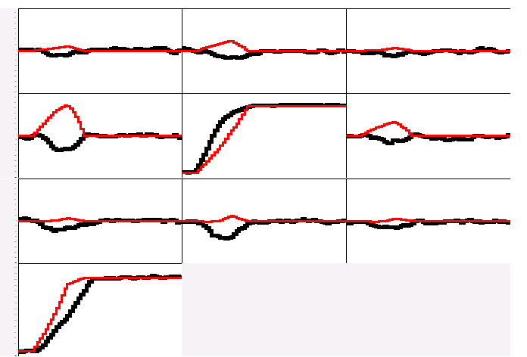
Pulse Shape Analysis concept
A3
A4
A5
B3
B4
B5
(10,15,46)
C3
C4
C5
y
CORE
C4
B4
measured
calculated
D4
A4
x
E4
F4
791 keV deposited in segment B4
z = 46 mm

Slide 16
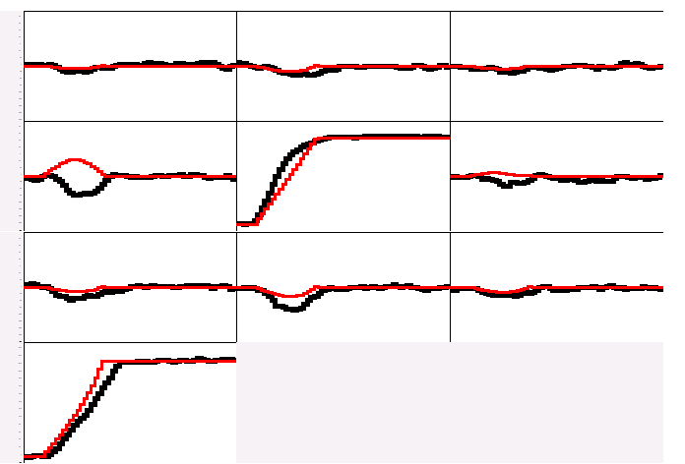
Pulse Shape Analysis concept
A3
A4
A5
B3
B4
B5
(10,20,46)
C3
C4
C5
y
CORE
C4
B4
measured
calculated
D4
A4
x
791 keV deposited in segment B4
E4
F4
z = 46 mm

Slide 17
Pulse Shape Analysis concept
A3
A4
A5
B3
B4
B5
(10,25,46)
C3
C4
C5
y
CORE
C4
B4
measured
calculated
D4
A4
x
791 keV deposited in segment B4
E4
F4
z = 46 mm

Slide 18
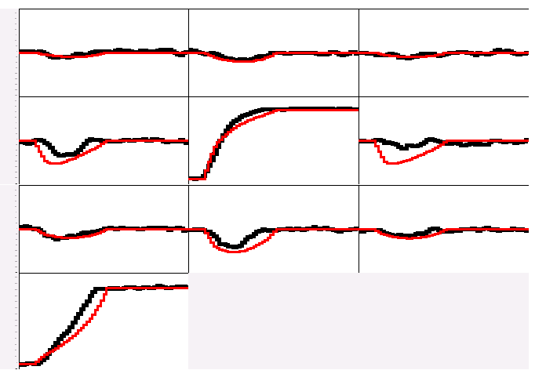
Pulse Shape Analysis concept
A3
A4
A5
B3
B4
B5
(10,30,46)
C3
C4
C5
y
CORE
C4
B4
measured
calculated
D4
A4
x
791 keV deposited in segment B4
E4
F4
z = 46 mm

Slide 19
Pulse Shape Analysis concept
A3
A4
A5
Result of
Grid Search
algorithm
B3
B4
B5
(10,25,46)
C3
C4
C5
y
CORE
C4
B4
measured
calculated
D4
A4
x
791 keV deposited in segment B4
E4
F4
z = 46 mm

Slide 20
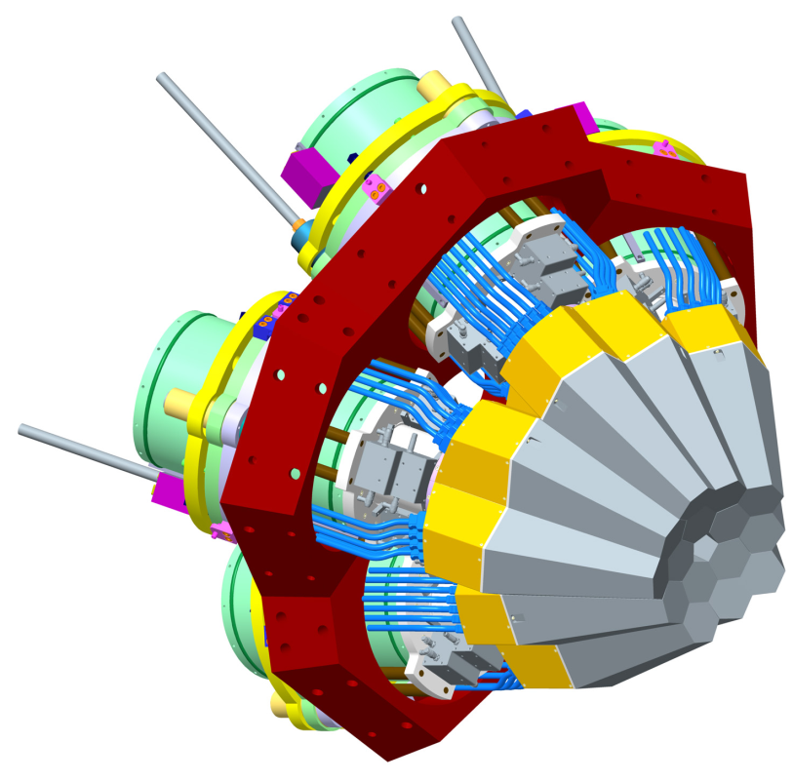
The AGATA Demonstrator
Objective of the final R&D phase 2003-2008
From Design to Reality
Notes:
Powerful array in its own right
Still to decide where to site
Still to decide the key test experiments

Slide 21
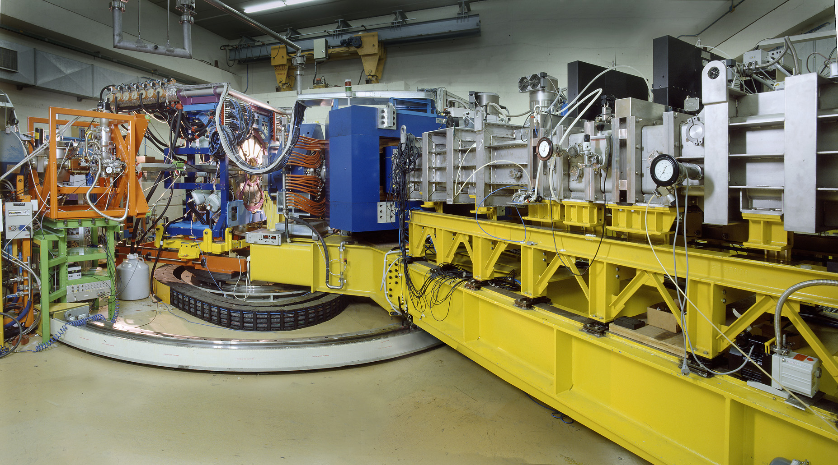
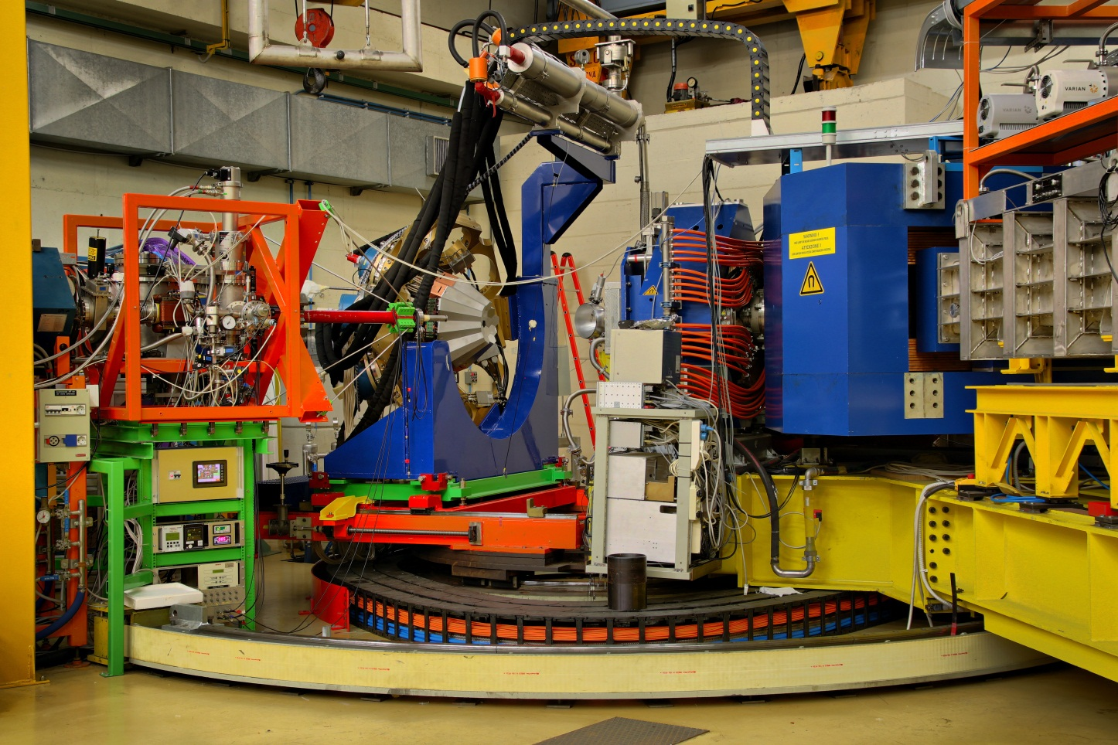
From CLARA to AGATA
March 2008
April 2010
May 2011

Slide 22
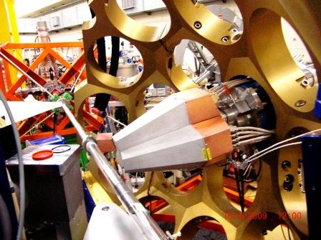

Position resolution
³⁰Si@70MeV + ¹²C
Systematic
uncertainty
4
Position resolution extracted from peak FWHM values at two distances
$$p^{2}=\frac{1}{k^{2}}\left(∆{E^{2}}_{close}−∆{E^{2}}_{far}\right){\left(\frac{1}{{d_{close}}^{2}}−\frac{1}{{d_{far}}^{2}}\right)}^{−1}$$
P.-A.Soderstrom, NIM A 638, 96 (2011);
F.Recchia, PhD thesis (2006)

Slide 23
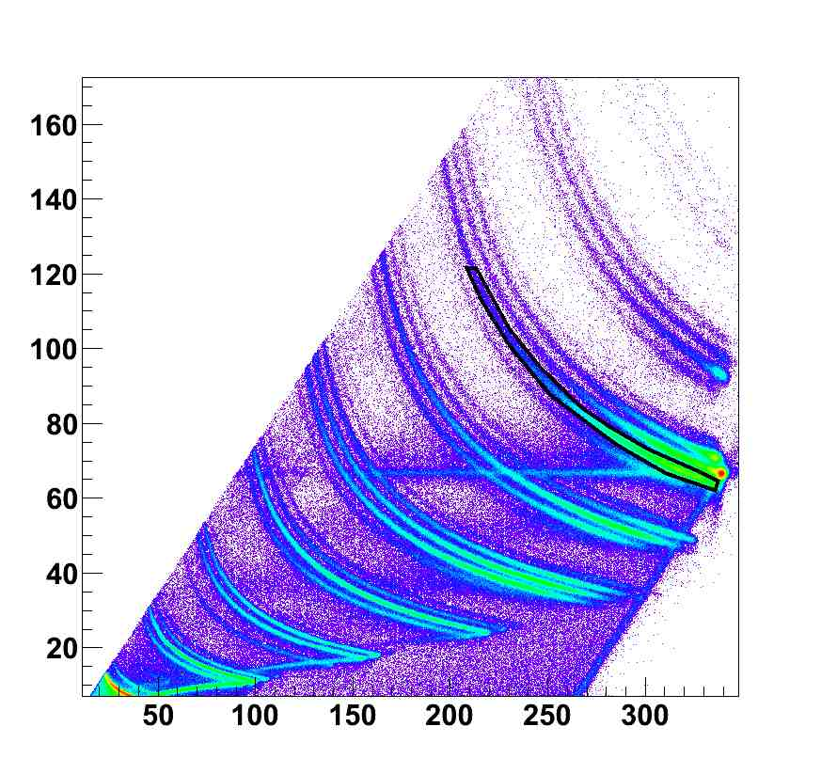
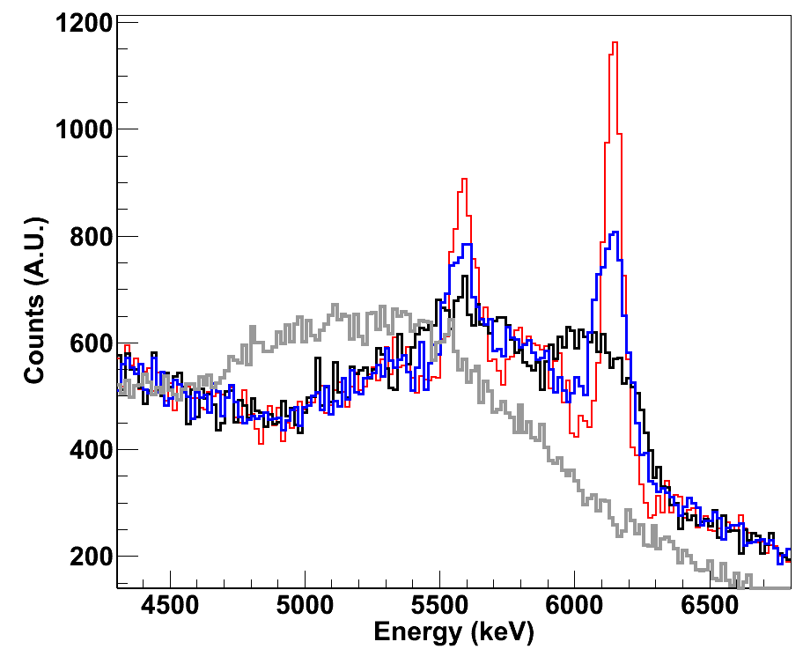
Doppler correction capabilities
Inelastic scattering
¹⁷O @ 20 MeV/u on ²⁰⁸Pb
¹⁶O
F
No Dopp Corr
Crystal Centers
Segment Centers
PSA+Tracking
O
N
C
dE (MeV)
B
Be
Li
α
TKE (MeV)
R.Nicolini, D.Mengoni

Slide 24
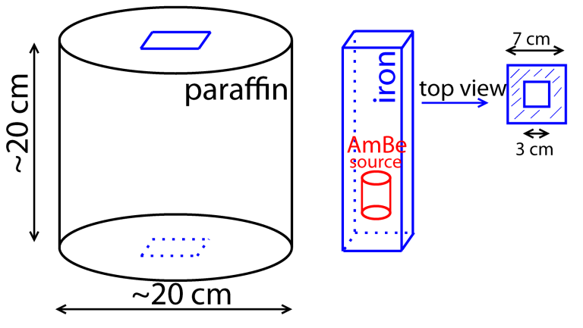
High-energy photons
source: ²⁴¹AmBe + Fe
Excellent energy resolution and linerarity up to 20MeV
F.Crespi
C.Michelagnoli, R.Depalo

Slide 25

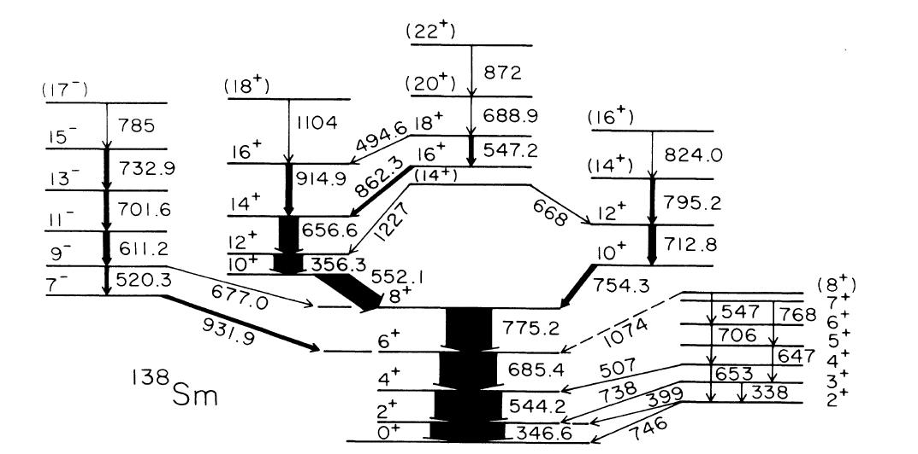
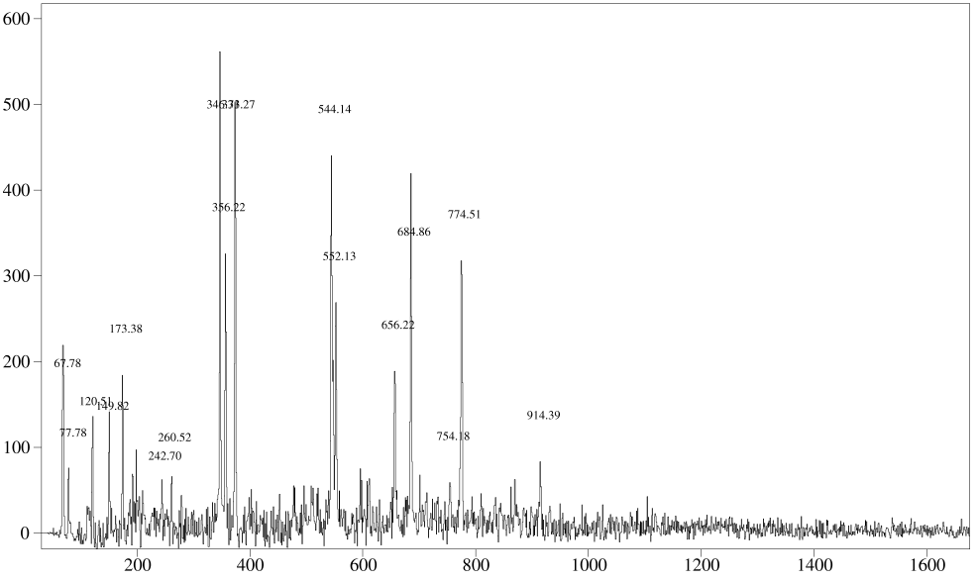
γγ capabilities
The performance of AGATA using γ-ray tracking is comparable with conventional arrays with a much larger number of crystals (possible issues with counting rates …)
³²S → ¹¹⁰Pd 135 MeV
6 AGATA crystals only
¹³⁸Sm
6 gates on:
347keV,545keV,686keV,775keV,552keV,357keV
872keV 22+ - 20+
R.Kempley

Slide 26
AGATA experiments LNL
AGATA commissioning 2009-2010
AGATA experiments 2010-2011
AGATA proposals (~19 runs + 4 test experiments)
Collectivity at maximum nucleon valency: Investigation of ground-state rotation in the neutron-rich Dy, Er and Yb nuclei J.Ollier, P.-A.Soderstrom, P.H.Regan, J.Simpson, J. Nyberg et al., +PRISMA+DANTE
Spectroscopy of neutron rich Th and U nuclei after multi-nucleon reactions, P.Reiter et. Al., +PRISMA+DANTE
Delayed shape transition in ¹⁹⁶Os, V. Modamio, Zs. Podolyak, C. Wheldon, W. Korten et al., + PRISMA
Characterization of new structures in octupole-deformed radium and thorium nuclei, J.F.Smith et al.,
Near and sub-barrier transfer reactions in 60Ni+118Sn, Montanari et al., PRISMA
Isospin mixing in N=Z nucleus ⁸⁰Zr at medium temperature, A Giaz, F. Camera et al., +HECTOR
Structure beyond the N=50 shell closure in neutron-rich nuclei in the vicinity of 78Ni: The case of N=51 nuclei, Verney, Duchene,de Angelis et al., +PRISMA+PLUNGER
Lifetimes of intruder states in N ~ 20 sd-pf-shell neutron-rich nuclei Chapman, Haas et al., +PRISMA+PLUNGER
RDDS lifetime measurement in the region of the neutron-rich doubly magic 132Sn: Lifetime of the 6+ state in 136Te. A. Gadea et al., +PRISMA+PLUNGER
Development of the nuclear structure of neutron–rich isotopes in the Z»38 region populated by heavy–ion induced fission Merchan Ur, Marginean et al., +PRISMA+LaBr3
Confirmation of the molecular structure of excited bands in 21Ne, C.Wheldon et al., +TRACE
Order‐to‐chaos transition in warm rotating 174W nuclei, Valeria Vandone, Silvia Leoni et al., +HELENA
Lifetime measurements of the neutron-rich Cr isotopes, Valiente-Dobon et al., +PRISMA+PLUNGER
Neutron-rich nuclei in the vicinity of ²⁰⁸Pb, Z.Podolyak et al., +PRISMA+DANTE
Lifetime measurement in neutron‐rich Ni, Cu, and Zn isotopes, Eda Sahin, Maria Doncel, Andreas Goergen et al., + PRISMA+PLUNGER
Lifetime measurement of the 6.792 MeV state in 15O, Roberto Menegazzo – Calin Ur et al., + PRISMA+PLUNGER
Coulomb excitation of the presumably superdeformed band in 42Ca, Adam Maj, Pawel Napiorkowski, Faisal Azaiez et al., +DANTE
Precision lifetime study in the neutron‐rich N=84 isotone ¹⁴⁰Ba from DSAM measurements following Coulomb‐barrier alpha‐transfer reactions on a ¹³⁶Xe, Leske Joerg et al., Si detector
Inelastic scattering as a tool to search for highly excited states up to the region of the Giant Quadrupole Resonance Roberto Nicolini, Angela Bracco +HELENA+TRACE
Test Experiments (tandem beams only)
F.Haas et al, Lifetime measurements with the AGATA Demonstrator at LNL
F.Crespi, Response of AGATA to high-energy gamma rays (
P.G.Bizzeti, Polarization capabilities of AGATA
A. Atac, ²⁵²Cf source measurement.

Slide 27
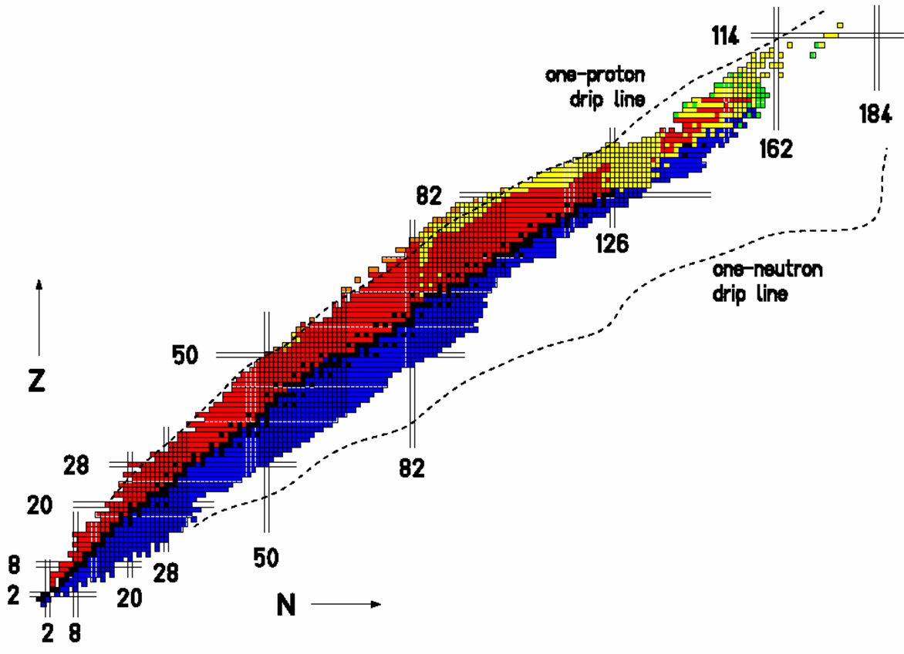
The Experimental Campaign at LNL
Octupole-deformed
Ra and Th nuclei
Isospin Mixing
in ⁸⁰Zr
Neutron-rich nuclei in
the vicinity of ²⁰⁸Pb
n-rich Th and U
Pygmy and GQR states
Neutron drip-line
High-lying states
in ¹²⁴Sn and ¹⁴⁰Ce
g.s. rotation
in Dy, Er, Yb
Shape transition
in ¹⁹⁶Os
Molecular structure of ²¹Ne
n-rich nuclei
Proton drip-line
Order-to-chaos
transition in ¹⁷⁴W
Lifetime
of ¹³⁶Te
protons
Coulex
of ⁴²Ca
N=84 isotone
¹⁴⁰Ba
N=51 nuclei
Neutron-rich nuclei populated by fission
19 (+3) exp.
148 days
Lifetimes of the
n-rich Cr isotopes
Lifetimes near the
island of inversion
Lifetimes in n-rich
Ni, Cu and Zn isotopes
neutrons
Lifetime of the
6.792MeV state in ¹⁵O

Slide 28

AGATA Analysis
and AGATA open meeting June 2011, Padvoa
all experiments presented
http://agenda.infn.it/conferenceDisplay.py?confId=3224
Second Workshop of the European Gamma and
Ancillary Detectors Network EGAN 2012
Orsay, 25-27 June 2012
Annual Open meeting of AGATA collaboration
27 June 2012
http://indico.in2p3.fr//event/egan2012

Slide 29
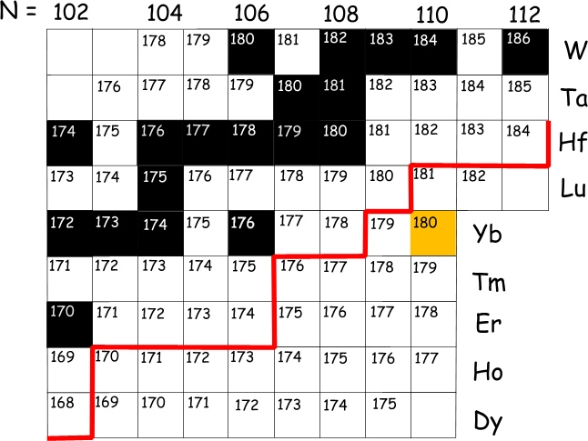
Collectivity at maximum nucleon valency: investigation of ground-state rotation in the neutron-rich Dy, Er and Yb nuclei
AGATA + DANTE + PRISMA
J. Nyberg, P-A. Soderstrom, J. Ollier, P.H. Regan, J. Simpson et al.,
Evolution of collectivity
Rigidity
Maximum valance nucleons
Nuclear deformations and the r-process
High-K isomers
¹⁸⁰Yb
Current limits of γ-ray
spectroscopy for neutron-
rich rare-earth nuclei
¹⁷⁶Er
¹⁷⁶Er
¹⁷⁰Dy
Deep-inelastic/multi-nucleon transfer reactions

Slide 30
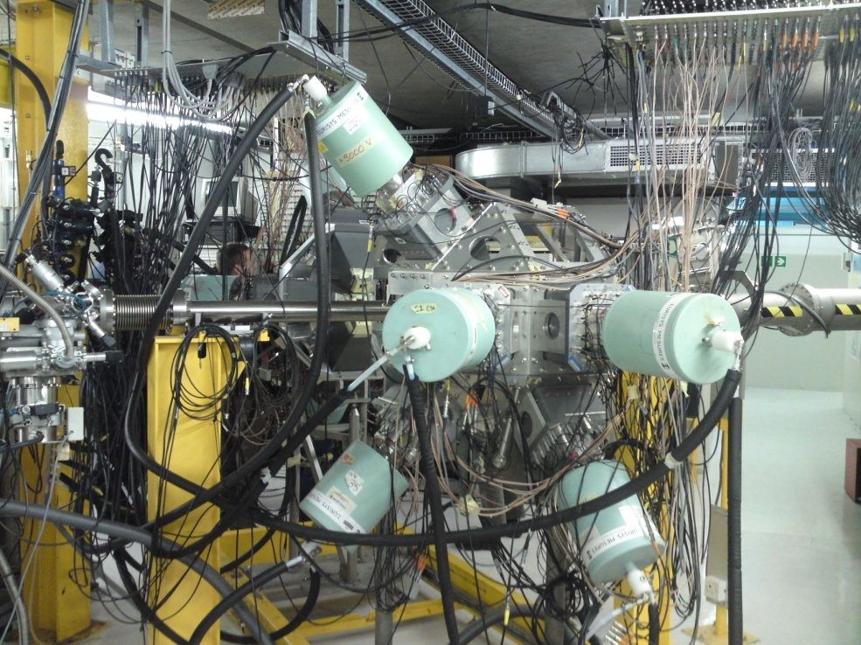
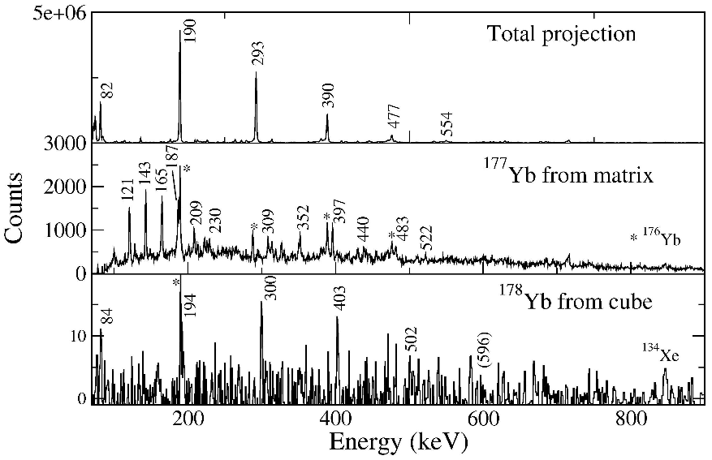
iThemba South Africa
¹³⁶Xe + ¹⁷⁶Yb to study ¹⁸⁰Yb.
AFRODITE thick target experiment, identify by partner
tagging
low beam intensity,
setup and reaction worked
Robust ground-state rotation: The search for ¹⁸⁰Yb, J. Ollier
et al., Daresbury

Slide 31
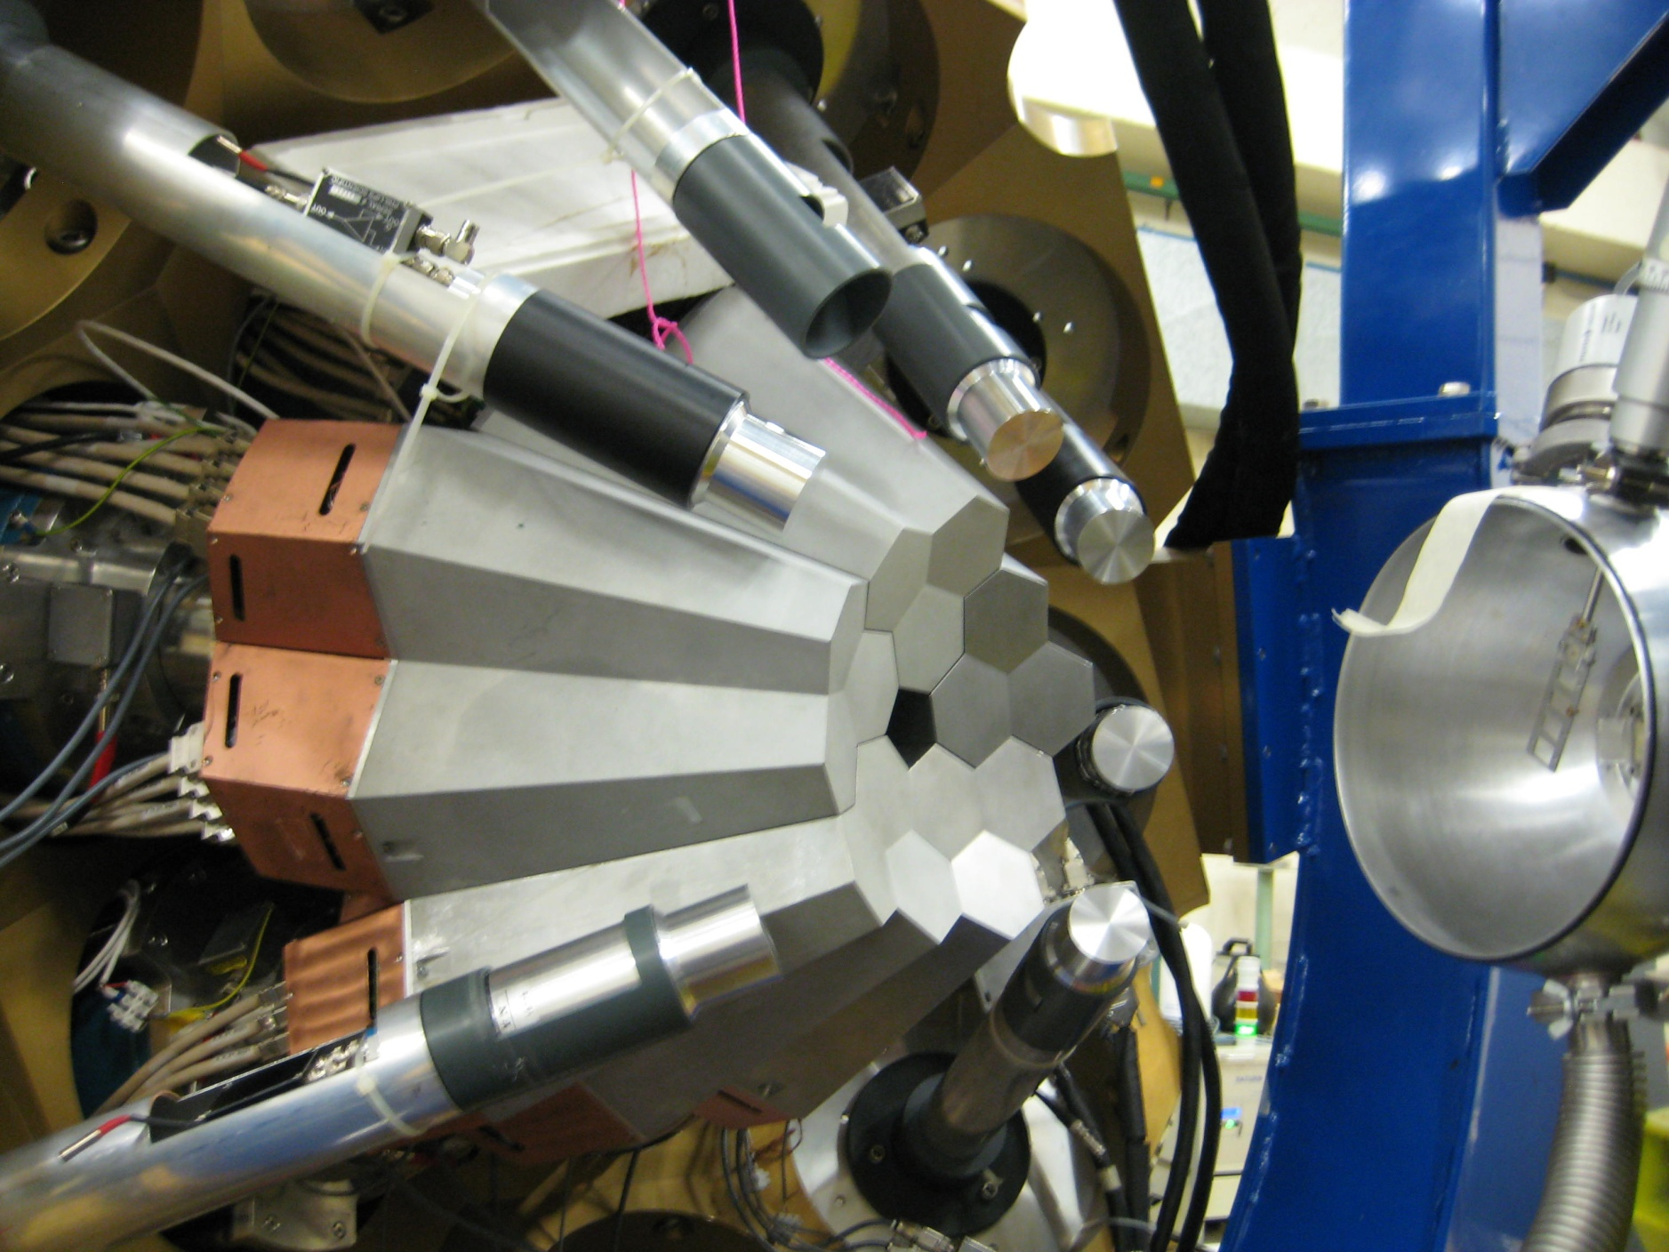
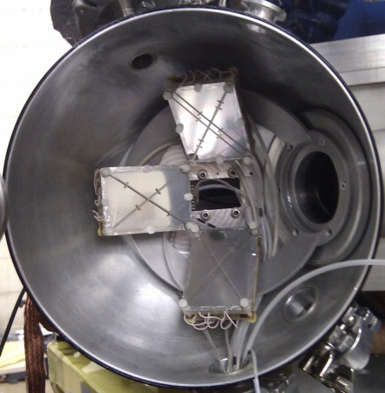
AGATA + DANTE + PRISMA + LaBr3
¹³⁶Xe beam at 859 MeV and 0.6 pnA
2 days with DANTE, 3.5 days with PRISMA+DANTE
500 g/cm2 thick self-supporting ¹⁷⁰Er target
Beam-like fragments identified by PRISMA
DANTE for tagging of isomers in ¹³⁴Ba and ¹³⁶Ba
Target-like fragments reconstructed using two-body
Kinematics
AGATA 12.4 k Hz
5.2 T bytes of data (various trigger combinations)
Alia Gengelbach (Uppsala), Peter Hampson (Liverpool)
In progress

Slide 32
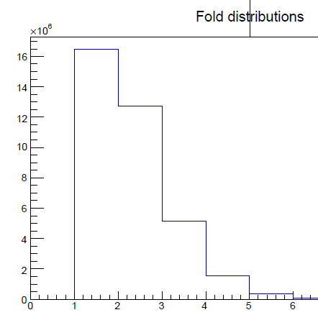
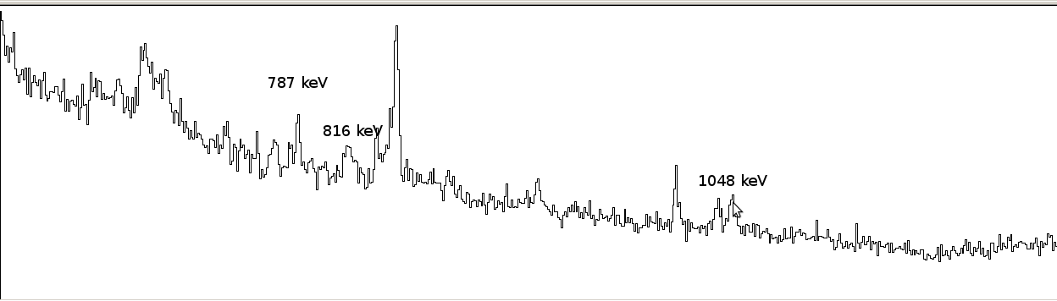
Spectroscopy of ¹⁷⁰Dy
P.-A. Söderström et al., PRC, 81:034310, 2010
PRISMA + CLARA experiment
AGATA + DANTE + PRISMA + LaBr3
¹³⁶Xe beam at 859 MeV and 0.6 pnA
2 days with DANTE, 3.5 days with PRISMA+DANTE
500 g/cm2 thick self-supporting ¹⁷⁰Er target
Beam-like fragments identified by PRISMA
DANTE for tagging of isomers in ¹³⁴Ba and ¹³⁶Ba
Target-like fragments reconstructed using two-body
Kinematics
AGATA 12.4 k Hz
5.2 T bytes of data (various trigger combinations)
Alia Gengelbach (Uppsala), Peter Hampson (Liverpool) In progress
Fold AGATA (offline)
¹⁷⁰Dy
Isomers ¹³⁶Ba (online)
¹⁷⁰Dy coming soon!

Slide 33
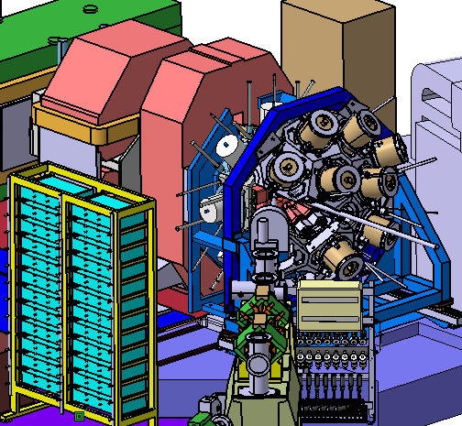
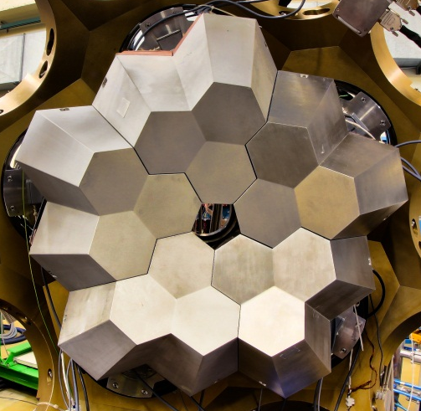
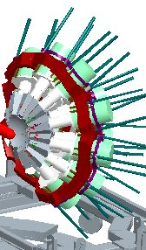

AGATA’s Movements
2010- 2011 LNL
5TC
2012 → GSI/FRS
5TC+5DC
2014 → GANIL/SPIRAL2
~15TC
AGATA +PRISMA
AGATA @ FRS
AGATA + VAMOS
+ EXOGAM+
Total Eff. ~6%
Total Eff. > 10%
Total Eff. > 20%

Slide 34

AGATA replaces RISING at GSI
photopeak efficiency: ε_{γ} = 2.8%
energy resolution: ΔE_{γ} = 21 keV
distance to target d = 70 cm

Slide 35


proposals
Conveners: M. Bentley, W. Korten
May 2010: Presentation of 35 LoIs
G-PAC (Nov. 2011): 11 proposals (80 days)
G-PAC (Fall 2012): ~15 proposals
12+ weeks of beam time for AGATA (2012/13)
8 (+1 comm) approved, 146 days
126
82
50
protons
Evolution of nuclear collectivity
  ⁷⁰Kr, ^{106,108}Zr, ²⁰²Pt
28
Evolution of nuclear shell structure :
  ¹³¹In
82
20
50
Nuclear structure at the N=Z line :
  ^{44,46}Cr, ⁵²Fe
8
28
neutrons
2
20
Dipole and octupole strength : ⁶⁴Fe, ⁸⁵Br, ¹³²Sn
2
8

Slide 36





In-flight Spectroscopy at relativistic energies
⁵⁶Cr
100-200
MeV/u
⁸⁶Kr, 480MeV/u
Lund-York-Cologne
CAlorimeter (LYCCA)
AGATA
Ge detector array
Higher SIS intensities and fast ramping
  10⁹(U) to 10¹⁰ (Xe, Kr) ions/spill
New FRS tracking detectors (>10⁶ s⁻¹ at S2, 10⁵s⁻¹ at S4)
New LYCCA-0 particle identification and tracking system
⁵⁶Cr
Z
secondary
target
DSSSD
Plastic (diamond)
DSSSD
A/Q
(x,y,ΔE)
(x,y,ΔE)
RIB from FRS
CsI
CsI
time-of-flight
Plastic

Slide 37



AGATA performance
Challenge: FRS beam size!!!
AGATA S2 Geometry
=
+
10 triple Cluster + 5 double Cluster
5 Doubles provide almost 50% of the efficiency!
Sensitivity 30x RISING
photopeak efficiency: ε_{γ} = 17.5%
γγ-efficiency = 2.5%
energy resolution: ΔE_{γ} = 4 keV
( intrinsic spatial resolution of 2 mm )
beam pipe diameter = 12 cm
chamber diameter = 43 cm

Slide 38




Slide 39

Ready and Operating by April 2012!

Slide 40


Slide 41

AGATA @ GSI
Initial in-beam commissioning April-June 2012
First experiments Sept-November 2012
28-29th June 2012, ORSAY, EGAN
G-PAC late 2012
Experiments 2013

Slide 42



AGATA 1π at GANIL : possible locations
In G1 coupled to VAMOS (and EXOGAM2 if needed): SIBs, RIBs
At the intermediate focal plane of S3: SIBs

Slide 43
Acknowledgements
Huge technical achievement
Many people and laboratories
Ongoing
Physics

Slide 44

Acknowledgements
AGATA – Advanced Gamma Tracking Array
Nuclear Instruments and Methods in Physics Research A 668 (2012) 26–58

Slide 45
THANKS

