Slide 1

Experience and first results of
@GANIL

Slide 2
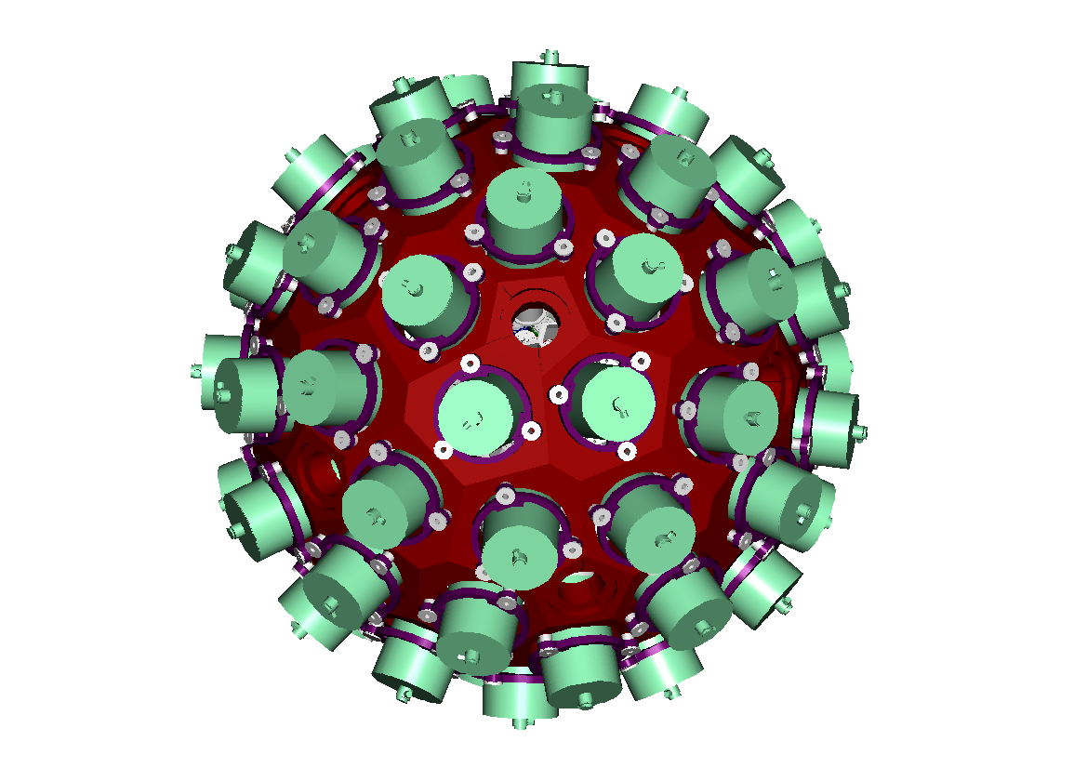
AGATA
(Advanced GAmma Tracking Array)
The innovative use of detectors :
pulse shape analysis,
γ-ray tracking,
digital DAQ
high efficiency (~40%)
http://www.facebook.com/agata.detector

Slide 3
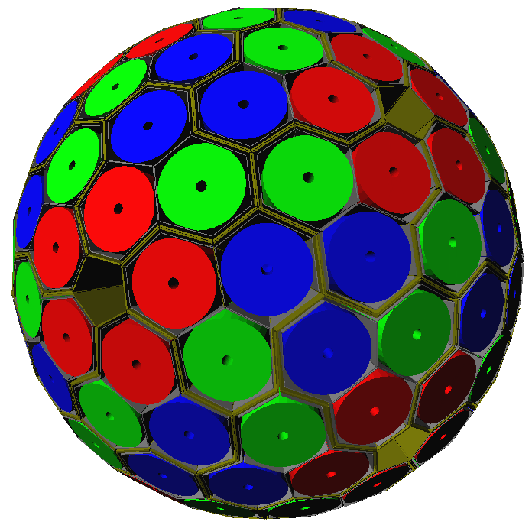
180 hexagonal crystals
60 triple-clusters
Amount of germanium 362 kg
Solid angle coverage 82 %
36-fold segmentation 6480 segments
Singles rate >50 kHz
Efficiency: 43% (M_{γ}=1) 28% (M_{γ}=30)
Peak/Total: 58% (M_{γ}=1) 49% (M_{γ}=30)
6660 high-resolution digital electronics channels
High throughput DAQ
Pulse Shape Analysis
→ position sensitive operation mode
γ-ray tracking algorithms

Slide 4
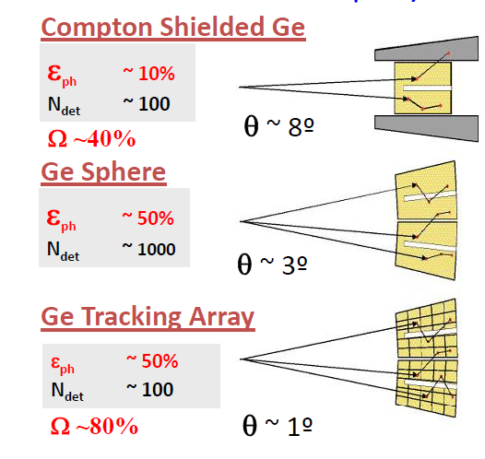
AGATA

Slide 5
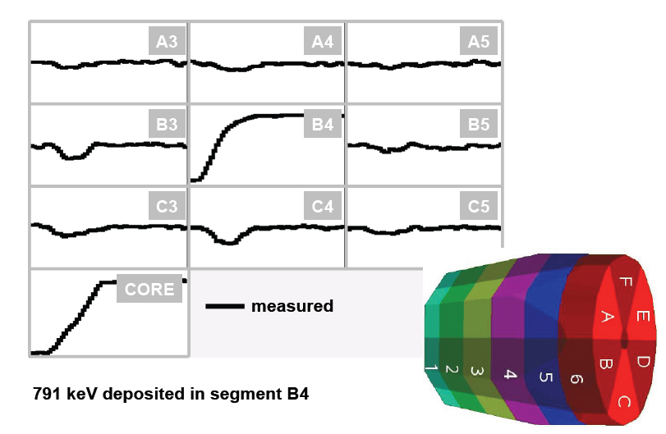

Slide 6
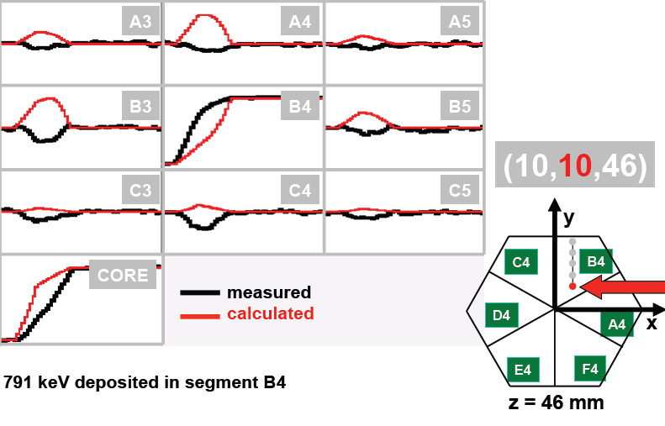

Slide 7
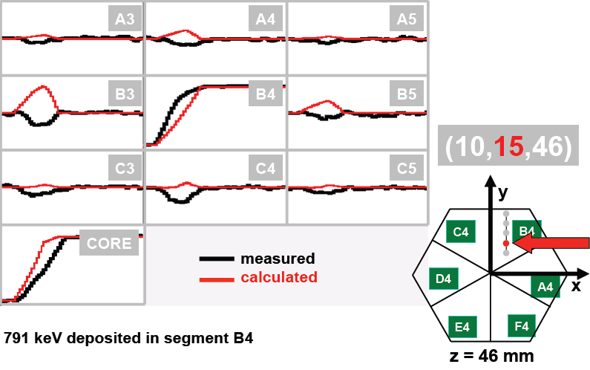

Slide 8
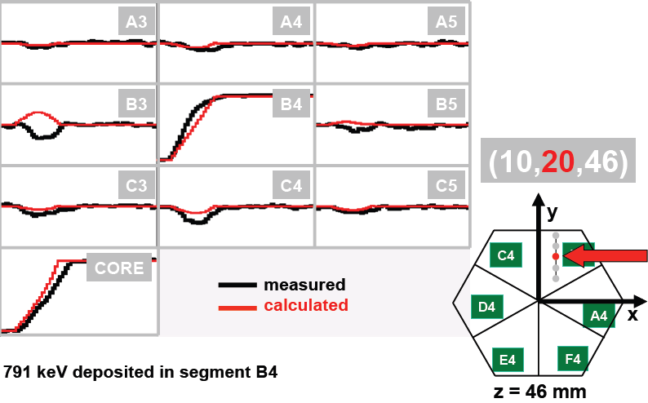

Slide 9
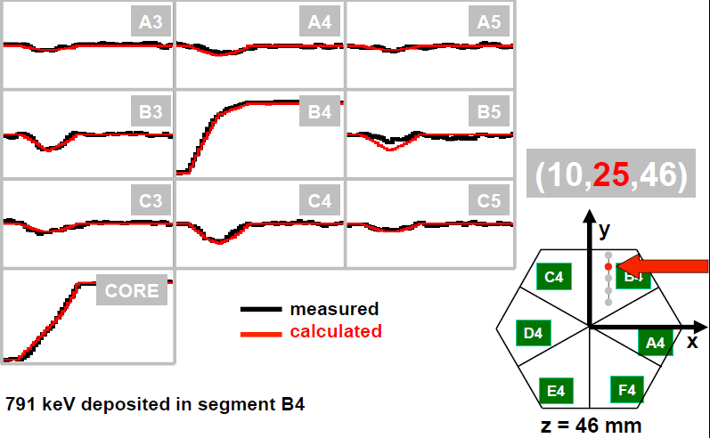

Slide 10
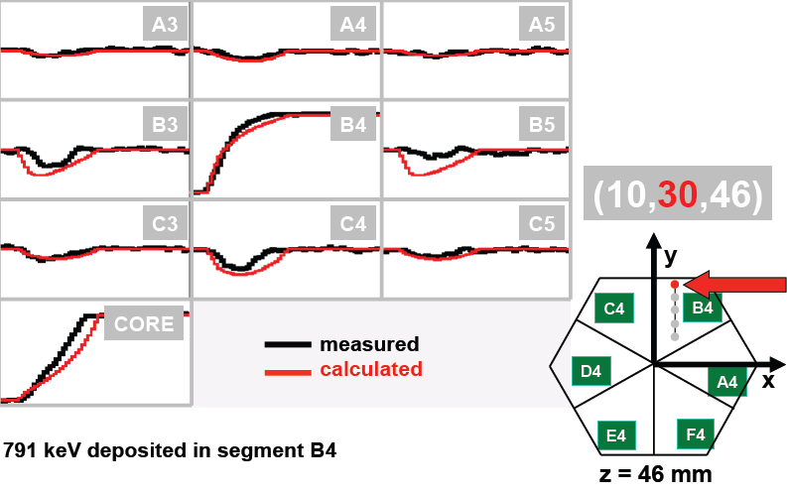

Slide 11
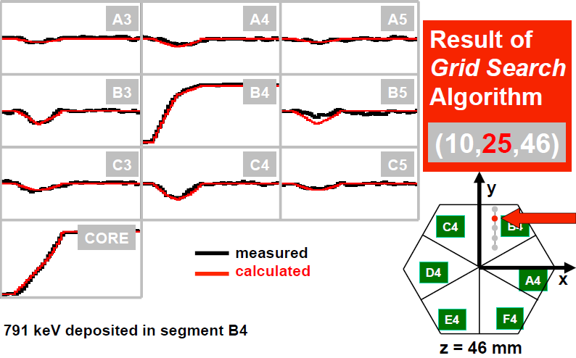

Slide 12
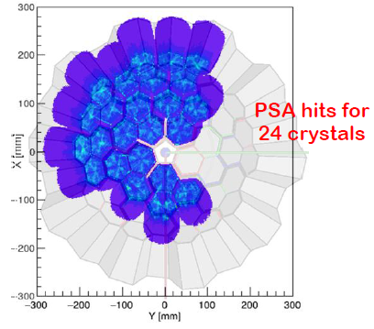
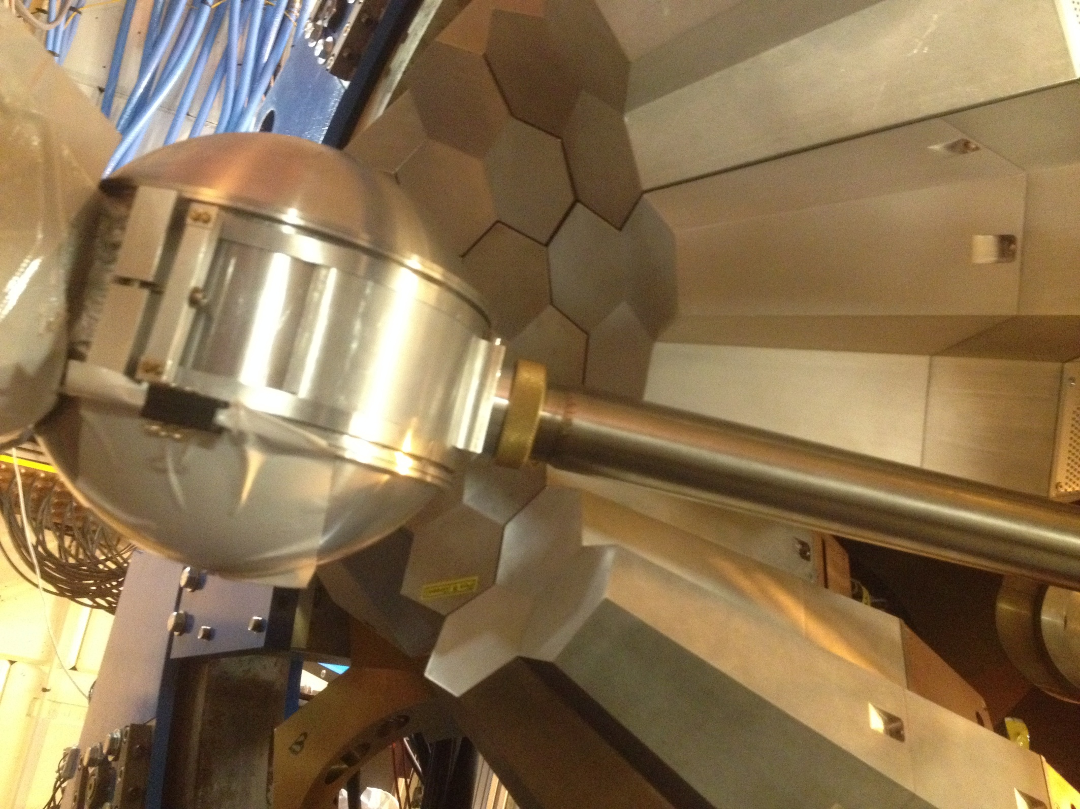
AGATA@GANIL – April 2015

Slide 13
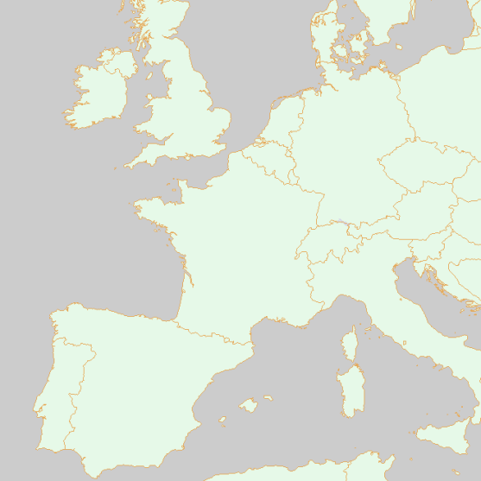
AGATA Collaboration
Three facilities identified :
  LNL/SPES (Legnaro) 2010-2012
  GSI/FAIR (Darmstadt) 2012-2014
  GANIL/SPIRAL2 (Caen) 2014-2018
>10
8
5

Slide 14
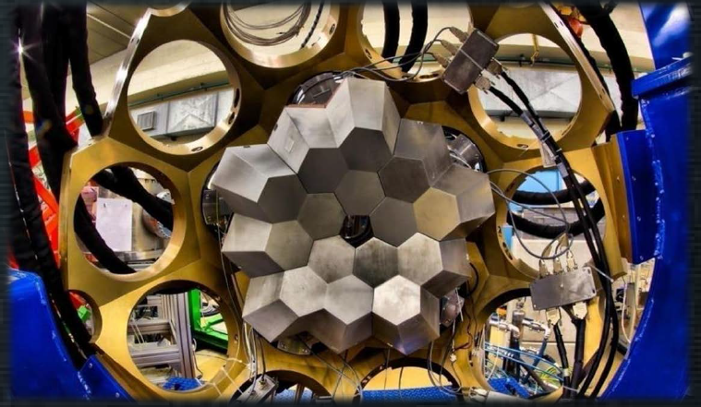
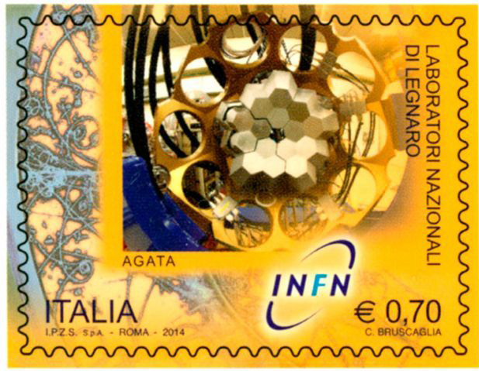
LNL results
20 experiments performed between 2010-2012
S. Ceruti et al, Phys. Rev. Lett.. 115, 222502 (2015)
F. C. L. Crespi et al Phys. Rev. C 91, 024323 (2015)
A. Vogt, et al Phys. Rev. C 92, 024619 (2015)
P. G. Bizzeti et al Eur.Phys.J. A 51, 49 (2015)
B. Birkenbach et al. Phys.Rev. C 92, 044319 (2015)
E. Sahin, et al Phys. Rev. C 91, 034302 (2015)
P.R. John, et al Phys. Rev. C 90, 021301(R) (2014)
L. Pellegriet al Phys. Lett. B 738 (2014) 519
F.C.L. Crespi et al Phys. Rev. Lett. 113, 012501 (2014)
V. Modamio et al, Phys. Rev. C 88, 044326 (2013)
V. Vandone et al, Phys. Rev. C88, 034312 (2013)
C. Louchart, et al, Phys. Rev. C 87, 054302 (2013)
P.-A. Soderstrom, et al, Phys. Rev.C 86, 054320 (2012)

Slide 15
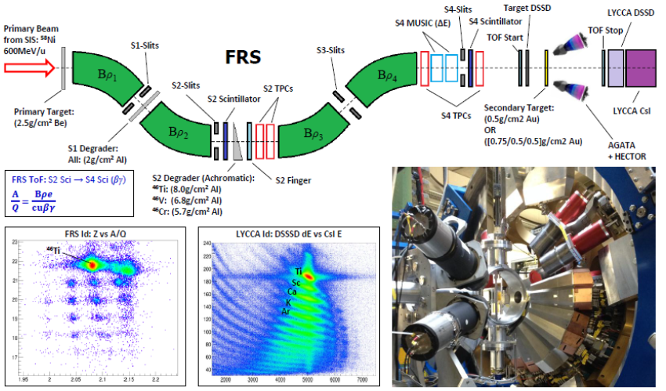
The GSI Campaign 2012-2014

Slide 16
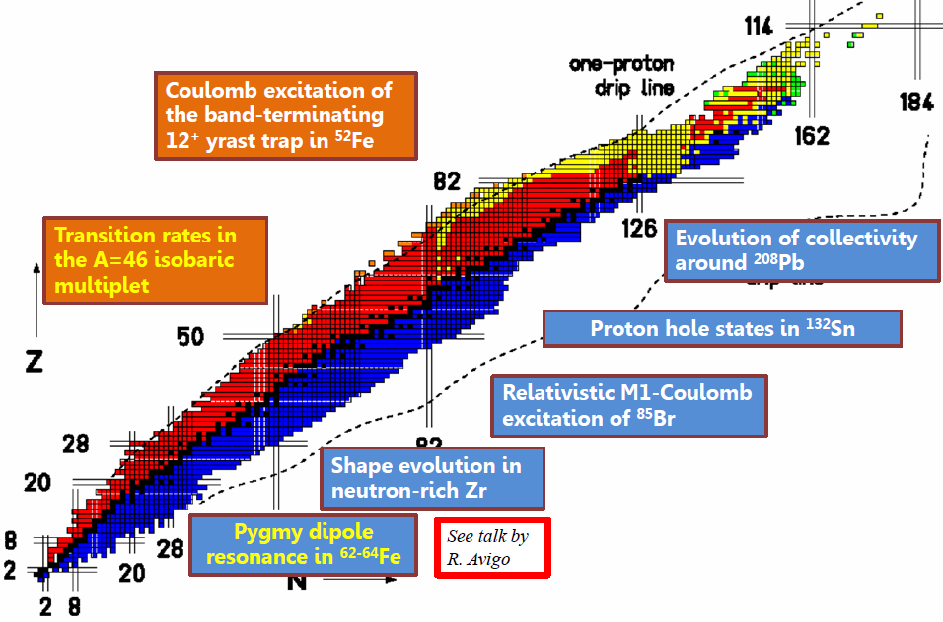
The GSI Campaign 2012-2014
→ Data under analysis

Slide 17

The GANIL Campaign
Neutron and charged particles detected in NEDA/DIAMANT
Charged particles detectors for Coulex and nucleon transfer
Separated and tagged by their decay in the VAMOS GFM
Recoils identification by the VAMOS magnetic spectrometer
Post-accelerated RIB from SPIRAL1
Multinucleon Transfer and fusion-fission
Fusion-evaporation
The physics case of AGATA@GANIL is the in-beam γ-ray spectroscopy of exotic nuclei populated by heavy-ions collisions at the Coulomb Barrier

Slide 18
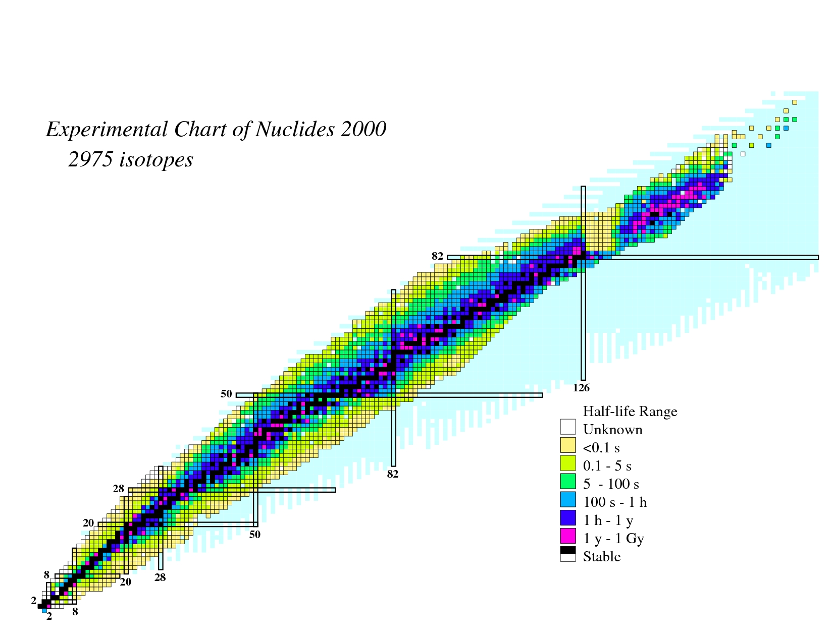
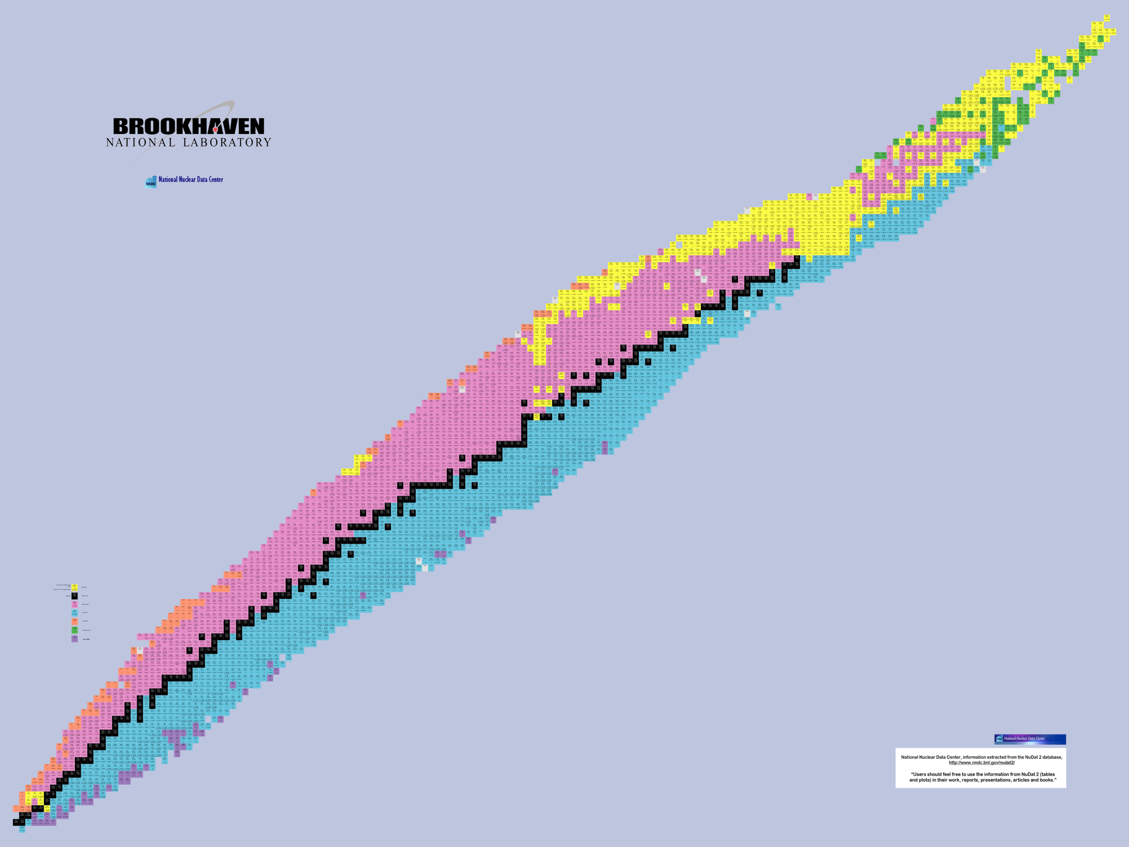
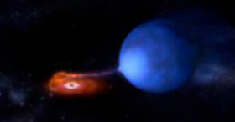
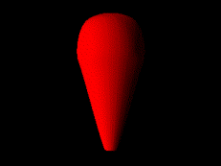
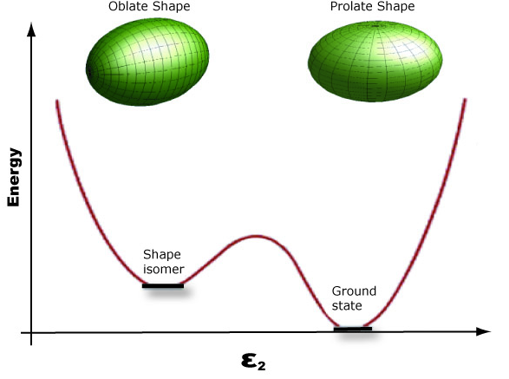
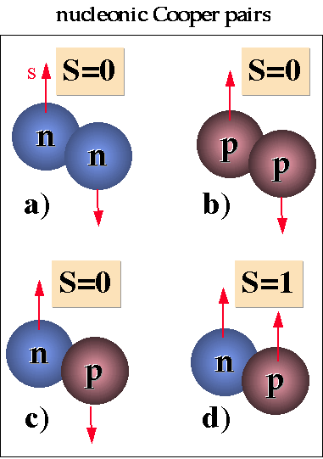
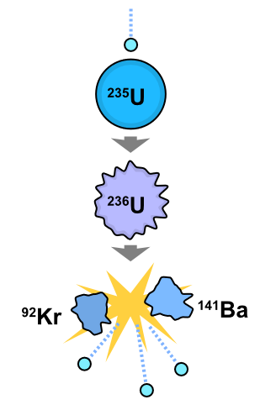
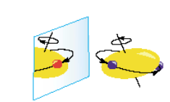
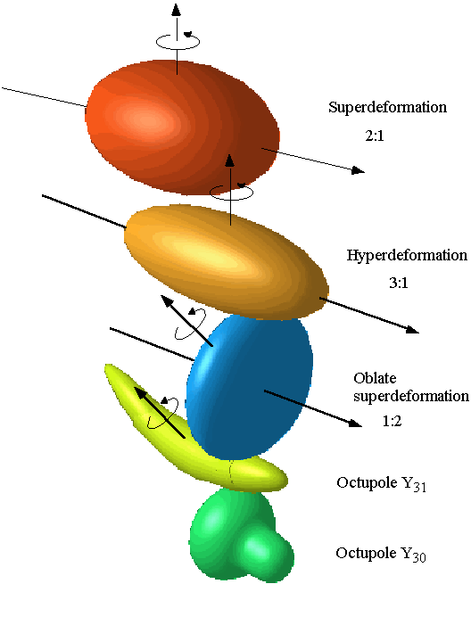
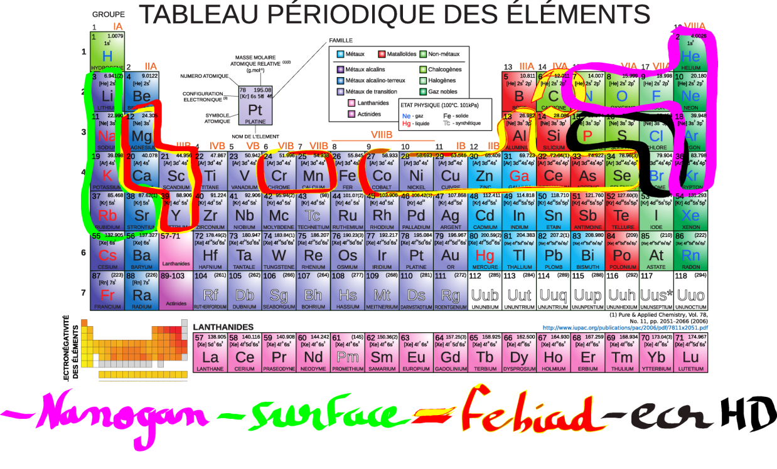
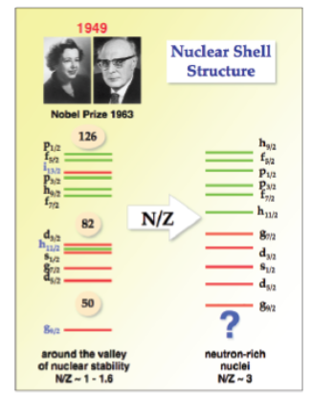
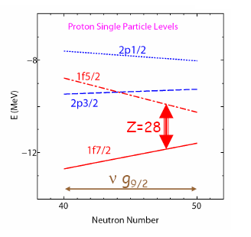

Physics cases for the AGATA campaign in GANIL
⁴⁸Ca,⁵⁰Ti→ SHE
²⁵⁶Rf
²⁵⁴No
Cm,Bk
Cf,Es
¹⁹⁴Pb
¹⁷⁶Hg
Sm,Pm
²⁰⁶Hg
¹⁰²Sn
Dy,Er,Yb
¹⁰⁰In
Ru, Pd
⁵⁸Ni,⁴⁰Ca→ N=Z
Xe,Te
⁸⁰Zr
Zr, Mo
⁷⁷Y
¹³²In
⁷⁵Sr
Zr, Sr
⁷⁸Ni
⁸⁰Zn
⁶³Ge
⁶⁸Ni,Fe,Co,Cu
³⁸K
⁴⁶Ti
²³⁸U,²⁰⁸Pb → n-rich
³⁴Ar
^{46,48}Ca
S,Cl,Ar,K
Ne,Na
SPIRAL1

Slide 19
The GANIL Campaign organization
The GANIL campaign is organized in different sub-campaigns associated to a main setup
They are organized between the ACC, the GANIL management and the campaign manager
(S. Lenzi from the University of Padova)
Each GANIL PAC has a “PrePac” workshop with a specific call : AGATA Collaboration Meeting
1st PAC in 2014 : VAMOS (10 experiments approved)
2nd PAC in 2015 : VAMOS || NEDA (10 experiments approved)
3rd PAC in June2016 : NEDA (more restricted)
10th-12th February 2016 – AGATA /NEDA
8th-10th February 2016 : SPIRAL1 Workshop
*Proposal for the AGATA-NEDA
*Updated LoI for SPIRAL1 and GFM
1st campaign (2015-2016) : AGATA+VAMOS coupling

Slide 20
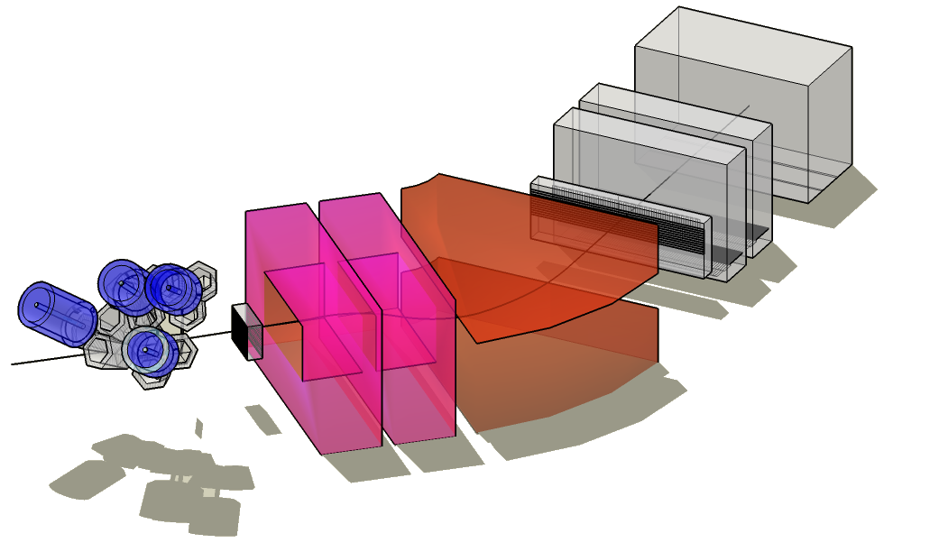
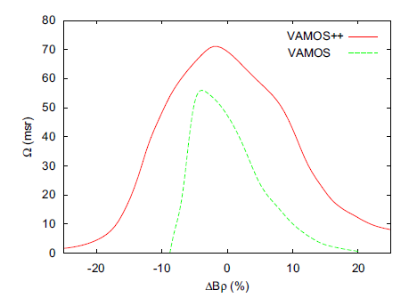
Multinucleon Transfer
fusion-fission
Recoils identification by the VAMOS++ magnetic spectrometer
Full reconstruction over the whole acceptance
Mass resolution ~ 1/220
Z identification up to Z= 62
H. Savajols et al, NIM B 204 (2003) 146-153
S. Pullanhiotan, et al NIM A, 593( 2008)
M. Rejmund et al, NIM A 646 (2011) 184–191
M. Vandebrouck et al, NIM A 812 (2016) 112–117

Slide 21
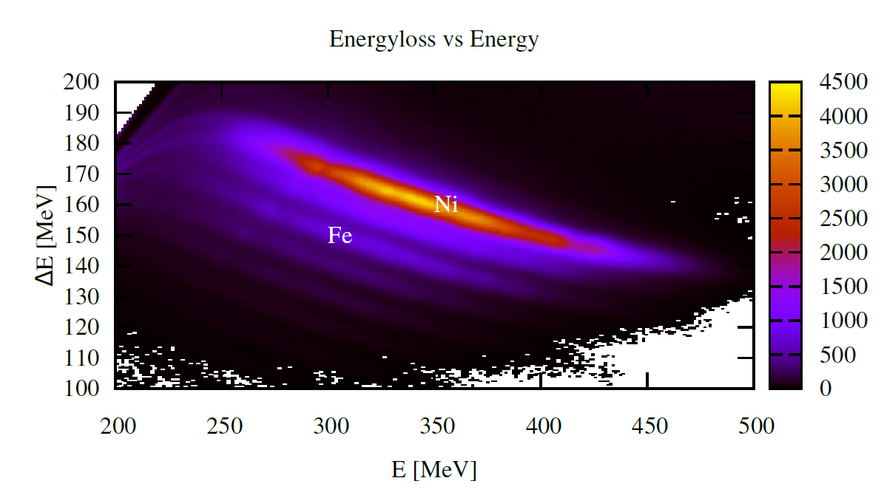
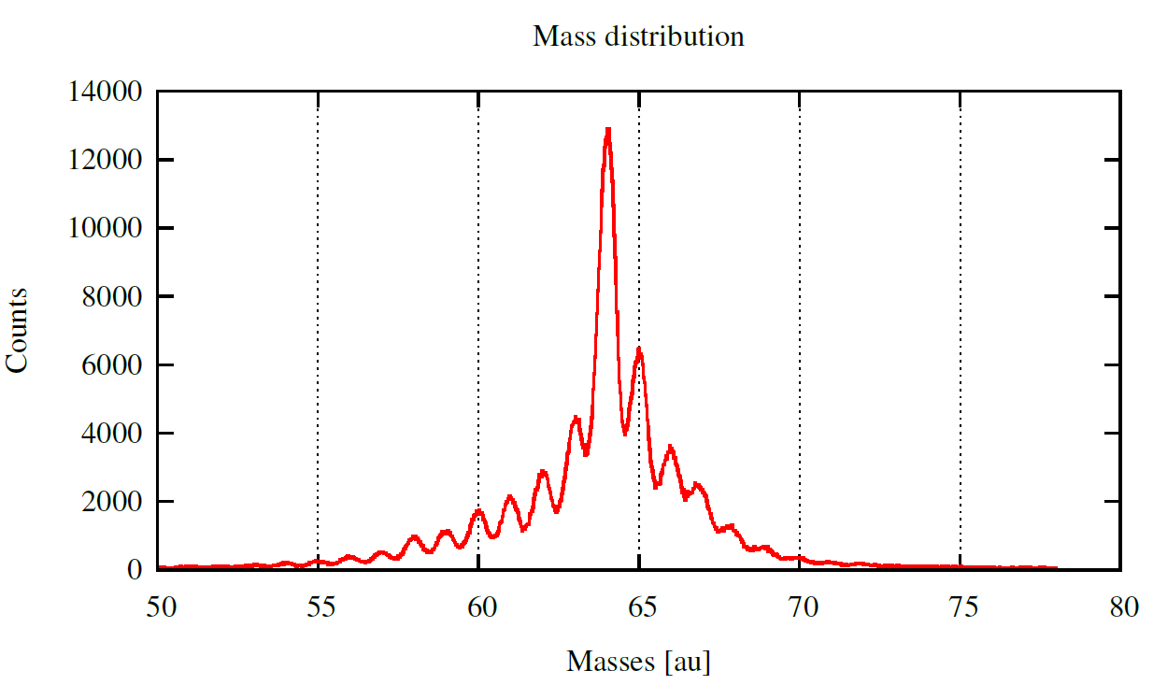
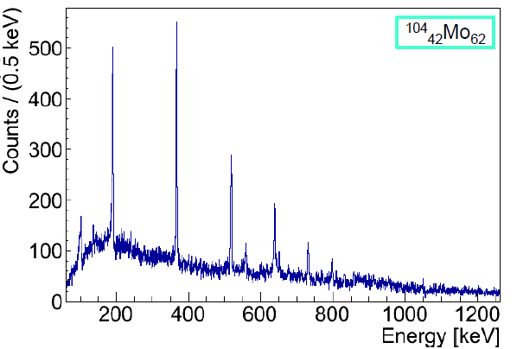
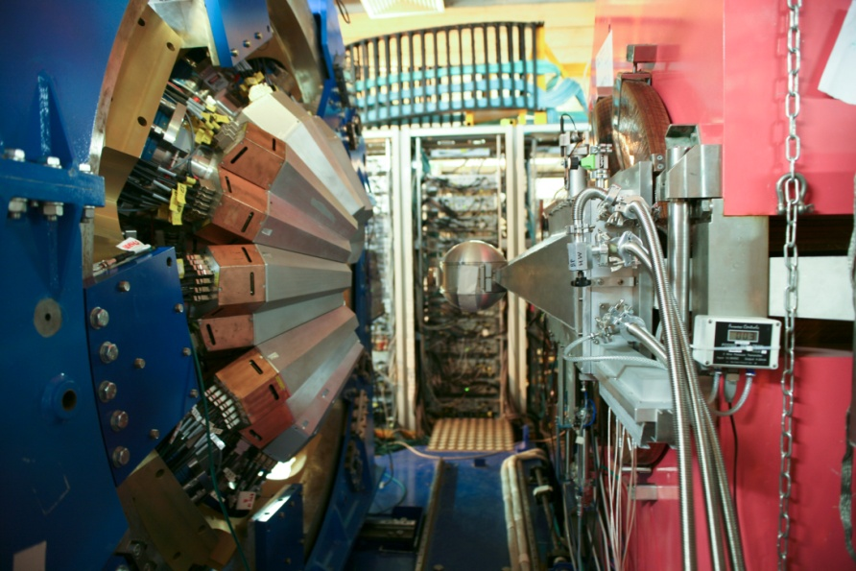
Z
Our strengths are :
Recoils identifications (fission / MNT)
Relatively high spins
High Resolution
Lifetimes measurements
ε_{γTracked (mgt)} = ~4%

Slide 22
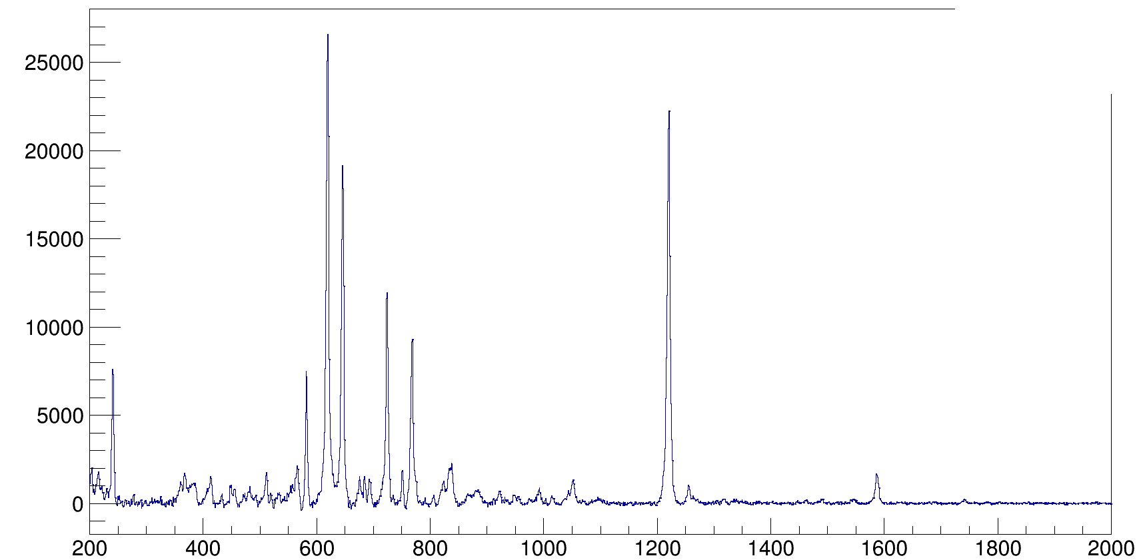
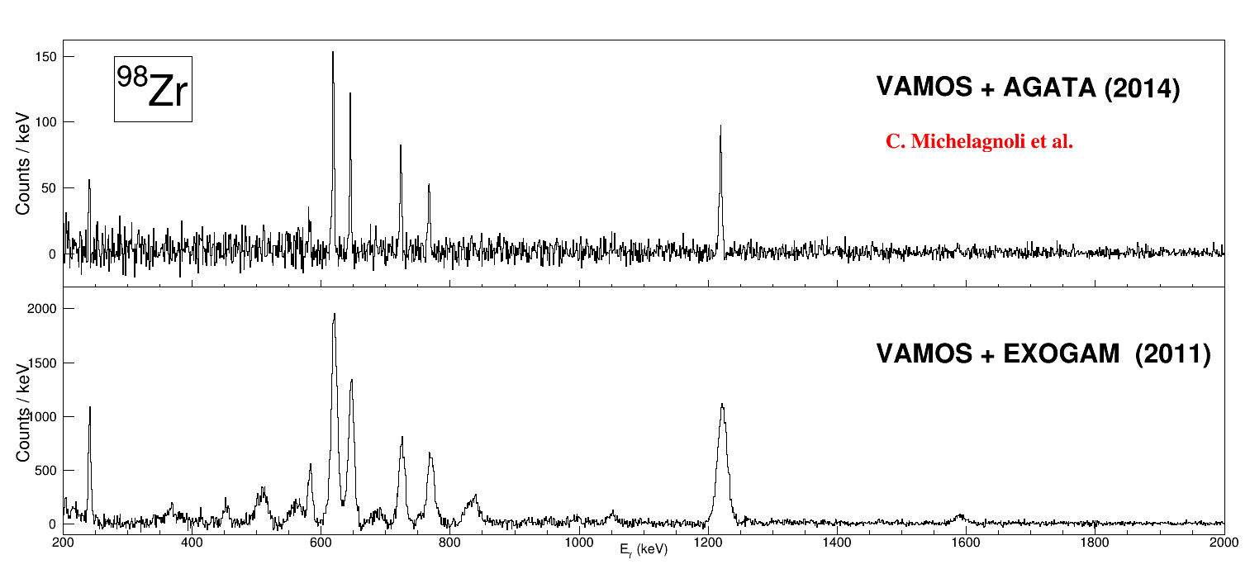
Commissioning runs – December 2014
⁹⁸Zr
VAMOS ++ AGATA (2015)
J. Dudouet (IPNL)-Preliminary

Slide 23
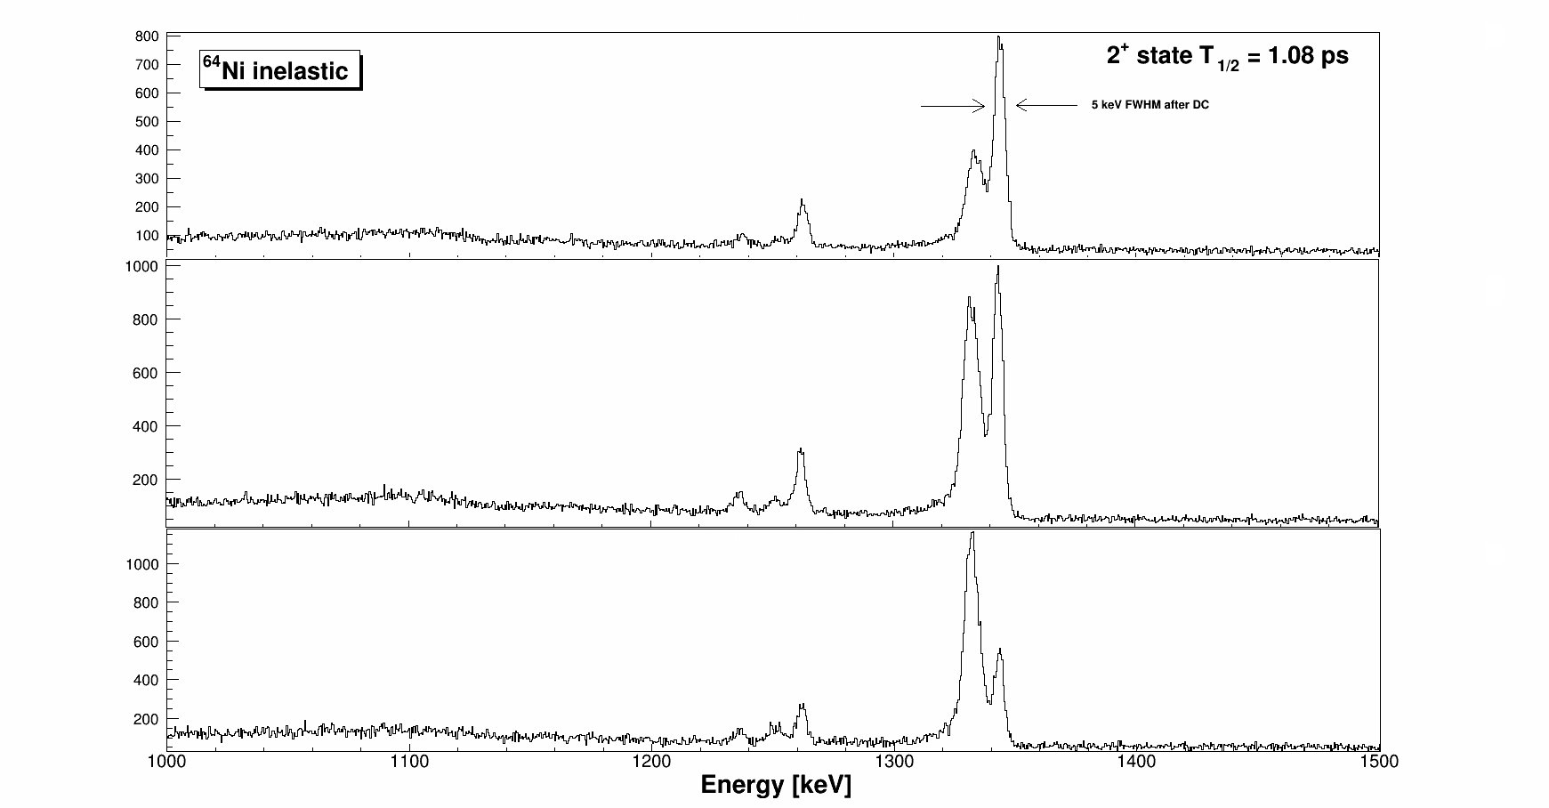
Lifetime measurement at AGATA@GANIL
Not simulation , Real in-beam data
⁶⁴Ni
J+2
T_{1/2}
²³⁸U
VAMOS
T.o.F.
J
To be completed by the FastTiming method with the use of LaBr3 and the continus 2D DSAM**

Slide 24
Physics cases of the 1st run AGATA at GANIL : Nuclear structure in the vicinity of doubly magic nuclei
p-n , n-n correlations in the vicinity ¹³²Sn;¹⁰⁰Sn, ⁶⁸Ni, ⁴⁸Ca
Terra-incognita ²⁰⁸Pb
Tensor force and monopole migration around ⁷⁸Ni
3 body forces
G. Georgiev et al; 2⁺ lifetimes and g factor ^{204,206,208}Hg : 17th -29th July
C. Domingo-Pardo et al ; 4⁺, 2⁺ lifetime in ⁹⁴Ru and ⁹⁶Pd
²⁰⁸Pb
J. J. Valiente Dobon et al 4⁺, 2⁺ lifetime in ^{106,108}Sn
P. R. John et al ; Shape transition in W isotopes: ¹⁹⁰W and ¹⁹²W spectroscopy and fast timing
¹⁰⁰Sn
¹³²Sn
A. Navin et al ; i_{13/2} single particle state in ¹³³Sn and high spin in ¹⁰⁸Zr
⁶⁸Ni
⁷⁸Ni
D. Verney et al; lifetime measurement in ⁸³Ge.
G. Duchêne et al; ⁸⁰Zn and ⁸²Ge highest spin structures
J. Ljungvall et al ; 2⁺, 4⁺ 6⁺ lifetime and g-factor in ^{62,64,66}Fe
⁴⁸Ca
A. Lemasson et al : spectroscopy of ^{39,41,43}S
S. Leoni et al ; Lifetime in n-rich C and O isotopes: test of the three body forces

Slide 25
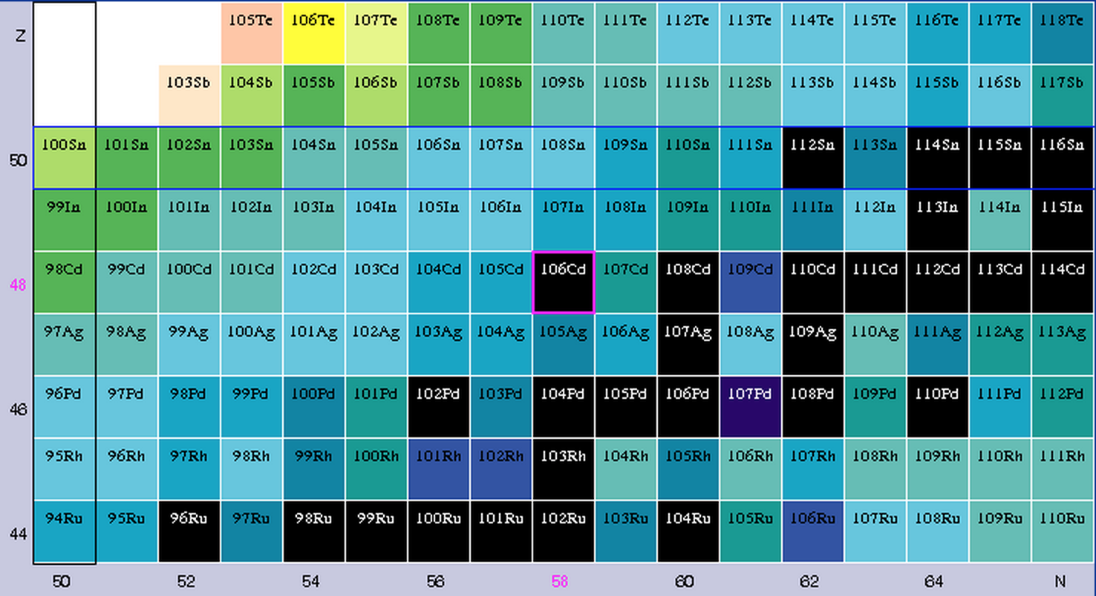
Liftetime measurement in the ¹⁰⁰Sn region
Q_{value} -8 MeV -3 MeV
Multinucleon-transfer reactions in the neutron-deficient side to populate the Sn/Ru isotopes and measure the lifetimes of the 2⁺ and 4⁺ states

Slide 26
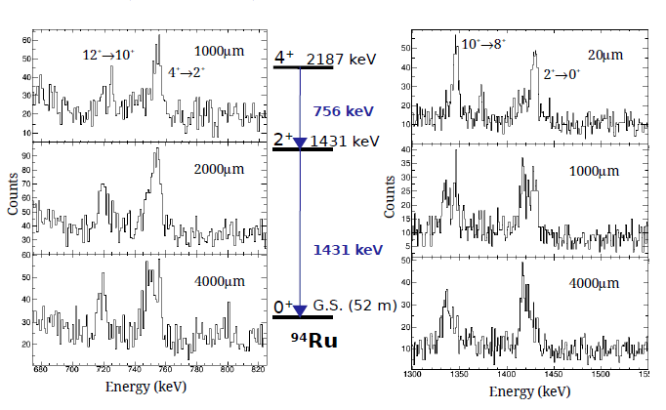
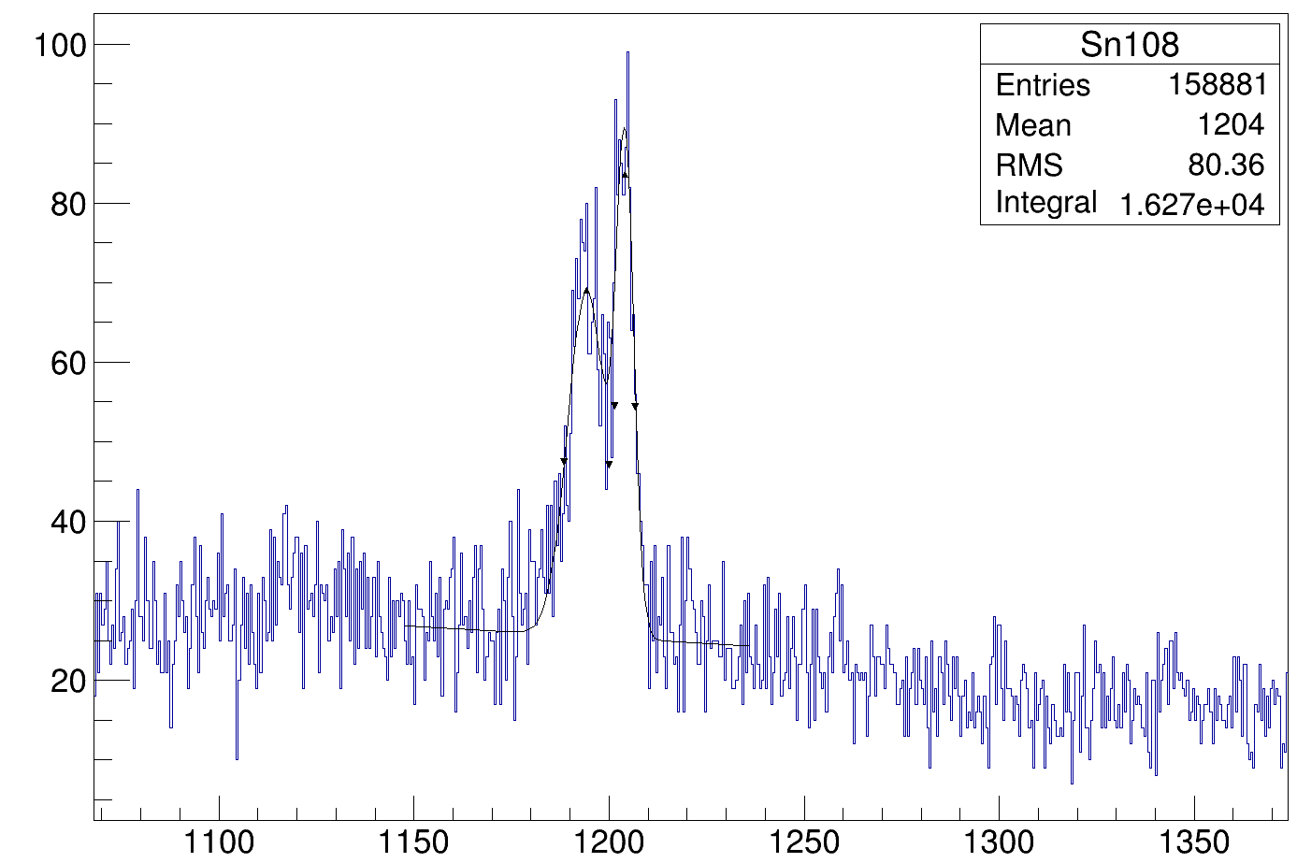
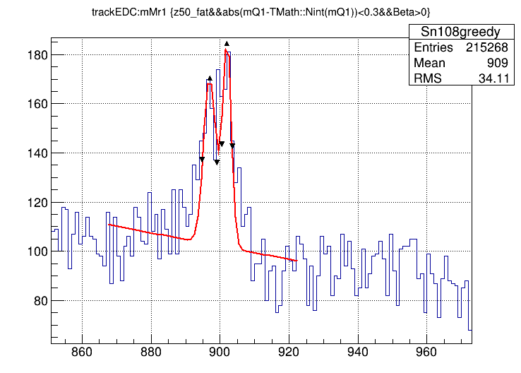
Physics cases of the 1st run AGATA at GANIL : Nuclear structure in the vicinity of doubly magic nuclei
R. Perez, et al. (IFIC)
p-n , n-n correlations in the vicinity ¹³²Sn;¹⁰⁰Sn, ⁶⁸Ni, ⁴⁸Ca
Terra-incognita ²⁰⁸Pb
Tensor force and monopole migration around ⁷⁸Ni
3 body forces
G. Georgiev et al; 2⁺ lifetimes and g factor ^{204,206,208}Hg : 17th -29th July
C. Domingo-Pardo et al ; 4⁺, 2⁺ lifetime in ⁹⁴Ru and ⁹⁶Pd
²⁰⁸Pb
J. J. Valiente Dobon et al 4⁺, 2⁺ lifetime in ^{106,108}Sn
P. R. John et al ; Shape transition in W isotopes: ¹⁹⁰W and ¹⁹²W spectroscopy and fast timing
¹⁰⁰Sn
On-Line
¹³²Sn
A. Navin et al ; i_{13/2} single particle state in ¹³³Sn and high spin in ¹⁰⁸Zr
¹⁰⁶⁻¹⁰⁸Sn 2⁺,4⁺
M. Siciliano, et al. (LNL)
⁶⁸Ni
⁷⁸Ni
D. Verney et al; lifetime measurement in ⁸³Ge.
G. Duchêne et al; ⁸⁰Zn and ⁸²Ge highest spin structures
J. Ljungvall et al ; 2⁺, 4⁺ 6⁺ lifetime and g-factor in ^{62,64,66}Fe
⁴⁸Ca
A. Lemasson et al : spectroscopy of ^{39,41,43}S
S. Leoni et al ; Lifetime in n-rich C and O isotopes: test of the three body forces

Slide 27
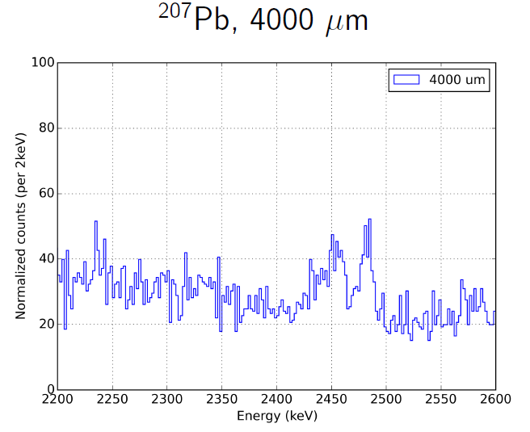
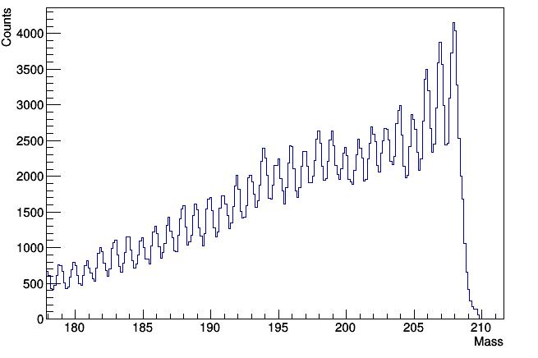
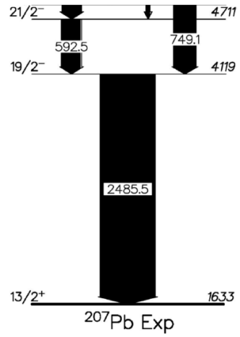
Physics cases of the 1st run AGATA at GANIL : Nuclear structure in the vicinity of doubly magic nuclei
p-n , n-n correlations in the vicinity ¹³²Sn;¹⁰⁰Sn, ⁶⁸Ni, ⁴⁸Ca
Terra-incognita ²⁰⁸Pb
Tensor force and monopole migration around ⁷⁸Ni
3 body forces
G. Georgiev et al; 2⁺ lifetimes and g factor ^{204,206,208}Hg : 17th -29th July
C. Domingo-Pardo et al ; 4⁺, 2⁺ lifetime in ⁹⁴Ru and ⁹⁶Pd
²⁰⁸Pb
J. J. Valiente Dobon et al 4⁺, 2⁺ lifetime in ^{106,108}Sn
P. R. John et al ; Shape transition in W isotopes: ¹⁹⁰W and ¹⁹²W spectroscopy and fast timing
D. Ralet et al (CSNSM)
¹⁰⁰Sn
A. Navin et al ; i_{13/2} single particle state in ¹³³Sn and high spin in ¹⁰⁸Zr
¹³²Sn
On-Line
⁶⁸Ni
⁷⁸Ni
D. Verney et al; lifetime measurement in ⁸³Ge.
G. Duchêne et al; ⁸⁰Zn and ⁸²Ge highest spin structures
J. Ljungvall et al ; 2⁺, 4⁺ 6⁺ lifetime and g-factor in ^{62,64,66}Fe
⁴⁸Ca
A. Lemasson et al : spectroscopy of ^{39,41,43}S
S. Leoni et al ; Lifetime in n-rich C and O isotopes: test of the three body forces

Slide 28
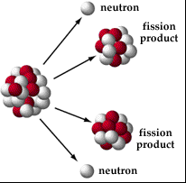
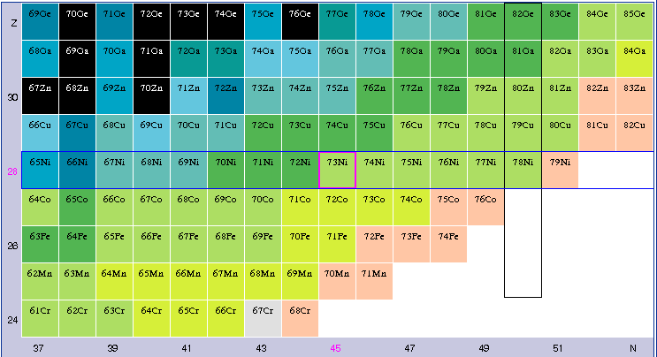
Spectroscopy in the ⁶⁸⁻⁷⁸Ni region
LPNS interaction

Slide 29
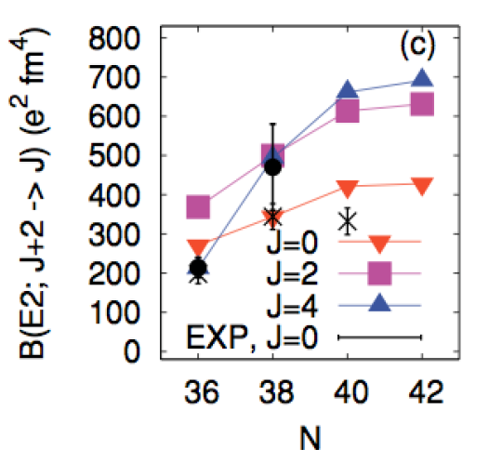
Lifetime in the 4⁺ states in ^{62,64}Fe
J.Ljungvall et al, Phys.Rev. C 81, 061301 (2010)
W.Rother et al, Phys.Rev.Lett. 106, 022502 (2011)
S. M. Lenzi, F. Nowacki, A. Poves, and K. Sieja, Phys. Rev. C 82, 054301 (2010)

Slide 30
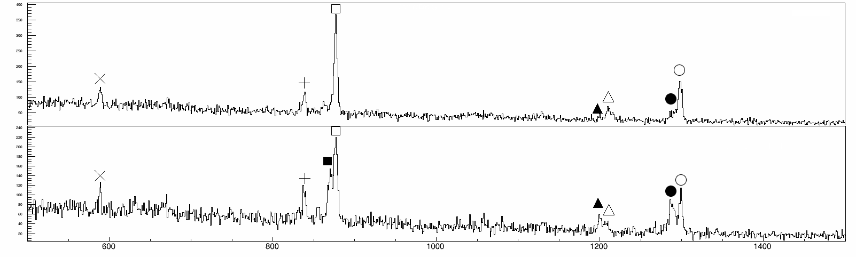
Lifetime in the 4⁺ states in ^{62,64}Fe
τ₄⁺ states
τ₆⁺ states (?)
⁶²Fe
J. Ljungvall et al in preparation (CSNSM)
+ Lifetime in Co and Mn

Slide 31
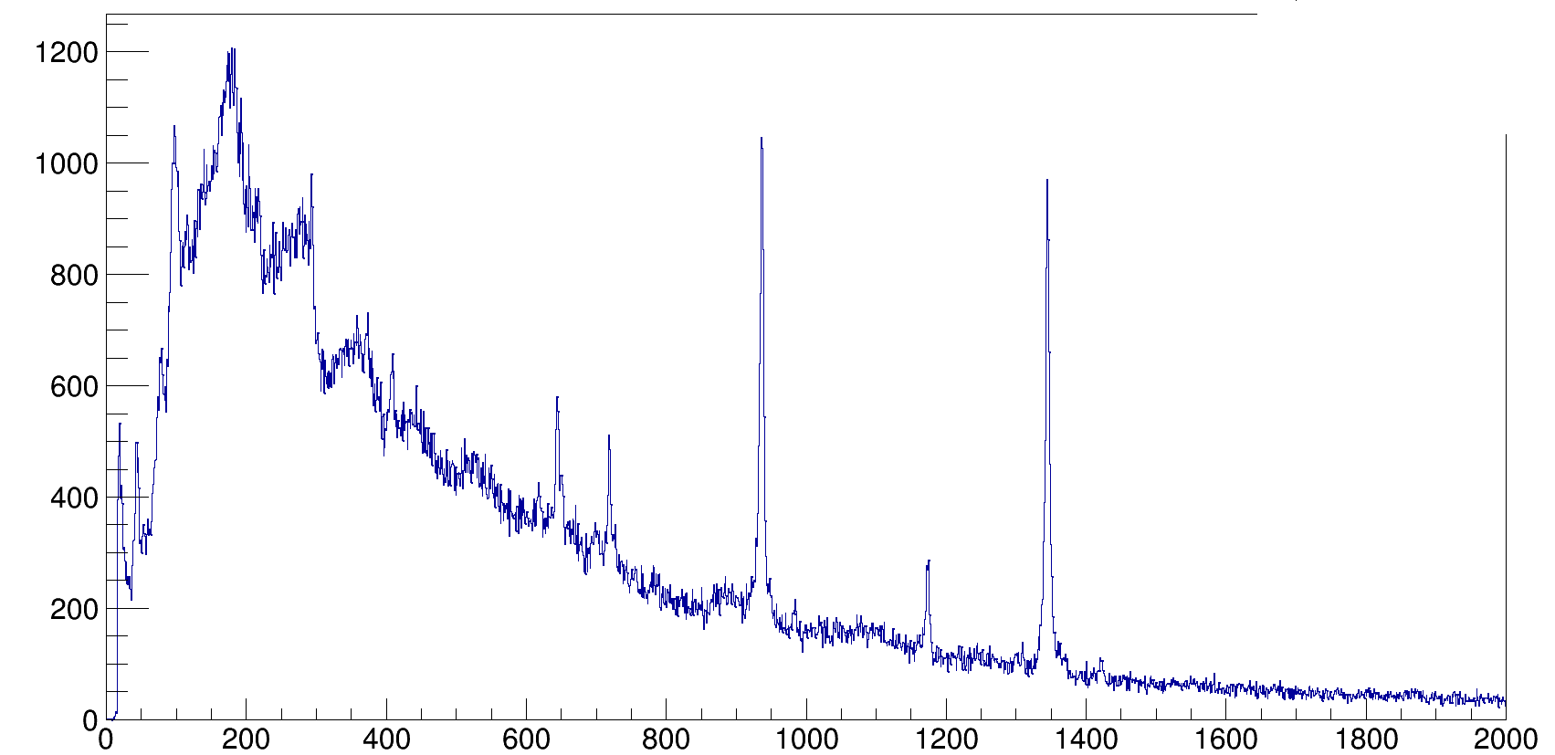


Lifetime and spectroscopy in the ⁷⁸Ni vicinity
(4⁺₂)→2⁺₁
(6⁺₂)→(4⁺₂)
⁸²Ge
Fission Fragments produced by fusion-fission ²³⁸U+⁹Be in inverse kinematic
Fully identified in VAMOS
Magnetic spectrometer placed at large angle to select the lowest mass region
2⁺₁→0⁺₁
(8⁺₁)
(5,6⁺₁)→(4⁺₂)
J^{π}→(4⁺₂)
(6⁺₂)
(5,6⁺₁)
(x)
(8⁺₂)→(6⁺₂)
Kr
(4⁺₂)
Se
2⁺₁
Ge
Ni
Zn
0⁺₁
N=50
Unique opportunity for γ-ray
spectroscopy of light FF
51
52
J. Dudouet et al (IPNL) Preliminary

Slide 32
Physics cases for the 2nd run (2016-2017) : nuclear structure in the vicinity of doubly magic nuclei, N=Z nuclei, astrophysic and deformation
J. Nyberg et al. : Studies of excited states in ^{102,103}Sn to deduce two-body neutron interactions, single-particle energies and N=Z=50 core excitations
M. Doncel et al. :Production test for spectroscopy and lifetime measurements in the A=78 isobaric triplet using
multi-nucleon transfer reactions
S. Lenzi et al. : Effects of Isospin Symmetry Breaking in the A=63 mirror nuclei
A. Jungclauss et al. :Exploration of alpha-cluster structures in heavy nuclei: The unique case of ²¹²Po (²⁰⁸Pb + α)
P. Regan et al. : Understanding Nuclear Collectivity Approaching the π−ν Valence Maximum: Transition Quadrupole Moments in ^{166,168}Dy.
²⁰⁸Pb
2nd PAC 27th-28th Avril 2015
P. R. John et al ; Shape transition in W isotopes: ¹⁹⁰W and ¹⁹²W spectroscopy and fast timing
¹⁰⁰Sn
¹³²Sn
A. Navin et al ; i_{13/2} single particle state in ¹³³Sn and high spin in ¹⁰⁸Zr
W. Korten et al. :Shape coexistence and triaxiality in neutron-rich fission fragments in the mass A=100-120
⁶⁸Ni
⁷⁸Ni
I. Celikovic et al. :Evolution of collectivity around N=40: lifetime measurements in ^{73,75}Ga
C. Fransen et al. : Evolution of the shell structure in the region of neutron-rich Ti isotopes
P. Bednarczyk et al. : Investigation of a high spin structure in ⁴⁴Ti
⁴⁸Ca
A. Lemasson et al : spectroscopy of ^{39,41,43}S
C. Michelagnoli et al . : The lifetime of the 7.786 MeV state in ²³Mg as a probe for classical novae models
S. Leoni et al ; Lifetime in n-rich C and O isotopes: test of the three body forces

Slide 33
Physics cases for the 2nd run (2016-2017) : nuclear structure in the vicinity of doubly magic nuclei, N=Z nuclei, astrophysic and deformation
J. Nyberg et al. : Studies of excited states in ^{102,103}Sn to deduce two-body neutron interactions, single-particle energies and N=Z=50 core excitations
M. Doncel et al. :Production test for spectroscopy and lifetime measurements in the A=78 isobaric triplet using
multi-nucleon transfer reactions
S. Lenzi et al. : Effects of Isospin Symmetry Breaking in the A=63 mirror nuclei
A. Jungclauss et al. :Exploration of alpha-cluster structures in heavy nuclei: The unique case of ²¹²Po (²⁰⁸Pb + α)
P. Regan et al. : Understanding Nuclear Collectivity Approaching the π−ν Valence Maximum: Transition Quadrupole Moments in ^{166,168}Dy.
²⁰⁸Pb
2016’s run : 4 experiments
P. R. John et al ; Shape transition in W isotopes: ¹⁹⁰W and ¹⁹²W spectroscopy and fast timing
¹⁰⁰Sn
¹³²Sn
A. Navin et al ; i_{13/2} single particle state in ¹³³Sn and high spin in ¹⁰⁸Zr
W. Korten et al. :Shape coexistence and triaxiality in neutron-rich fission fragments in the mass A=100-120
⁶⁸Ni
⁷⁸Ni
I. Celikovic et al. :Evolution of collectivity around N=40: lifetime measurements in ^{73,75}Ga
C. Fransen et al. : Evolution of the shell structure in the region of neutron-rich Ti isotopes
P. Bednarczyk et al. : Investigation of a high spin structure in ⁴⁴Ti
⁴⁸Ca
A. Lemasson et al : spectroscopy of ^{39,41,43}S
C. Michelagnoli et al . : The lifetime of the 7.786 MeV state in ²³Mg as a probe for classical novae models
S. Leoni et al ; Lifetime in n-rich C and O isotopes: test of the three body forces

Slide 34

The GANIL experimental campaign has started and 6 experiments were performed
Next run is starting in March 2016
Analysis is going well for most of the experiments
LaBr3 sub campaign in 2017
NEDA-DIAMANT setup in 2018
Looking forward the VAMOS gaz-filled and SPIRAL1 campaigns
Next PAC 9-10th of June 2016
32 caps, January 2016 GANIL

Slide 36

Lifetime and spectroscopy in the ⁷⁸Ni vicinity
Lifetime in Ge, Se at N=51 ; ⁹Be (²³⁸U, FF)
0⁺ × ν1g_{7/2}
?
2⁺ × ν2d_{5/2}

Slide 37


Lifetime and spectroscopy in the ⁷⁸Ni vicinity
0⁺ × ν1g_{7/2}
?
2⁺ × ν2d_{5/2}

Slide 38


Slide 39


Slide 40



Slide 41

C. Michelagnoli et al, submitted to PRL

Slide 42


Slide 43




AGATA Configurations at GANIL
EXOGAM, LaBr3, BaF2 …
E. Farnea et al, Nuclear Instruments and Methods in Physics Research A 621 (2010) 331–343
E.Clément GANIL Scientific Council February 2013

Slide 44



Pure efficiency
Resolving power
Which combinaison of detector ?

Slide 45



GANIL preparation
FEBIAD Tests (ISOLDE’s VADIS)
Test bench 2011 – 2012
  9 new radioactive elements
  (Na, Mg, Al, P, K, Mn, Fe, Cu)
SPIRAL test at nominal power
Preliminary results from last December
  ³³Cl;²⁹P,²³Mg, ³⁷K, ³³Ar, ^{25,26,29}Al,^{21,25}Na, ²⁰F, ¹⁴O, ^{38(m)}K …
*On line yields at full power are according to expectation
*First estimates (LoIs) are therefore still valid
*Consolidated yields shall come soon
collaboration

Slide 46


Isospin mixing in the triplet A=46
Courtesy of S. Milne and A. Boso
Investigate the degree of isospin purity in the wave functions by measuring the B(E2) in analogue states
Measurement of the EM transitions that are sensitive to the isospin admixture

Slide 47



Isospin mixing in the triplet A=46
Coulex for ⁴⁶Ti and ⁴⁶Cr
Plunger data for ⁴⁶V
Courtesy of S. Milne and A. Boso

